Slide 1
A GEM of a GME Geriatric Medicine Experience
James L. Meisel, MD, MHPE^{a,b}
Lionel S. Lim, MBBS, MPH, MBA^{a,b}
Maria L. Romero, BSª
Chelsea Hawley, PharmD, MPH^{a,b}
Steven D. Shirk, PhD^{a,c}
National Collaborative for
Improving the Clinical Learning Environment
October 17-18, 2023
ª VA Bedford Healthcare System
^{b} Boston University Chobanian & Avedisian School of Medicine
^{c} University of Massachusetts Medical School
Notes:
The subacute rehabilitation and long-term care settings present underutilized opportunities for geriatric education and interprofessional teaming.
Target Audience
Physicians, residents, other health professions educators and health professions trainees in the long-term care environment
NCICLE Teaming Pathway 1
Clinical learning environment promotes teaming as an essential part of interprofessional learning and development
https://ncicle.org/t-pathway-1

Slide 2
Suggested citation: Meisel JL, Lim LS, Romero ML, Hawley C, Shirk SD. A GEM of a GME geriatric medicine experience. Presented at National Collaborative for Improving the Clinical Learning Environment Teaming Resource Challenge. Chicago, IL. Oct. 17-18, 2023. Veterans Affairs, Teaming Pathway 1, Teaming Resources, https://ncicle.org/t-pathway-1. Available at https://hdl.handle.net/2144/49571. CC BY-NC-SA 4.0 2023 unless otherwise noted. You may share and adapt this for non-commercial use with credit to the authors.
The appearance of external hyperlinks does not constitute endorsement by the authors or the Department of Veterans Affairs of the linked websites, or the information, products or services contained therein.
The views and opinions of authors expressed herein do not necessarily state or reflect those of the United States Government and shall not be used for advertising or product endorsement purposes.

Slide 3
Note: in PowerPoint®
To read explanatory text:
on “View” menu, in “Presentation View,” select “Normal”
To enable animations when presenting to an audience,
use “Slide Show”

Slide 4
A GEM of a GME Geriatric Medicine Experience*
Slide #
5. Goal
6. Geriatric Medicine Rotation Instructional Design: Curriculum
7. Geriatric Medicine Rotation Instructional Design: Team Integration
8. Geriatric Medicine Rotation: Optimize Cognitive Load
9. Program Evaluation
10. Program Support
11. Key Takeaway
11. Their Curiosity Has Brought Back My Curiosity
12. Success Factor #1
13. Success Factor #2
* Presented at National Collaborative for Improving the Clinical Learning Environment Teaming Resource Challenge. Chicago, IL. Oct. 17-18, 2023. Veterans Affairs (VA), Teaming Pathway 1, Teaming Resources, https://ncicle.org/t-pathway-1.

Slide 5
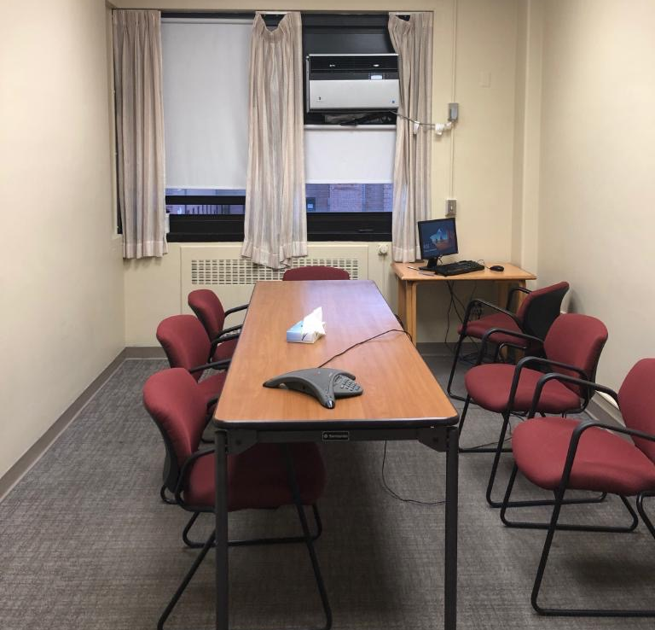
VA Bedford campus photo by Jeff Spence, used with permission
Notes:
Goal
Create a resident-focused, interprofessional rotation in the VA Geriatric Evaluation and Management (GEM)/subacute rehabilitation and long-term and clinical learning environments (CLEs) by
Influencing the dynamic interplay between patient, faculty, and learner within the CLE (Wong, Holmboe 2016)
Providing an array of resources and activities to help residents achieve the learning outcomes
Implementation
Approximately 240 PGY2-3 family medicine and internal medicine residents from four Boston-area programs, and 33 PGY4 subspecialty geriatrics trainees from two programs.
Rotations were 2-4 weeks in length.
Reference:
Wong BM, Holmboe ES. Transforming the academic faculty perspective in graduate medical education to better align educational and clinical outcomes. Academic Medicine 2016; 91:473–479.

Slide 6
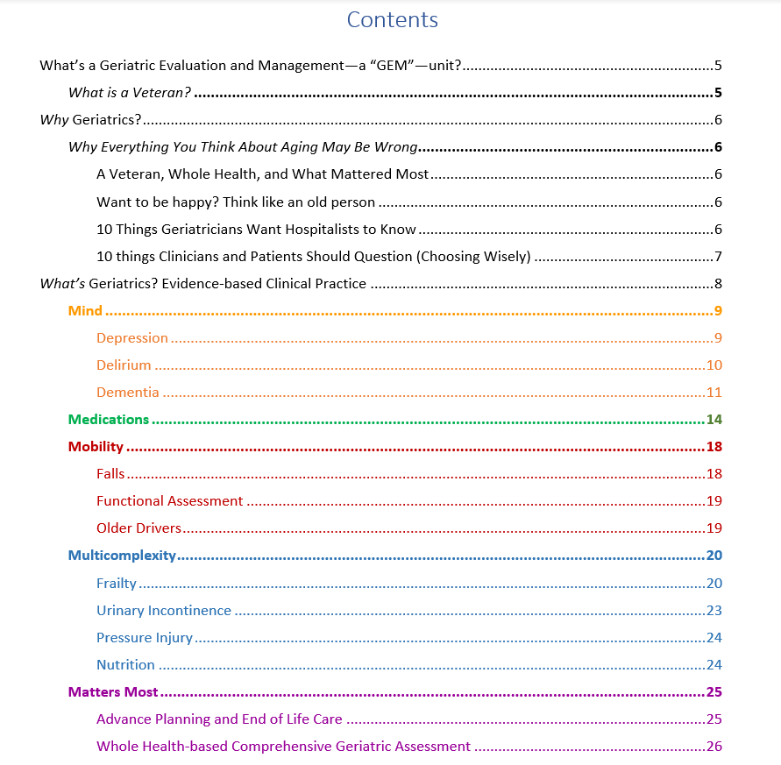
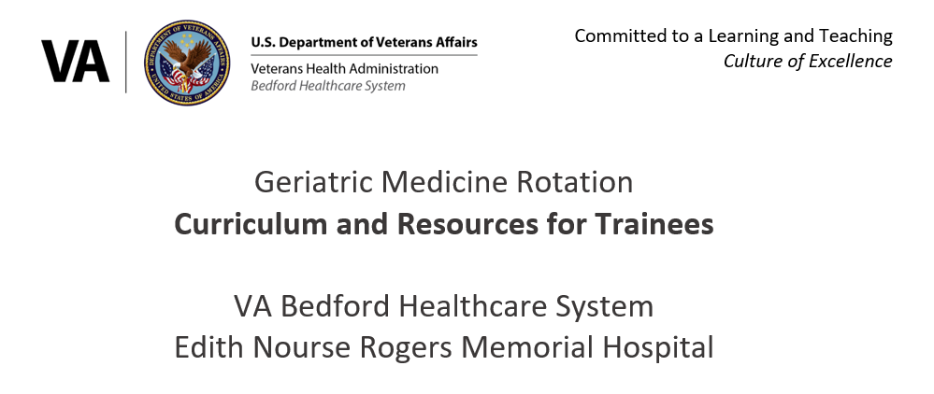
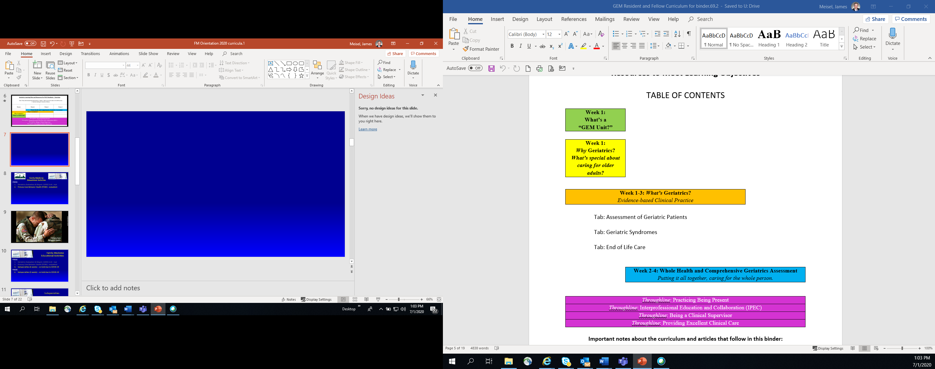
Geriatric Medicine Rotation Instructional Design: Curriculum
Notes:
Geriatric Medicine Rotation Instructional Design: Curriculum
Premise: interprofessional teaming is integral to the practice of geriatric medicine.
We used constructivist instructional design and rapid-cycle improvements to create a patient-centered, scaffolded constructivist CLE, an environment in which the patient benefits from the learner being active, constructing meaning from experience, pursuing understanding by reasoning about gaps in their knowledge, and being a sense-maker (Jonassen 1999, Reiser 2014).
Learning Outcomes
Provide Age-Friendly healthcare, focusing on the 5Ms: Mobility, Mind, Medications, Multicomplexity, and Matters Most
Integrate with and learn from, with, and about the interprofessional geriatrics care team
Practice mindful awareness abilities
References:
Bowen RS. Understanding by Design. Vanderbilt University Center for Teaching. https://cft.vanderbilt.edu/guides-sub-pages/understanding-by-design/. Published 2017, accessed 8/13/2023.
Jonassen D. Designing constructivist learning environments. In Reigeluth C, ed. Instructional Design Theories and Models: A New Paradigm of Instructional Theory, Vol. II; 1999:215-239.
Reiser BJ, Iris T. Scaffolding. In: Sawyer RK, ed. The Cambridge Handbook of the Learning Sciences. Second ed. Cambridge University Press; 2014:44-62.
Tinetti M, Huang A, Molnar F. The geriatrics 5M's: a new way of communicating what we do. J Am Geri Soc. 2017 Sep;65(9):2115.

Slide 7
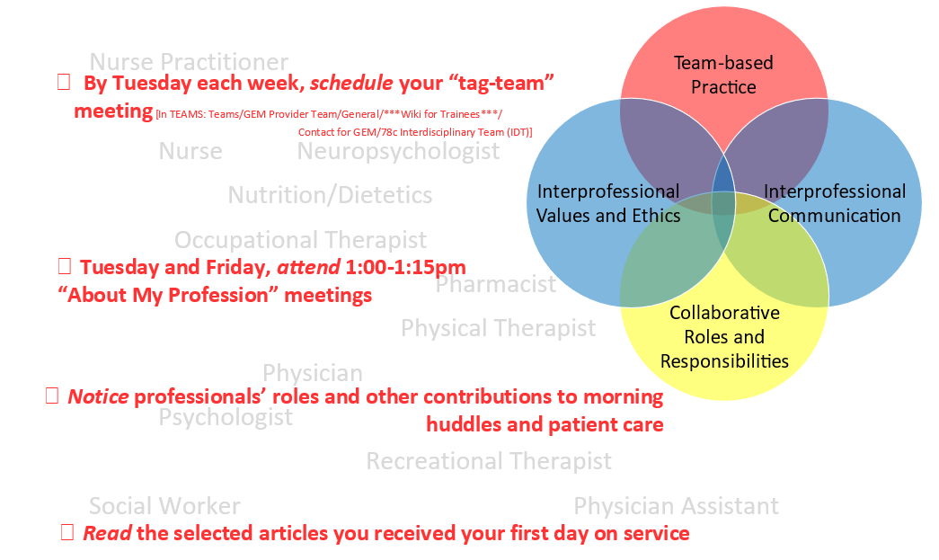
Geriatric Medicine Rotation Instructional Design: Team Integration
Notes:
Geriatric Medicine Rotation Instructional Design: Team Integration
Emphasized at resident orientation (see “Rotation Director and Facilitators’ Guide,” p.4)
Residents read articles, join interprofessional morning huddle, and participate in team meetings
Examples:
Perform comprehensive geriatric assessments (CGAs) at patients’ bedsides and by seeking interprofessional input at a weekly CGA team meeting (available in Resource D)
Attend weekly scheduled “tag-team” meetings to learn or observe patient care from the perspective of the associated health professional of their choice
Join short “about my profession” sessions led twice weekly by team members
Participate in case-based workshop, adopting the persona of other professionals (Resource E)
Many VA Bedford associated health professionals enthusiastically embraced learning from, with, and about the medical residents
Venn diagram adapted from: Interprofessional Education Collaborative. Core competencies for interprofessional collaborative practice: 2016 update. Washington, DC: Interprofessional Education Collaborative

Slide 8
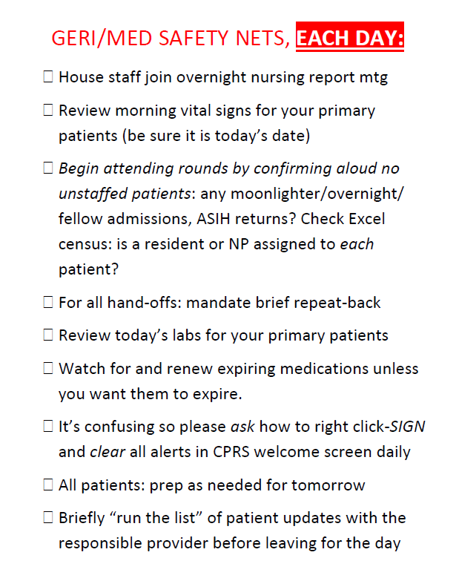
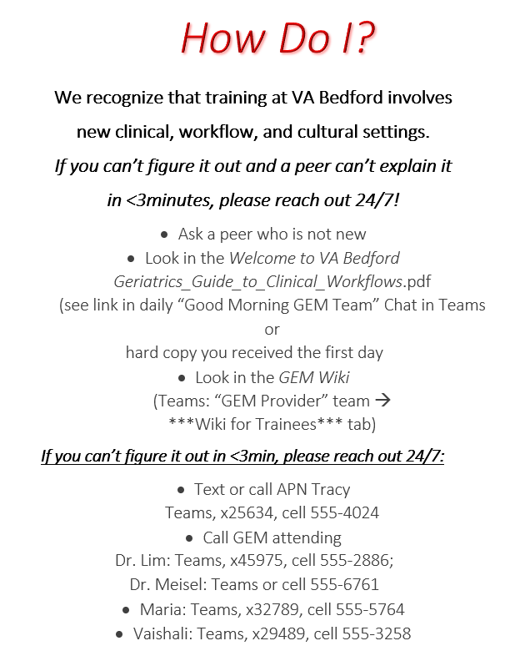
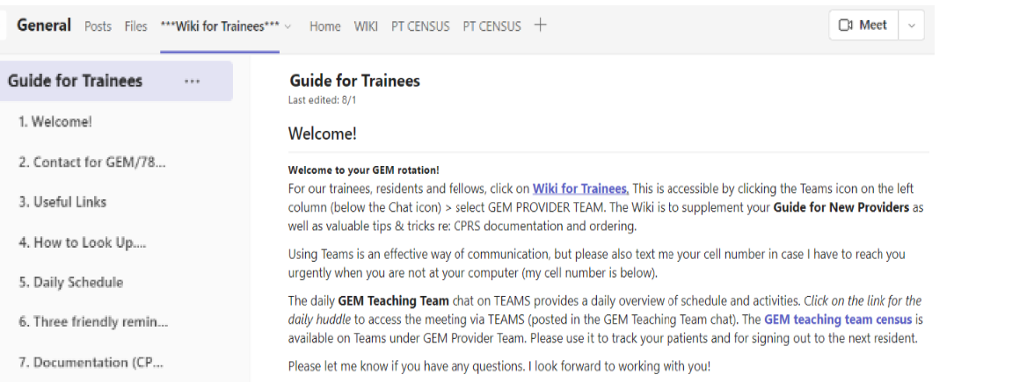
Geriatric Medicine Rotation: Optimize Cognitive Load
Notes:
Geriatric Medicine Rotation: Optimize Cognitive Load
Addressing cognitive load associated with an unfamiliar electronic health record, medical discipline, clinical workflow, and local culture was critical
Tactics included focusing on psychological safety, relationship-building, and support for clinical workflows

Slide 9
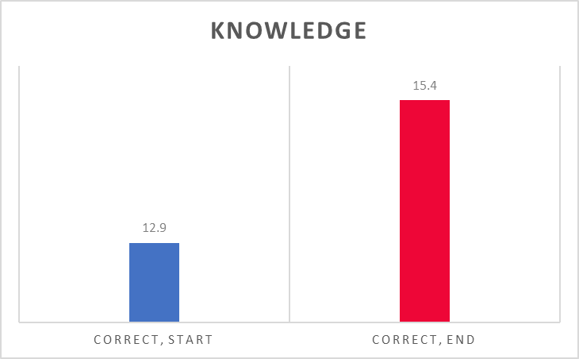
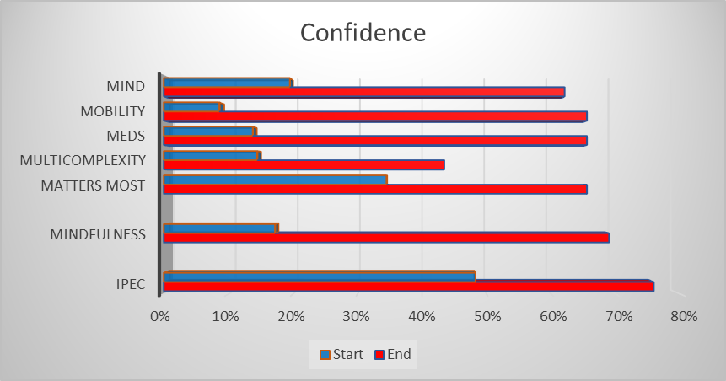
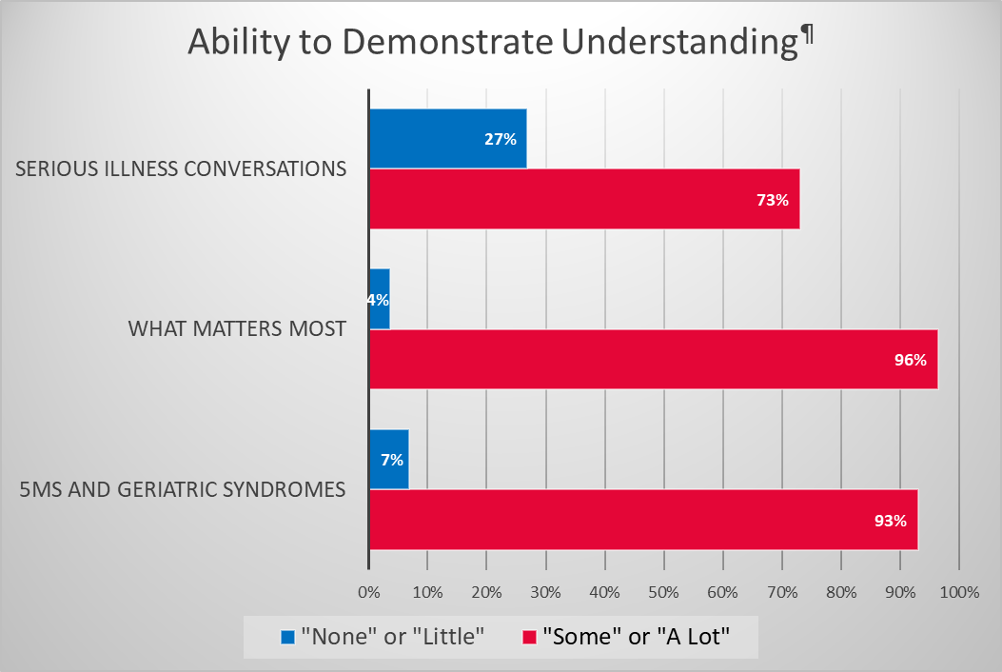
Program Evaluation
N=53 IM, FM, and subspecialty geriatrics trainees on 2-4-week rotations, 11/2021—11/2022. Smaller numbers were analyzable.
57% increase in confidence (48%→76%, a small-medium effect) in residents’ ability to collaborate and work effectively with an interprofessional team
Small sample size limited power
Notes:
Program Evaluation
Methodology
53 internal medicine, family medicine, and subspecialty geriatrics trainees
2-4-week rotations from 11/2021 to 11/2022
Approaches to assessment
Confidence: 14 Likert items, retrospective pre-/post (Wu et al 2020)
Knowledge: 23 MCQ items, pre-/post (Reuben et al 1997)
Curriculum effectiveness: 11 Likert items, post only (original)
Informal, anonymous feedback submitted with post-surveys
Results
Increased confidence in managing geriatric syndromes, interprofessional collaboration, and mindful awareness (n=29)
57% improvement in confidence (start 48%, end 76%, Cramer's V= 0.21, a small-medium effect) in residents’ ability to collaborate and work effectively with an interprofessional team that included social workers, pharmacists, rehabilitation therapists, dietitians, and other health professionals.
Improved knowledge (n=10, effect size 0.8)
Representative free-text responses (n=39)
“Most Useful” aspects of the rotation
“Learning 5Ms, frailty, and matters most and later applying it to patient interactions”
“Loved [working] with a highly engaged interdisciplinary team”
“Opportunities for Improvement” were more idiosyncratic, EMR was a frequent challenge
Limitations included small sample size that limited power. Feedback was representative, not from a formal thematic analysis
References:
Wu S, Jackson N, Larson S, Ward KT. Teaching geriatrics and transitions of care to internal medicine resident physicians. Geriatrics (Basel). 2020 Oct 8;5(4):72
Reuben DB, Lee M, Davis JW, et al. Development and validation of a geriatrics knowledge test for primary care residents. J Gen Intern Med. 1997 Jul;12(7):450-2

Slide 10
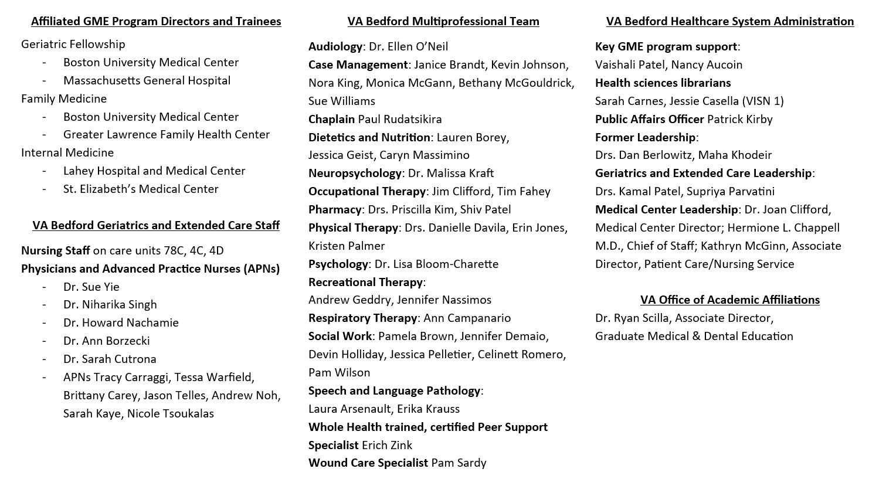



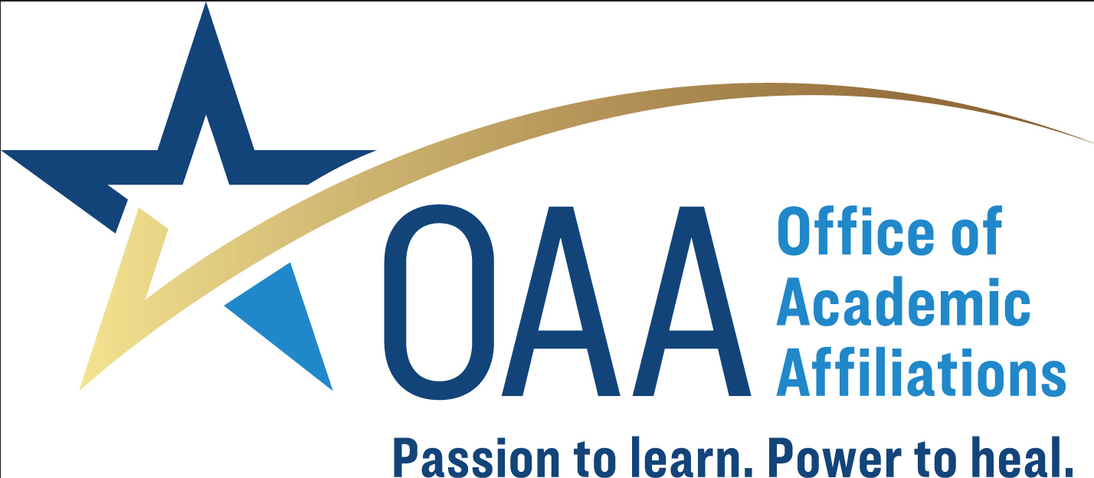
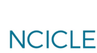
Program Support: It Took a Village 2017-2023
Notes:
Program Support
Support needed from clinical learning environment leadership
Shared vision
Open communication with health professions education program leadership
Administrative program support
Key stakeholders
Affiliated residents, fellows, and program directors
VA Bedford Geriatrics and Extended Care physician, advanced practice nurse, nursing staff and the VA Bedford multiprofessional team
VA Bedford Healthcare System Administration

Slide 11

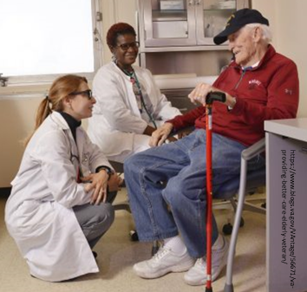
Key Takeaway
Subacute Rehabilitation and Long-term Care Settings Are Underutilized
Clinical Learning Environments for Geriatric Education and Interprofessional Teaming
Their Curiosity Has Brought Back My Curiosity
Interprofessional Teaming at VA Bedford Healthcare System
https://vimeo.com/855105520
Notes:
Key Takeaway
Subacute rehabilitation and long-term care settings present underutilized clinical learning environments for geriatric education and interprofessional teaming.
We found two factors critical to creating a successful clinical learning environment: purposeful design of the curriculum and multiple approaches to optimizing trainees’ cognitive load.

Slide 12
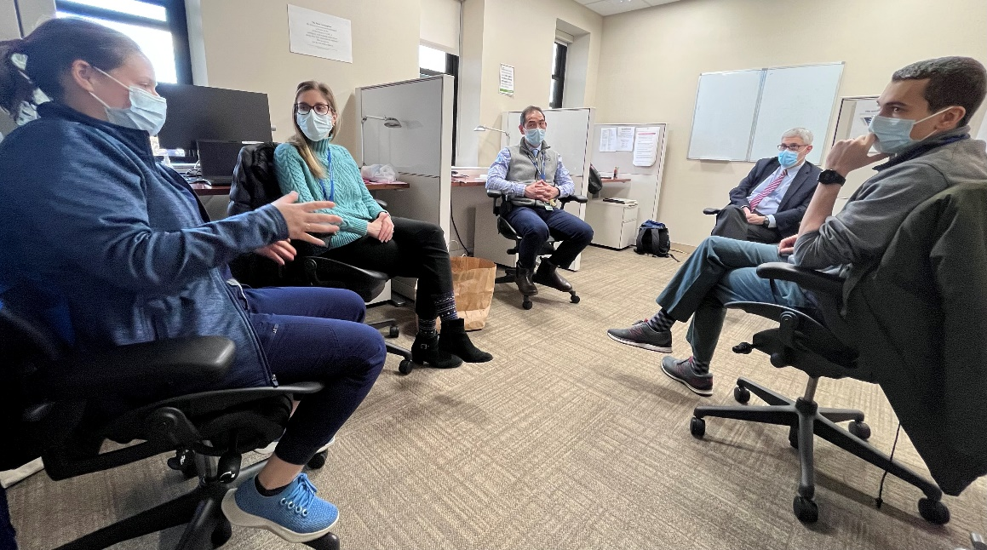
Key Takeaway
Success Factor #1:
Use Instructional Design for Geriatric Education and Interprofessional Teaming
Notes:
Key Takeaway
Success Factor #1: use purposeful instructional design to create a geriatric education and interprofessional teaming curriculum
“I loved the dedicated daily teaching…without being worried about time. I could really focus on…patients, their morbidities, and their evolving care.”
“I loved being able to work with a highly engaged interdisciplinary team.”
“Great rotation and will strongly recommend to my colleagues.”
“Learning 5Ms, frailty, and matters most and later applying it to patient[s]…”
--Representative free-text trainee responses from 11/2021 to 11/2022 program evaluation
Pictured, clockwise from left:
Boston University Family Medicine PGY2 Sidney Karnovsky,
Mass General Geriatrics Fellow Linsey Barker,
VA Bedford geriatrician-educator Lionel Lim,
VA Bedford Visiting Professor Harvard Medical School Professor Edward Marcantonio,
St. Elizabeths Internal Medicine PGY3 Mohamed Abdelazeem

Slide 13
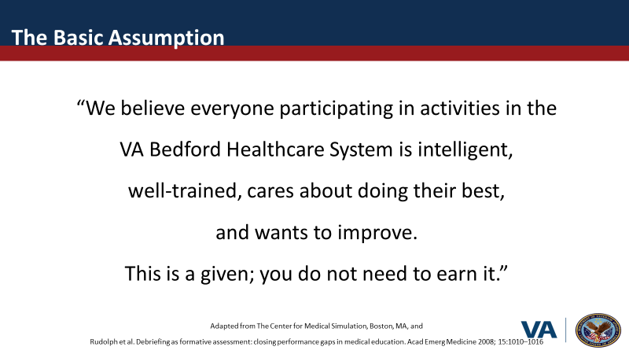
Key Takeaway
Success Factor #2: Optimize Trainees’ Cognitive Load:
Psychological Safety, Relationship Building and Support For Clinical Workflows
Notes:
Key Takeaway
Success Factor #2: use multiple approaches to optimize trainees’ cognitive load, including psychological safety, relationship building, and support for clinical workflows
This approach could benefit other types of clinical learning environments.

