Slide 1


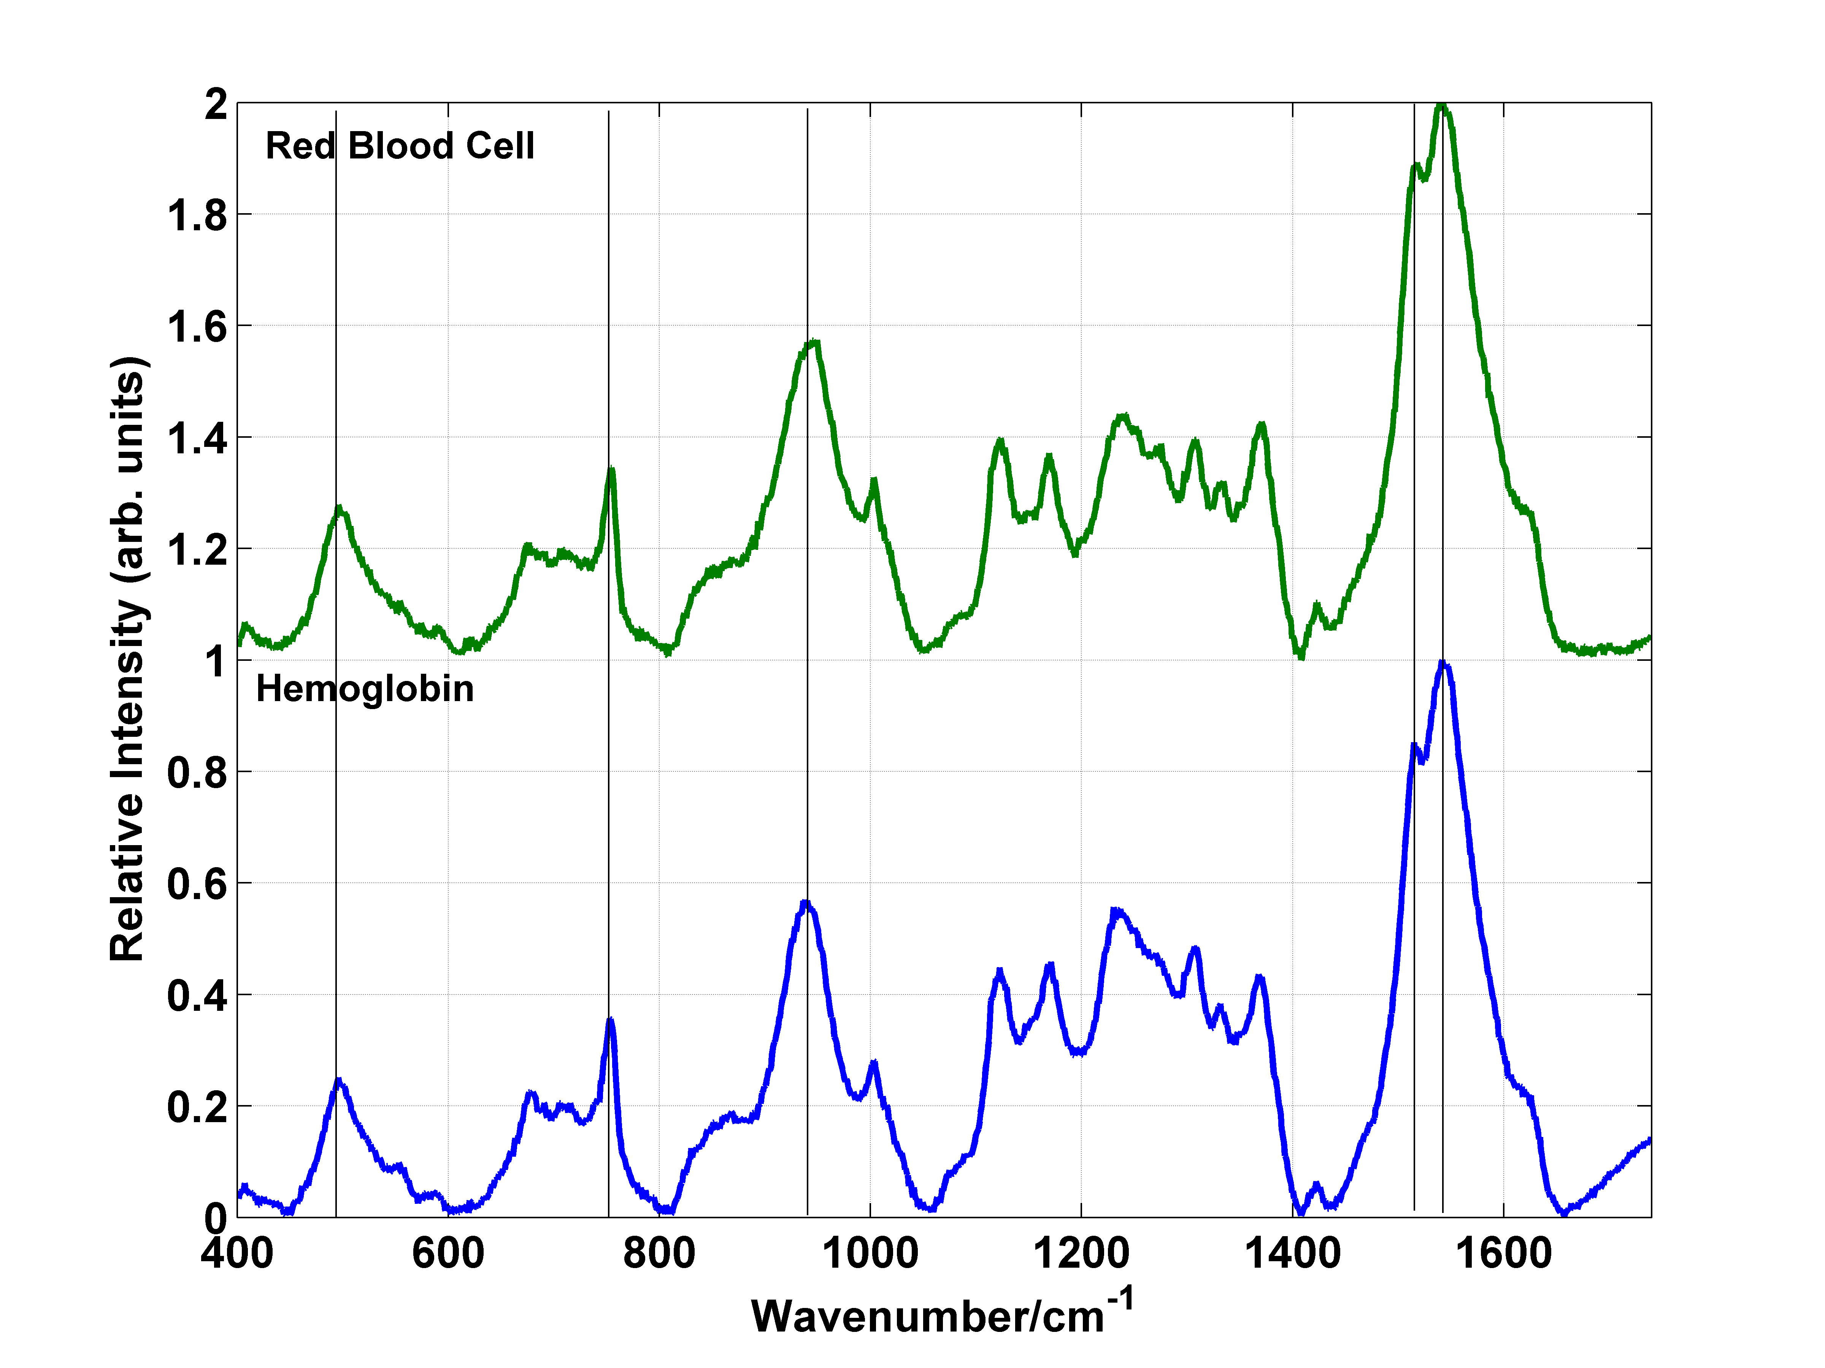
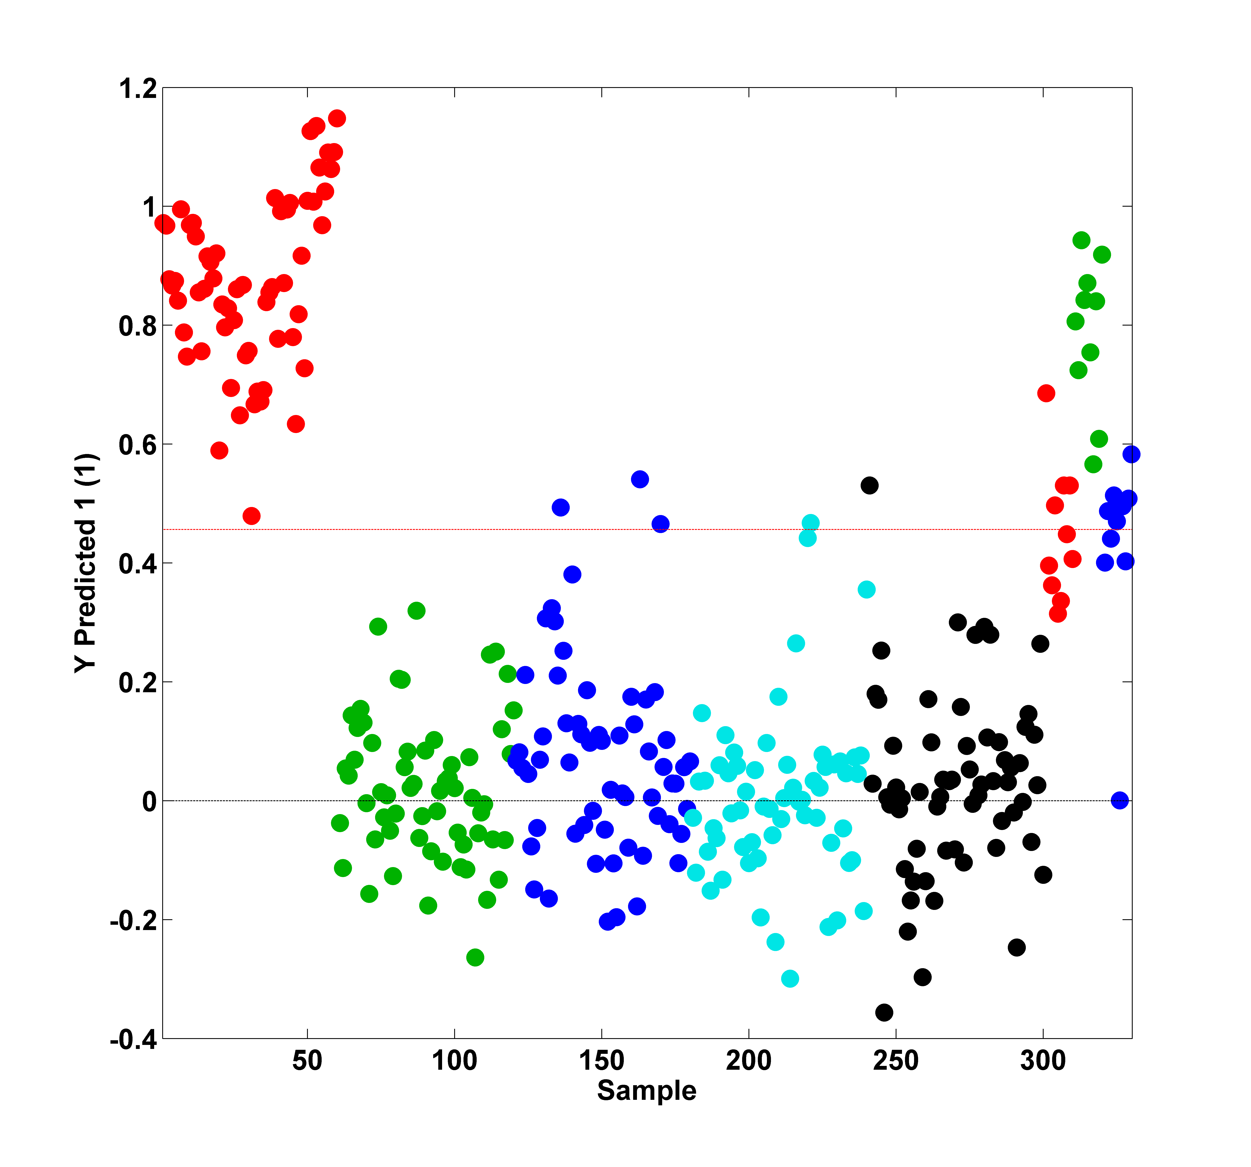
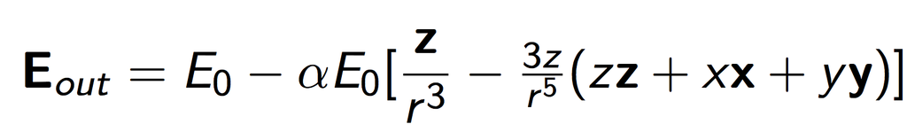
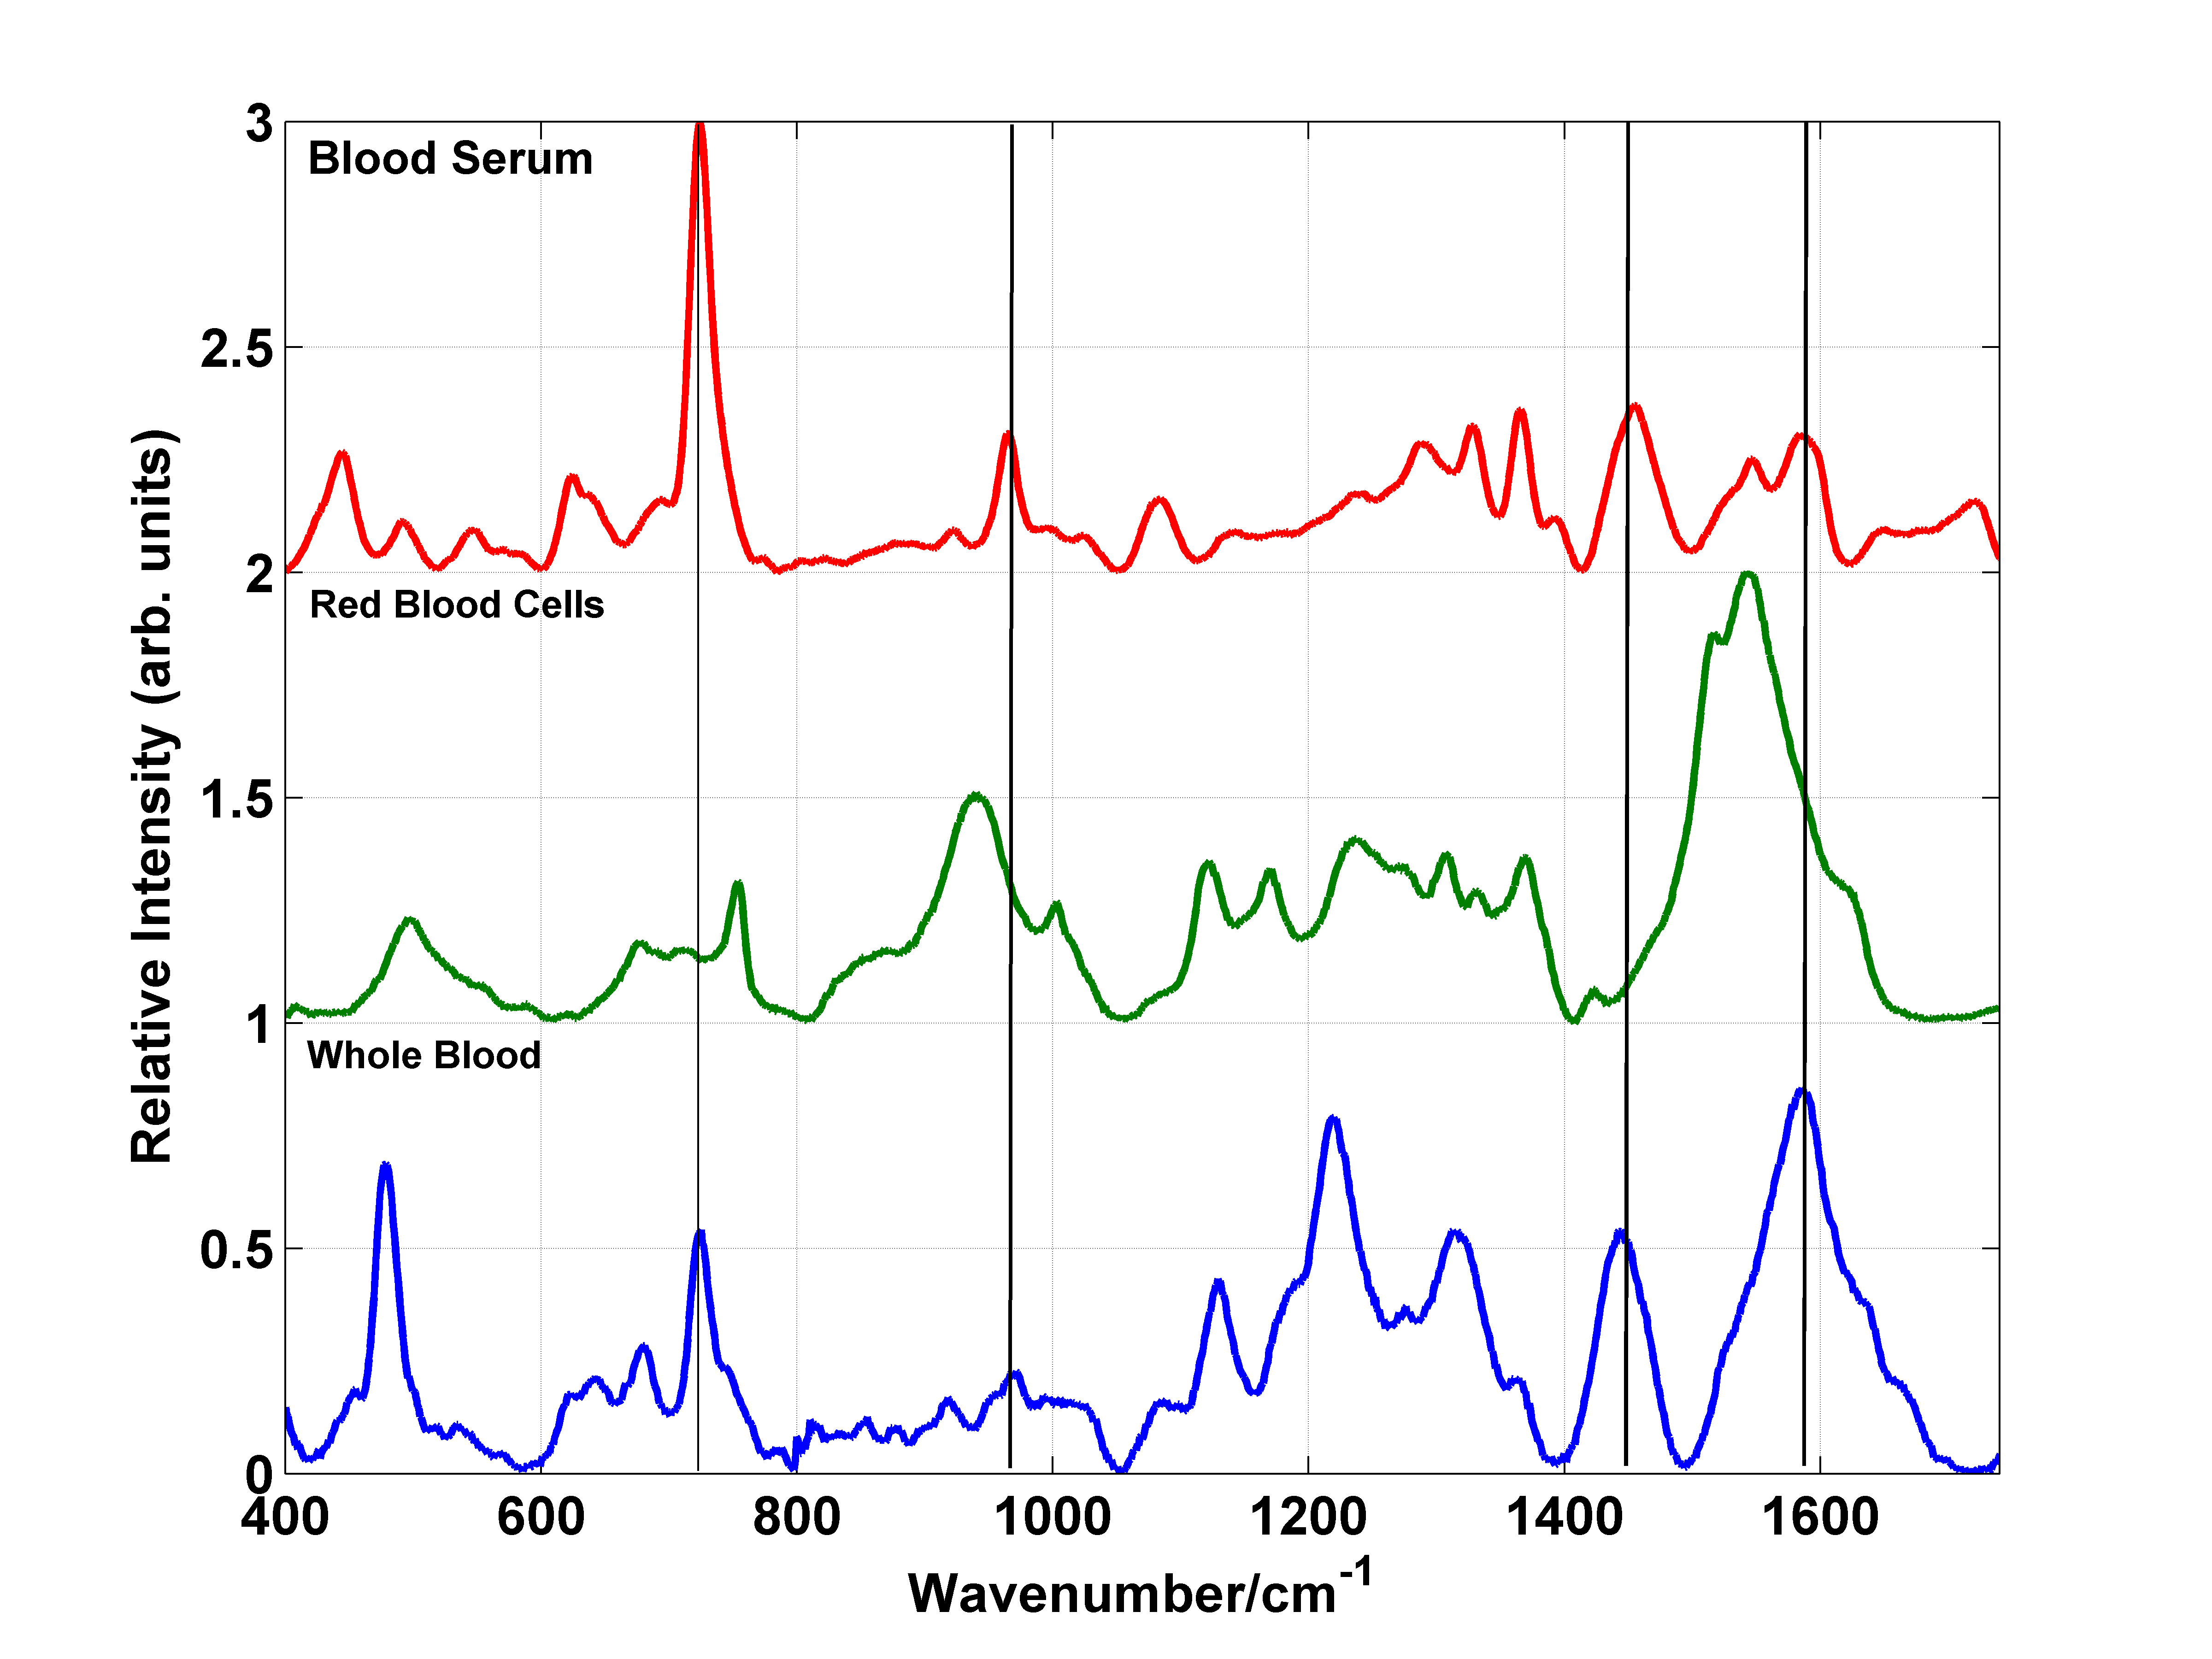
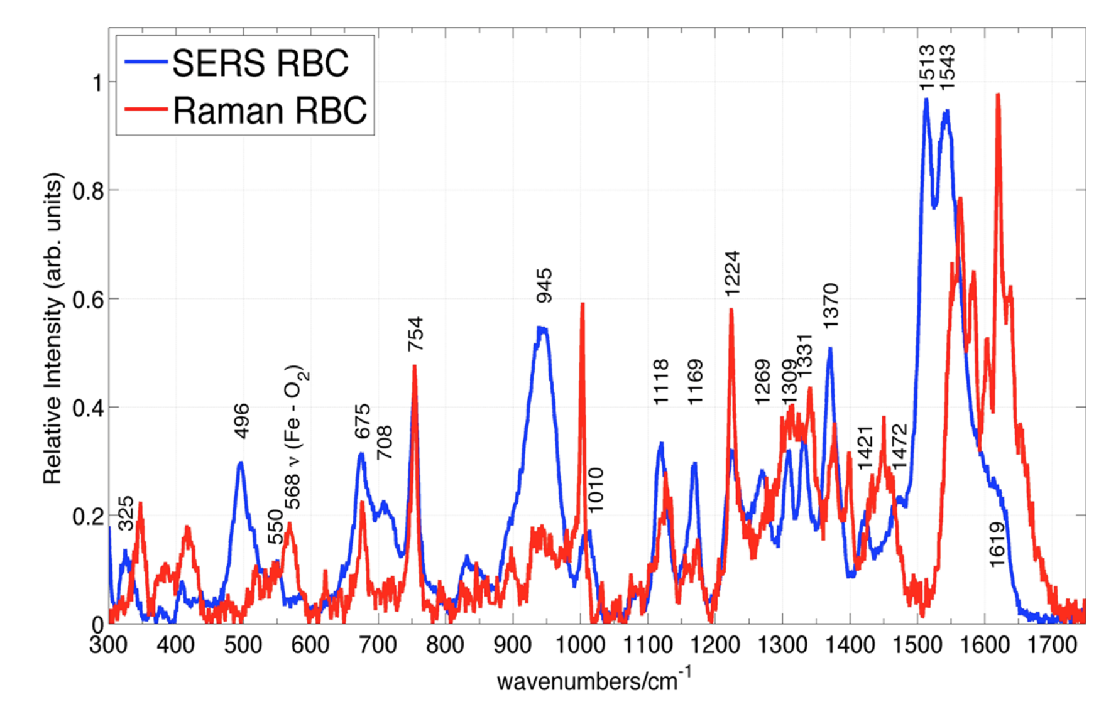
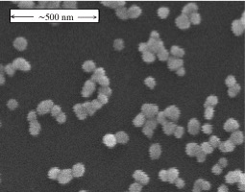
Body Fluid Analysis by Surface Enhanced Raman Spectroscopy for Medical and Forensic Applications
Zhe Mei and Lawrence D. Ziegler
Department of Chemistry, Boston University, Boston, MA
Abstract
Surface Enhanced Raman Specroscopy(SERS) of human erythrocytes on Au nanoparticle SiO2 substrates excited by 785 nm laser radiation in a Raman microscope were reported. It was determined that the signal of Red Blood Cells originates entirely from hemoglobin. Preliminary analysis of the forensics applications of SERS determined that SERS offers a single, rapid, highly sensitive analytical tool for the identification of human body fluids and species origin of blood samples. SERS detection limits for body fluid detection one or two orders of magnitude greater than current forensic techniques.
c
Blood Work
Body Fluid Analysis
A comparison between the SERS spectra of oxygenated RBCs and oxygenated hemoglobin shows the spectra to be extremely similar. This indicates that the SERS spectrum of RBCs is entirely dominated by hemoglobin and has no contributions from the cell membrane. By comparing these spectra with commercial hemin spectrum, it is also proved that hemoglobin signal is dominated by the porphyrin ring structure within the protein matrix. Hemoglobi exhibits unique vibrational fingerprints which can be used in body fluid detection
SERS siganatures of five different body fluids are all collected. PLS-DA statistical method is used to build the model for body fluid testing. All five body fluids can be seperated and identified within the model. In the model testing with blood showed in figure 5, 27 out of 30 spectra are correctly identified as blood.
Experimental Background
SERS is a surface-sensitive technique that enhances Raman scattering by molecules adsorbed on rough metal surfaces or by nanostructures such as plasmonic-magnetic silica nanotubes. The enhancement factor can be as much as 10¹⁰ to 10¹¹ , which means the technique may detect single molecule. The enhancement factor can be calculated by the following equation.
Figure 3: SERS spectra of RBC and hemoglobin. Both are averaged out of 30 SERS spectra.
Figure 5: PLS-DA model testing. Body fluid samples from left to right: blood, saliva, semen, urine and vaginal fluid.
A comparison between the SERS spectra of RBC, blood serum and whole blood. The blood serum signal is greatly dominated by hypoxanthine, a purine derivative in human metabolism. RBC provides more evidence in whole blood signal at wavenumber between 1000 to 1400 cm⁻¹. Whole blood spectrum at low wavenumber is greatly dominated by blood serum. Work has also been done for all peak assignments.
Future work
The work with red blood cells indicates the possibility of using SERS as a diagnostic method for malaria disease, as well as a quantitative measurement of the efficiency of anti-malarials. Investigation into other mixtures of different fluids, the reproducibility of spectra across donors, and the molecular origins of the uncharacterized spectra were outside the scope of preliminary analysis, and is a goal for future work.
Figure 1: Comparison of the relative per red blood cell Raman scattering cross-sections and bulk (normal) Raman at 785nm. The intensity of the normal Raman is multiplied by a factor of 20000.
Figure 2: A SEM image of the gold nanoparticle covered SERS substrate produced by an gold-ion doped sol-gel process. Au particles have size at ~80 nm.
Acknowledgement
I would like to give my thank to Dr. Lawrence Ziegler, Dr. Jen Fore, Dr. Brandon Scott, Ying Chen, Harrison Ingraham for their help in the lab, as well as Bard College for funding over the summer.
Figure 4: SERS spectra of RBC, blood serum and whole blood. All are averaged out of 30 SERS spectra.

