Slide 1


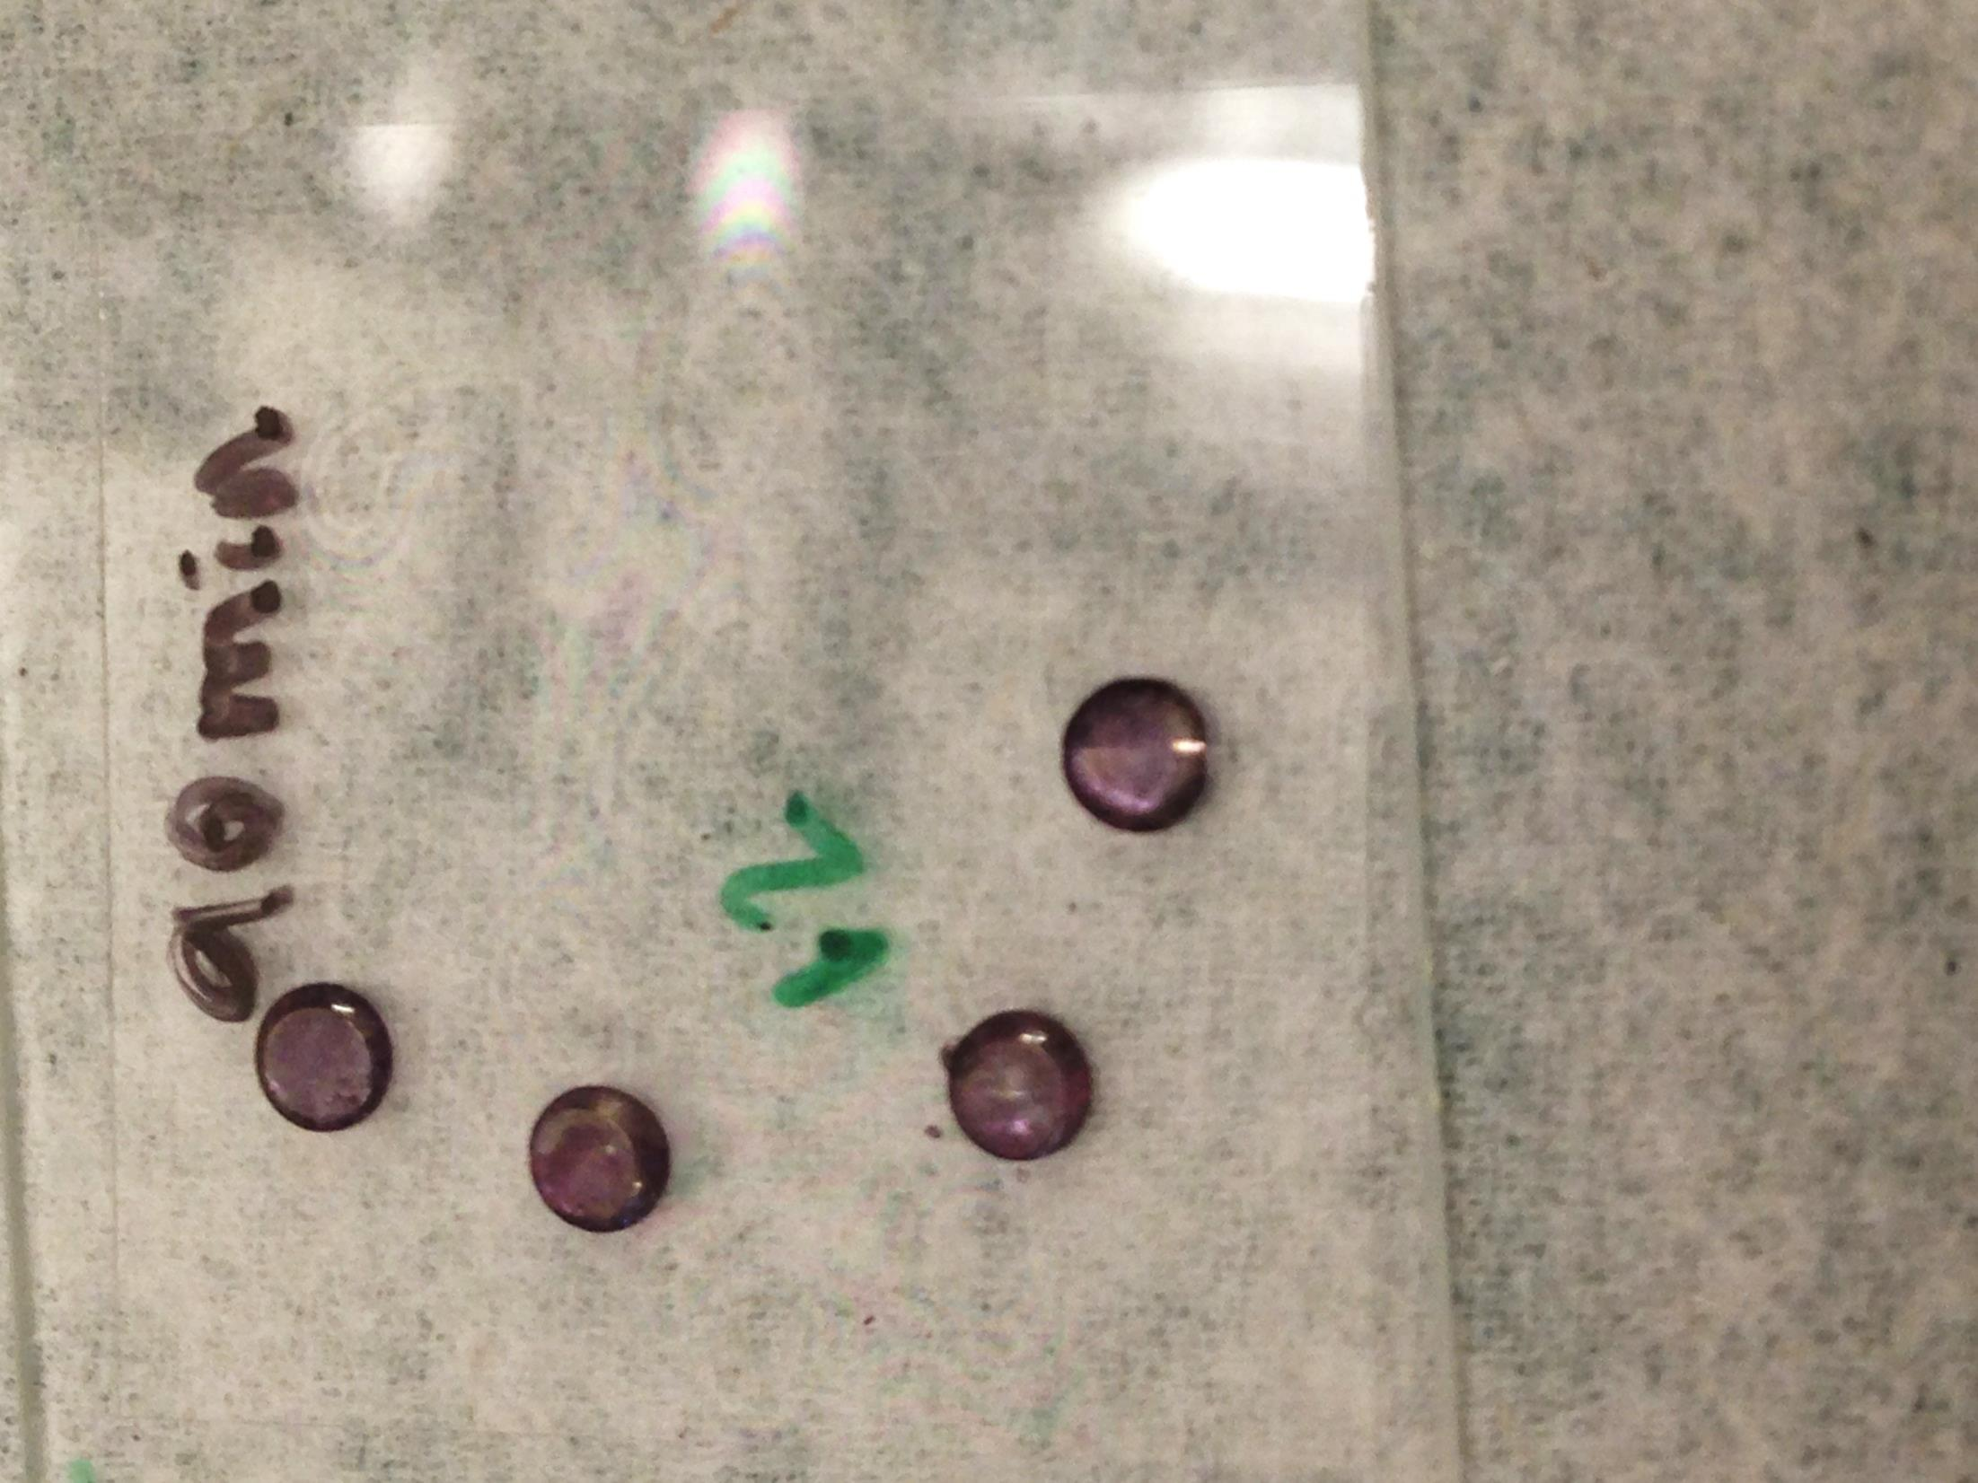
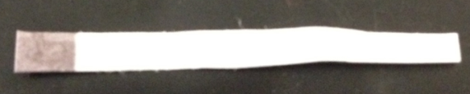
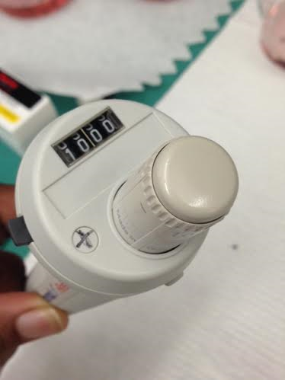
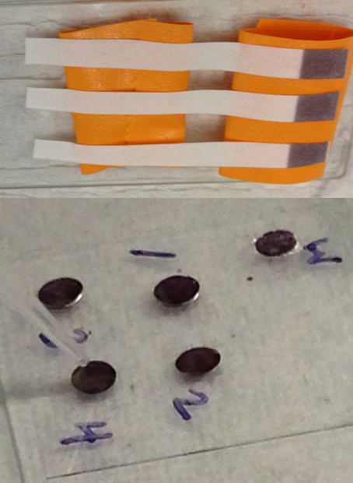
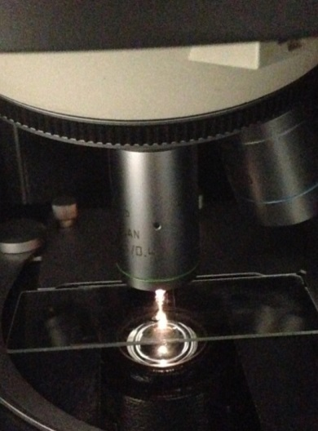
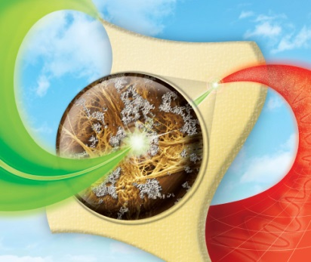

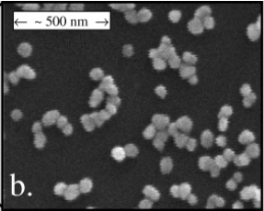

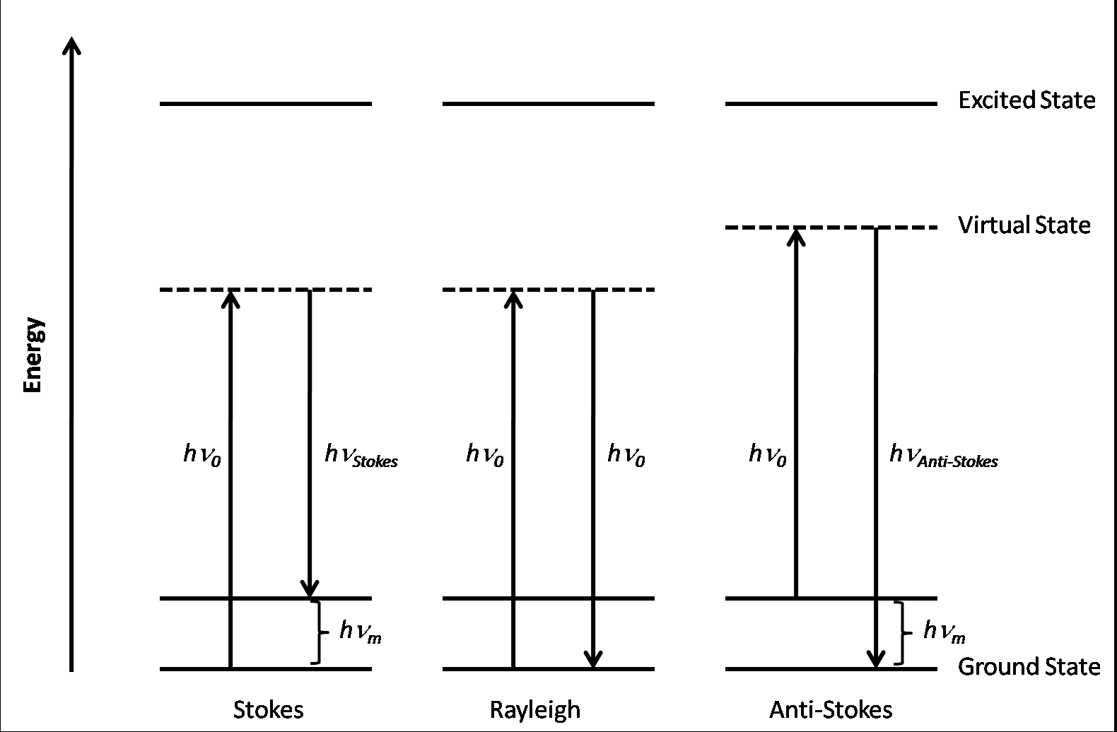
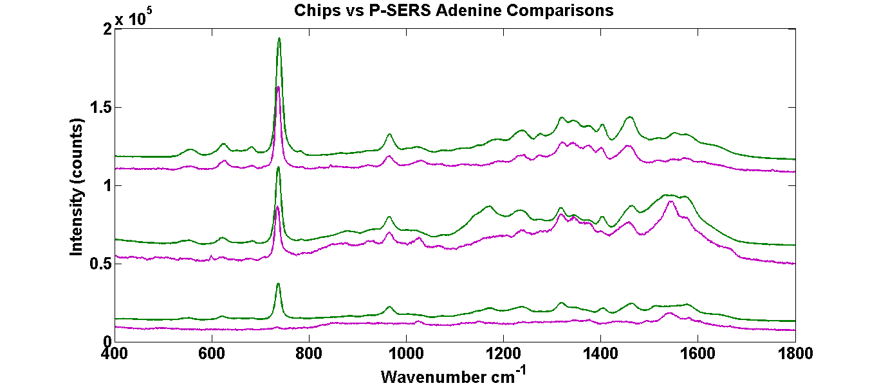
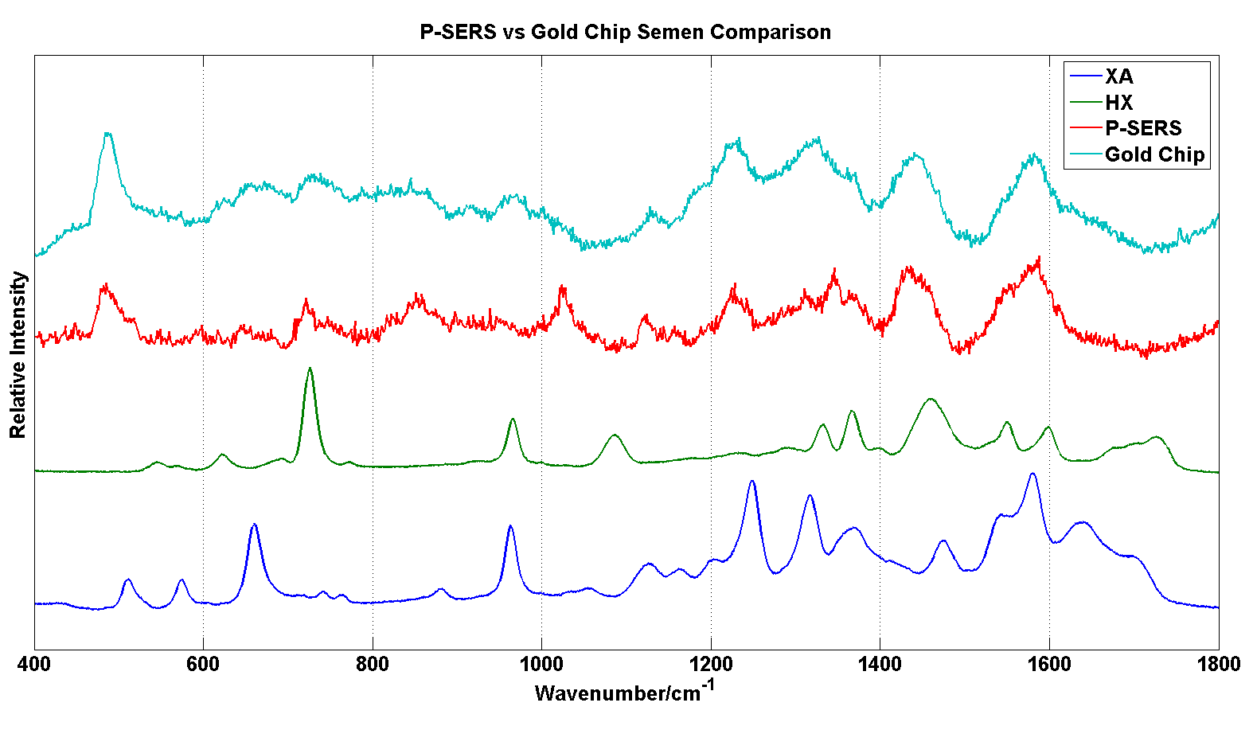
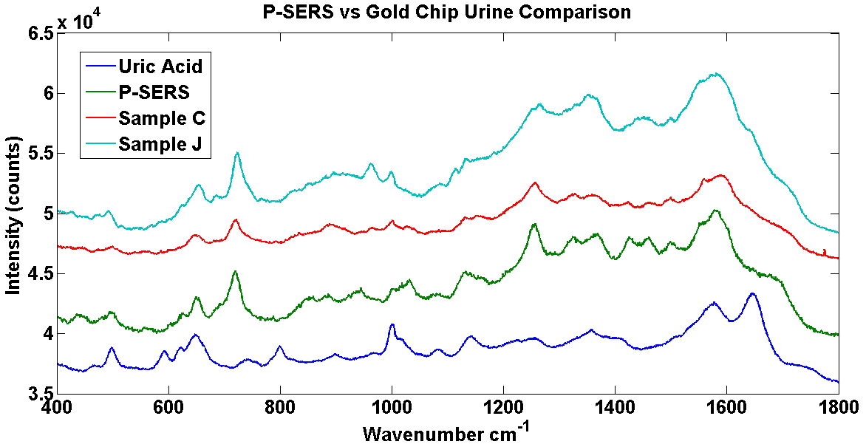
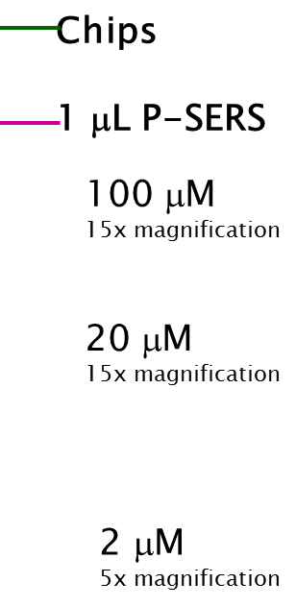
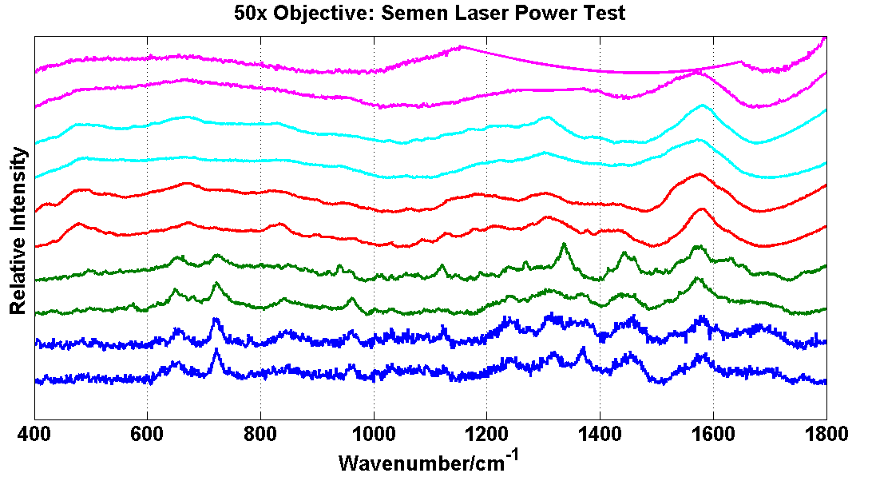
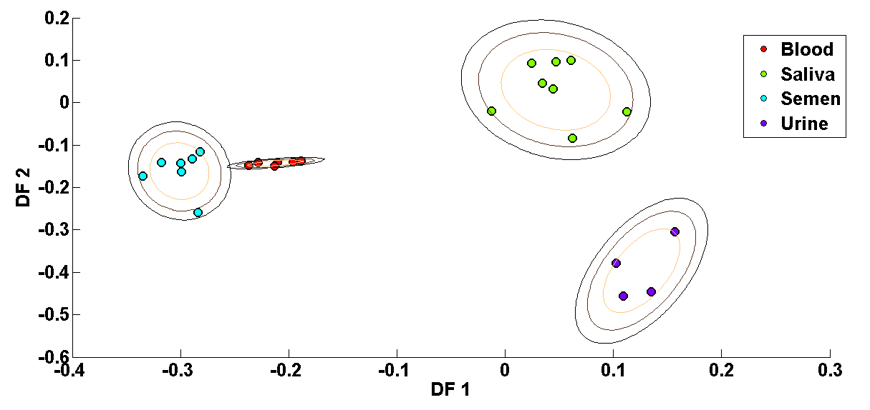
Determining the Efficiency of Surface-Enhanced Raman Spectroscopy Substrates in Body Fluid Identification
Marsella Hatfield^{1,2}, Jennifer Fore¹, Ranjith Premasiri¹, Jessica Irvine¹, Cindy Pyles¹, and Lawrence Ziegler¹
¹ Department of Chemistry, Boston University, Boston, MA
² Alcorn State University, Lorman, MS
³ Biomedical Forensic Sciences, Boston Medical School, Boston University, Boston, MA
Introduction
Experimental
A forensic scientist has many goals at a crime scene, including identifying unknown stains (possibly containing body fluids) and collecting evidence for further DNA testing. Body fluid identification is important to understand the nature of the crime and the possible perpetrators. The current methods of body fluid identification include alternate light sources, phenolphthalein, and luminol tests, which can give yield false positive results.¹ A method for overcoming these current limitations is to utilize Raman and surface-enhanced Raman spectroscopy to identify the substance.
Substrates
Renishaw Raman micro-spectrometer
BU Gold Nano Chips
P-SERS Strip
Developed in the Ziegler Research Laboratory at Boston University.
Raman spectroscopy is a molecular identification method in which molecules interact with light yielding a molecular fingerprint due to the various molecular vibrations present in a sample. A visible light source excites a molecule existing in a ground state to a virtual excited state and decays back to the ground state, Rayleigh scattering. However, if the ground state molecule interacts with light, the molecule decays to the first vibrational excited state (gains energy), Stokes scattering. A third scenario occurs when a molecule is already present in the first vibrational exited state and interacts with light to decay back to the ground state (losing energy), anti-Stokes scattering. In surface-enhanced Raman spectroscopy (SERS), noble metal nanoparticles (such as gold and silver) have surface plasmons which can increase the normal Raman signal.² The surface plasmons of the nanoparticles experience an enlarged electromagnetic field when excited by a laser of the same energy. Due to this large electromagnetic field, any molecule that is in close proximity (~20Å) to the surface of the nanoparticle experiences an enhanced Raman Signal. This technique could potentially allow forensic scientists to accurately identify those body fluids in less than 10 minutes with minimal use of sample.
Developed and purchased from Diagnostic anSERS.
Pipette sample
Place sample on substrate
1 μL for BU gold nano chips
1-10 μL for P-SERS strips
Raman Spectrometer
(Renishaw)
785 nm excitation
0.6 – 20.1 mW laser power
10 sec acquisition
200-1800 cm⁻¹
10 spectra acquired
Sodium borohydride reduced AuNPs were seeded onto a sol-gel chip
A glycerol and ethanol based ink was created using gold nanoparticles and then printed onto chromatography paper.
Pros of Gold Nano-Chips
- Mass Production
- Small Surface Area
- Cheap
Cons of Gold Nano-Chip
- Small
- Easily Contaminated
Pros of P-SERS Strip
- Easy to Transport
- Flexible Sample Application
Cons of P-SERS Strip
- Absorption of Sample
- Must be Purchased
  - Labor/cost intensive
Methods
The samples were placed on the SERS substrate through pipetting in which the P-SERS substrates required a maximum of 10 μL in order to obtain a better signal-to-noise ratio that the BU gold nano chips (1 μL). The semen sample would remain frozen until ready for use whereas all other body fluids were collected fresh. All spectra were obtained within 24 hours of application to the substrate. The power measurements were obtained on P-SERS strips of previously dried body fluid samples.
The goals of this research was to determine the reproducibility, effects due to sample volume, and best SERS substrate between P-SERS strips (Diagnostic anSERS) and gold nano chips (BU gold nano chips) to accurately detect body fluids. Adenine was used as a calibration sample to test the substrate efficiency prior to proceeding with body fluid samples.
Results and Discussion
Conclusions
733
The BU gold nano chips exhibit a larger signal compared to P-SERS strips with 1 μL sample volumes. When 10 μL of the sample was placed on the P-SERS strips, a larger signal was observed, but still did not achieve the enhancements seen using the BU gold nano chips.
The P-SERS strips yielded consistently reproducible signals and the DFA was able to easily separate the four body fluids studied. The P-SERS strips with body fluids applied were able to withstand laser powers up to 2.1 mW reliably.
Future research will include building a body fluid donor database, further identifying all components within the body fluids, and exploring the capabilities of other SERS substrates to identify body fluids reliably.
Aromatic ring
Aromatic ring
C-N
1459
956
As the concentration of Adenine increases, the signal increases and the BU gold nano chips inherently have a larger signal compared to the P-SERS strips (as noted by the magnifications.
Hypoxanthine (HX) and xanthine (XA) are compared to semen samples to identify two possible components within semen.
Uric acid is present in most urine and is displayed along with urine samples to identify the main component observed in the SERS spectra.
Laser Power
0.6 mW
2.1 mW
5.3 mW
9.0 mW
20.1 mW
Principle component analysis (PCA) identifies the variance between data classes and discriminant functional analysis (DFA) will then maximize these differences in order to separate various classes of data. The benefit of this analysis is the use of the entire spectra in a barcode format. Barcodes of spectra are created through smoothing and calculating the second derivative of the data where any peak is identified as a positive value.
References:
[1]Serology. “Blood and Other Body Fluids”. Indigent Defense Services. 2013.
http://www.ncids.com/forensic/serology/serology.shtml
[2] http://hyperphysics.phy-astr.gsu.edu/hbase/elacol.html
[3] J. Fore. Vibrational Micro-spectroscopy: From Human Cells to Fuel Cells. 2013. Northeastern University.
E. Brachtel and Y. Yagi, Journal of Biophotonics (2012)
Acknowledgements:
Different laser powers were tested on all body fluids to determine the optimal laser power (2.1 mW) that could be used to obtain reliable SERS spectra when using the P-SERS substrates.
DFA was utilized to separate the SERS data acquired from the P-SERS substrates with body fluids. DFA was able to successfully separate all body fluids which can eventually be used to identify unknown body fluids.
The Boston University Research Experience for Undergraduates program funded by the National Science Foundation is acknowledged for funding this project.

