Slide 1



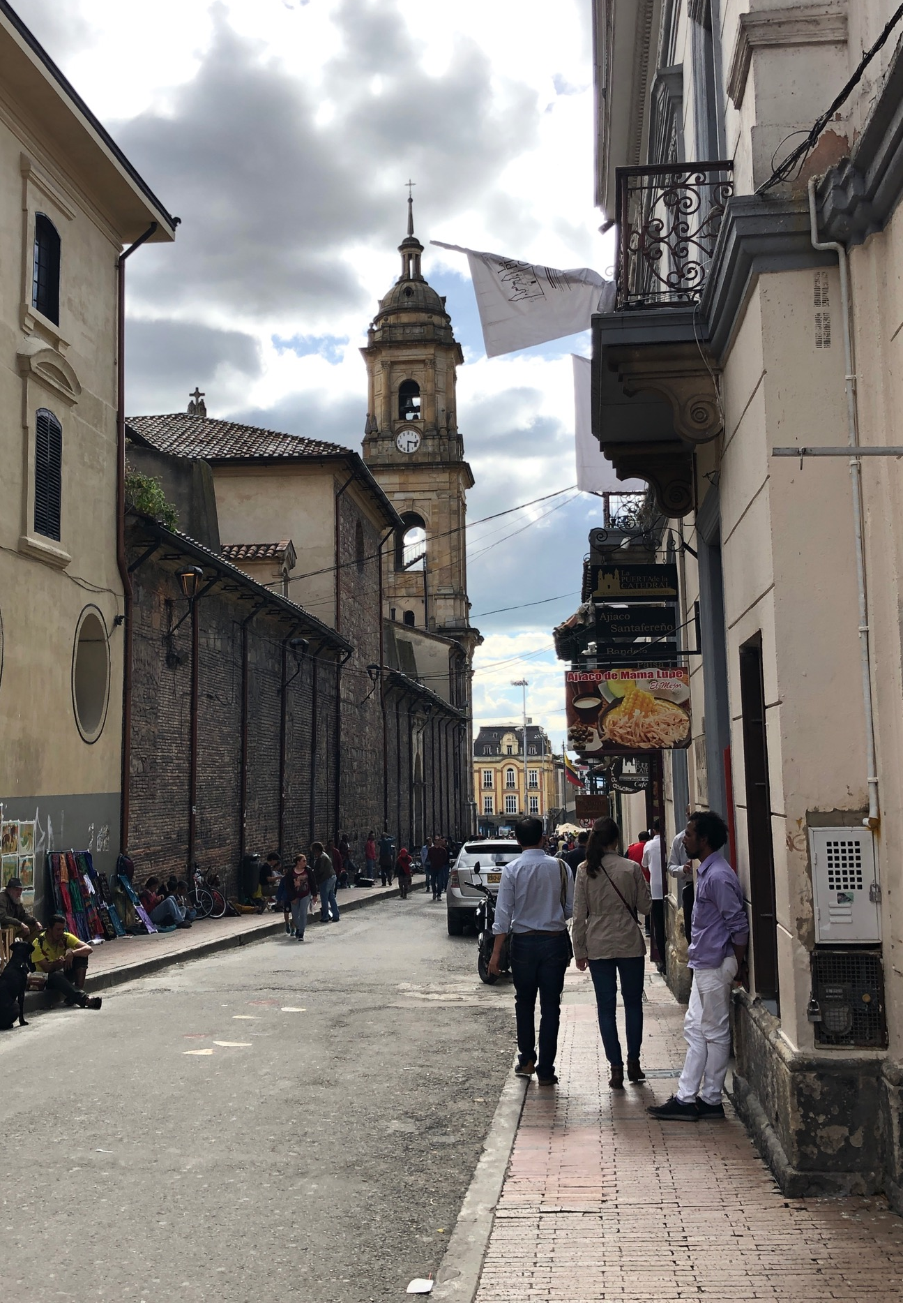
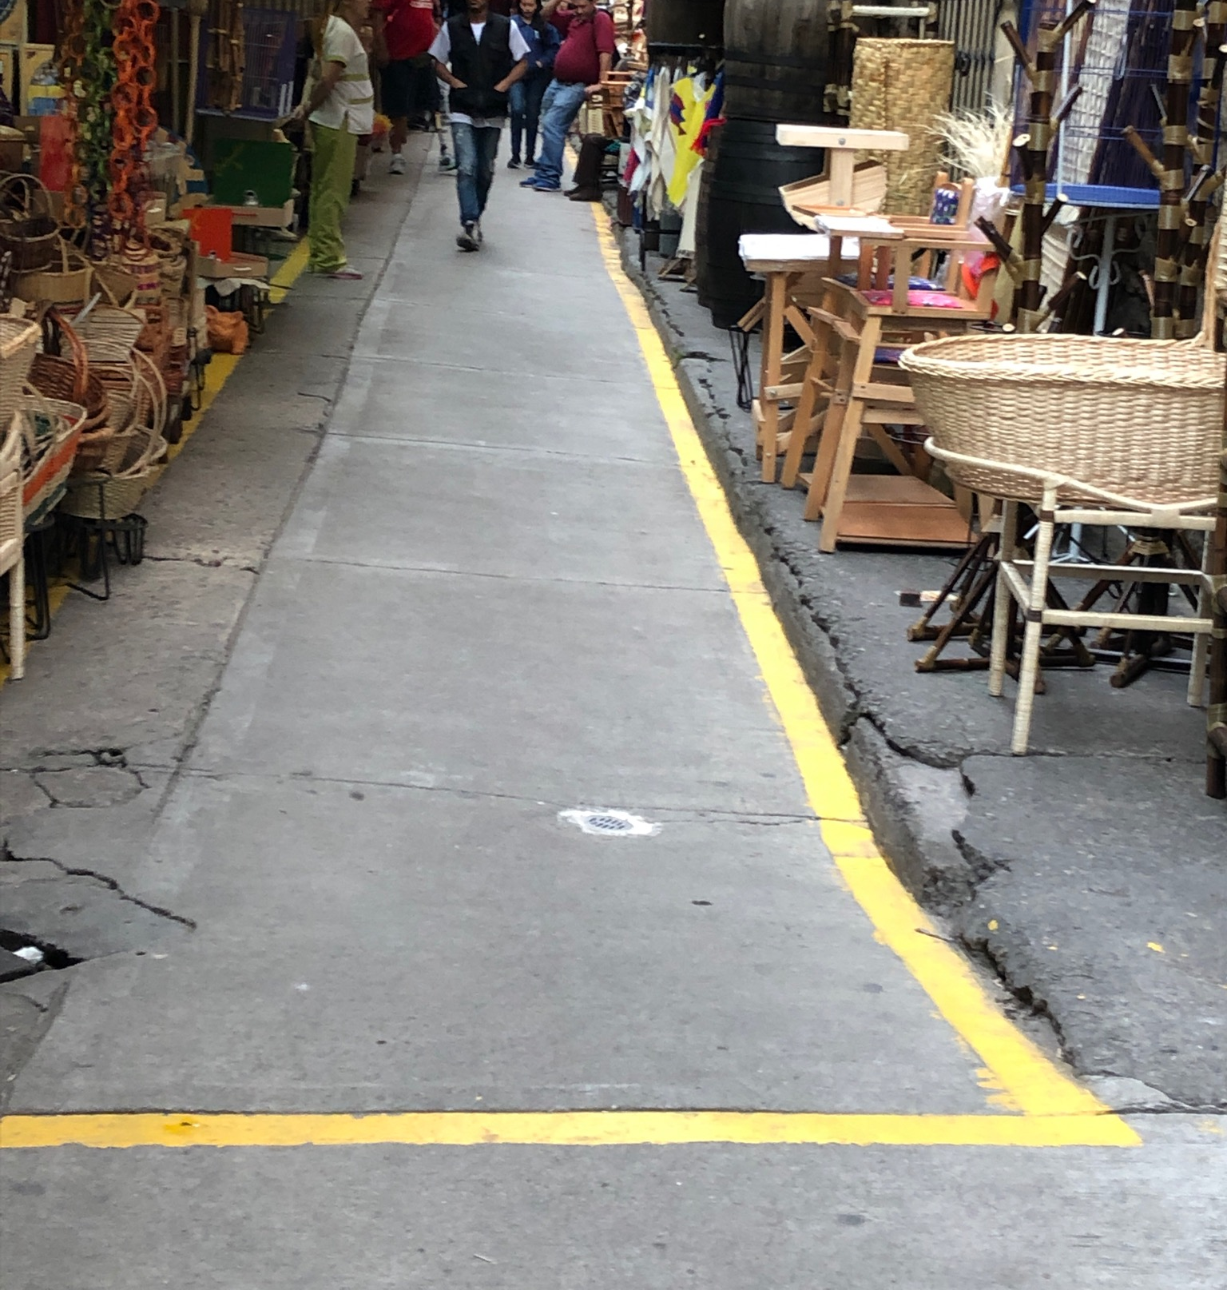
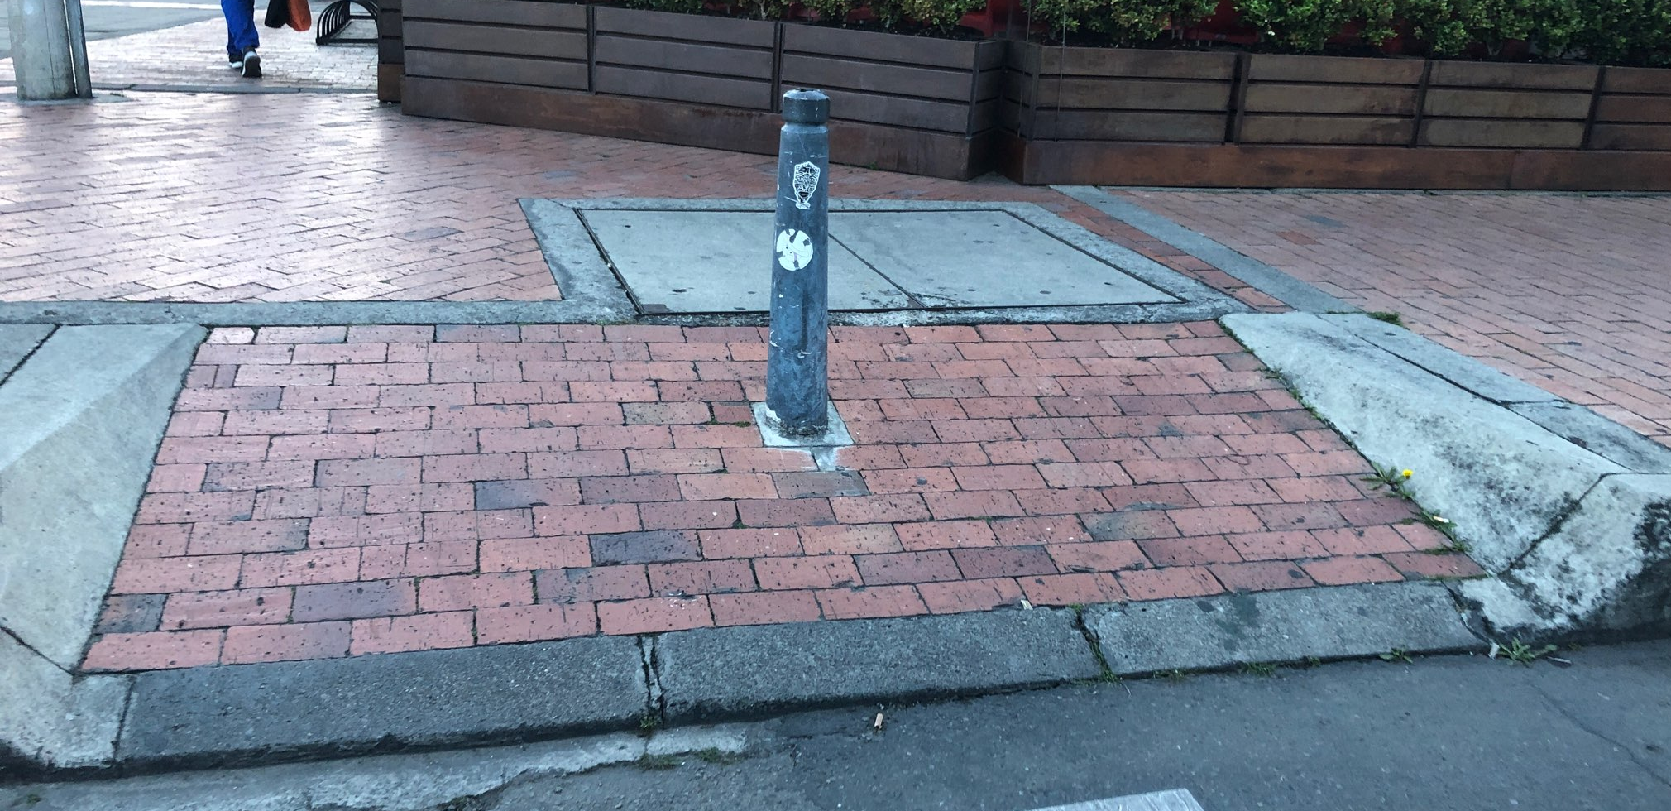
An Interprofessional Experience: Home & Community Participation in Bogotá, Colombia
Lucy Tamberrino¹, Kimberly Greenberg¹, Karen Jacobs¹, Rebecca Pierce Khurshid¹,
Marcela Múnera², Carlos Cifuentes², & Andrea Garzón³
¹Boston University, ²Escuela Colombiana De Ingeneria Julio Garavito, ³Mobility
ABSTRACT
PARTICIPANTS
DISCUSSION
Background: To create and assess the effectiveness of Assistive Technology (AT) devices for mobility, information must be known about the user (client factors and AT preferences), contexts (physical, social, cultural, and institutional), and activity.
Objectives: To examine the environmental, social, and client factors that influence participation in home and community environments for adults with ambulatory impairments in Bogotá, Colombia; and to assess the benefits and limitations of the current forms of AT for individuals that use AT for mobility (i.e. canes, walkers, and wheelchairs).
Methods: Two questionnaires were completed by 30 individuals with ambulatory impairments (mean age = 44.3 years). Participants were recruited from an outpatient rehabilitation facility in Bogotá, Colombia.
Results: The data suggests that the main environmental barriers that individuals with ambulatory impairments experience in the home/community are: stairs, lack of elevators/chairlifts, uneven sidewalks/pathways, lack of curb cuts, and a shortage of accessible public transportation. Additionally, individuals with ambulatory impairments express that they experience some stigma in the community, but overall, find that people in their home/community are willing to help them. Preferences for specific AT components are dependent on the type of AT device and user.
Conclusions: When developing or evaluating AT devices in Bogotá, Colombia, occupational therapy practitioners and engineers should take into account the client factors and the physical and social contexts surrounding the AT device user.
Table 1. Participant Demographics (n = 30)
Characteristic | Participants n (%) or M (SD; range)
Age (years) | 43.9 (16.2; 21-85)
Gender
Male | 23 (76.7)
Female | 7 (23.3)
Diagnosis
Stroke/CVA | 10 (33.3)
Spinal Cord Injury (SCI) | 11 (36.7)
Fracture | 3 (9.9)
Multiple Sclerosis | 2 (6.7)
Guillain Barre Syndrome | 2 (6.7)
Other | 2 (6.7)
Assistive Device Used
Manual Wheelchair | 14 (46.7)
Cane or crutches | 9 (30)
Walker | 1(3.3)
Manual Wheelchair & Walker | 1 (3.3)
None | 5 (16.7)
Housing
Apartment | 22 (73.3)
House | 2 (6.7)
House (renting a room) | 4 (13.3)
Other | 2 (6.7)
HACE
The data indicates that the participants are experiencing many environmental barriers in the home. Over 85% of participants indicated that they must travel up/down stairs to get to their home. These individuals have very little environmental adaptations to support them if they are unable to use the stairs with their AT device; 33% do not have a ramp at the main entrance of their home and ~ 97% do not have an elevator or chairlift. This data suggests that AT devices for mobility should be designed to support individuals as they travel up/down stairs in the home. The data also suggests that participants experience many environmental barriers in the community. While there may be some accessible and safe parks/walking areas, public places to sit and rest, public transportation, and handicap parking in the community, the majority of participants (80.8%) shared that there are not enough of these things to support full participation in community mobility. The majority of participants (97.6%) shared that there is a substantial shortage of curb cuts and accessible public transportation. This data suggests that AT devices for mobility should be designed to support individuals as they travel on uneven sidewalks/pathways without curb cuts and as they travel using public transportation. In terms of the social/cultural context, this data suggests that participants have an overall positive perception of how their family and community members treat them as they navigate their environment with ambulatory challenges. However, participant data appeared to lean less positively in regards to the question assessing community stigma (30% partially-to-strongly agreed that people in their community have negative perceptions about people with disabilities). Consequently, AT devices for mobility should be designed in a way that supports, and does not detract from, the individual’s ability to take part in social interactions.
QUEST
The data depicted in Table 3 suggests that participants have varying satisfaction levels among the eight AT dimensions assessed. However, after further analysis, it appeared that satisfaction levels are substantially dependent on the type of AT device the participant uses. When comparing the main AT devices that participants used, 24 out of 26 used only a manual wheelchair (n=14) or only a cane/crutches (n=9). The data suggests that users of manual wheelchair are substantially less likely to be satisfied with AT dimensions, weight, durability, adjustability, and comfort than users of canes/crutches. Two possible reasons for this is that it may be easier to navigate the environment and interact with people using a cane/crutches, when compared to using a manual wheelchair. The ability to participate in the environment with AT devices may impact one’s level of satisfaction.
INTRODUCTION
The interprofessional collaboration between occupational therapy practitioners and engineers has the potential to bring complementary perspectives together to create AT devices that make significant impacts at the global societal level¹. AT is most successful when its design and implementation matches the user, activity, and context; this idea is best depicted by the Human Activity Assistive Technology (HAAT) model².This poster describes the process by which a Boston University professor in occupational therapy and a Boston University professor in engineering worked collaboratively with two entry-level occupational therapy graduate students to assist in the assessment of AT devices in Bogotá, Colombia. Through a one-month interprofessional service learning experience in Colombia, the occupational therapy graduate students provided consultation to the Robotics Lab located at the Colombian School of Engineering Julio Garavito, and collaborated with engineering students on their robotic walker project³. This robotic walker project is in collaboration with Professor Khurshid’s Boston University Robotic Lab. The occupational therapy students also conducted a research project to identify the factors in the physical, social, and cultural contexts that influence participation in home and community environments for adults with ambulatory challenges in Bogotá, Colombia. For some participants, the benefits and limitations of their current forms of AT for mobility were also assessed.
Figure 1 Sidewalk at Calle 11 #6-50, Bogotá, Colombia
RESULTS
LIMITATIONS
Table 2. Descriptive Statistics of the Environment (n = 30)
Social Context | Strongly Agree n (%) | Agree n (%) | Partially Agree n (%) | Disagree n (%) | Strongly Disagree n (%)
People at home have negative attitudes about people with disabilities | -- | -- | 1 (3.3) | 6 (20) | 23 (77)
People at home are willing to help people with disabilities | 25 (83) | 5 (17) | -- | -- | --
People in community have negative attitudes about people with disabilities | 1 (3.3) | 1 (3.3) | 7 (23) | 9 (30) | 12 (40)
People in community are willing to help people with disabilities | 9 (30) | 15 (50) | 5 (17) | -- | 1 (3.3)
Home: Physical | Yes n (%) | No n (%) | No Data n (%)
Steps to/in House | 26 (85.8) | 4 (13.2) | --
Ramp to Main Entrance | 19 (63.3) | 10 (33.3) | 1 (3.3)
Elevator/Chairlift | 1 (3.3) | 29 (96.7) | --
Use Other AT Device (i.e. toilet grab bars, commode, reachers) | 25 (82.5) | 5 (16.5) | --
Community: Physical | A lot n (%) | Some n (%) | Not at All n (%)
Uneven Sidewalks/Pathways | 15 (50) | 15 (50) | --
Accessible Parks/Walking Areas | 10 (33.3) | 15 (50) | 5 (16.7)
Safe Parks/Walking Areas | 8 (26.7) | 17 (56.7) | 5 (16.7)
Public Places to Sit and Rest | 7 (23.3) | 18 (60) | 4 (13.3)
Curb cuts | -- | 19 (63.3) | 10 (33.3)
Public Transportation | 18 (60) | 10 (33.3) | 2 (6.7)
Accessible Public Transportation | -- | 10 (33.3) | 14 (46.7)
Handicap Parking | 3 (10) | 10 (33.3) | 15 (50)
The study had some limitations including: small sample size, limited access to participants (data collection was only three days), and researchers were not native Spanish-speakers. In addition, the two instruments used were not standardized for the Colombian population.
METHODS
CONCLUSION
The results of the study suggest that when occupational therapy practitioners and biomedical engineers work together to create or assess AT devices in Bogotá, Colombia, they should consider:
The environmental barriers of stairs, lack of elevators/chairlifts, uneven sidewalks/pathways, lack of curb cuts, and shortage of accessible public transportation
Social stigma on people with ambulatory impairments using AT devices
Trends in AT device preferences among users
Participants: 30 participants (ages: 21-85 years)
Procedure: Prior to conducting the study, all written materials were translated into Spanish, and for fidelity were translated back to English and Spanish. After obtaining Boston University Institutional Review Board (IRB) approval, participants were recruited for the study from an outpatient rehabilitation facility, Mobility Group. The inclusion criteria for participation included: the individual having an ambulatory impairment and no communication disorders (i.e., aphasia). Participants took part in the research study for approximately 30 minutes, over a three day collection period between May 27-June 20, 2019. One of the researchers, who was fluent in Spanish, read the instructions for the completion of the two questionnaires, while the other researcher recorded the responses.
Instruments:
    Home and Community Environment (HACE): a self-report measure of 36 questions that identifies factors that influence mobility participation in the home and community environment. This assessment has shown construct validity and reliability for individuals with medical, orthopedic, and/or neurological conditions (Keysor et al., 2006).
    Quebec User Evaluation of Satisfaction with Assistive Technology (QUEST): a self-report measure of 12 questions that assesses the benefits and limitations of the current form(s) of assistive technology for mobility (i.e. canes, walkers, and wheelchairs). For mixed populations, the assessment has shown excellent test/retest, interrater, and intra-rater reliability (Demers et al., 1999). If the participant reported using an assistive device, they were asked to complete the QUEST.
    Data Analysis: Using frequency distributions and visual analysis, an exploratory analysis was performed to uncover patterns in the dataset. Responses were excluded during analysis if they were found to be culturally irrelevant. For example, to obtain AT devices, most individuals in the study directly purchased the devices themselves because the delivery and maintenance system in Colombia is particularly different than the system in the US. Analysis started with determining the frequencies of each variable. After, frequencies of each variable were broken down by diagnosis and AT device to determine additional response trends.
Table 3. Descriptive Statistics of User Satisfaction (n = 26)
 | Not Satisfied At All | Not Very Satisfied | More or Less Satisfied | Satisfied | Very Satisfied | Not Applicable
Characteristic | n (%) | n (%) | n (%) | n (%) | n (%) | n (%)
Dimensions | -- | 2 (7.1) | 8 (28.6) | 9 (32.1) | 7 (25) | --
Weight | -- | 4 (14.3) | 2 (7.1) | 9 (32.1) | 10 (35.7) | 1 (3.6)
Adjustability | 3 (10.7) | 5 (17.9) | 2 (7.1) | 4 (14.3) | 9 (32.1) | 3 (10.7)
Safety | -- | 2 (7.1) | 7 (25) | 12 (42.9) | 5 (17.9) | --
Durability | -- | 4 (14.3) | 2 (7.1) | 13 (46.4) | 6 (21.4) | 1 (3.6)
Ease of Use | 3 (10.7) | 1 (3.6) | 2 (7.1) | 15 (53.6) | 5 (17.9 | --
Comfort | 2 (7.1) | 2 (7.1) | 5 (17.9) | 11 (39.3) | 7 (25) | --
Effectiveness | 0 (0) | 3 (10.7) | 4 (14.3) | 11 (39.3) | 28.6 | --
Figure 2 Cross Walk at Avenida Calle 116 #18-60, Bogotá, Cundinamarca
ACKNOWLEDGMENTS
Figure 3 Sidewalk at Calle 10 #950, Bogotá, Colombia
This work was supported by the 100,000 Strong in the Americas Project. A special thanks to the Mobility Group’s General Manager María del Pilar Núñez and the clinicians for their assistance in recruiting participants and providing a location for data collection. Thank you to the work of Daniel Gómez, Ramón Sánchez, and Steven Martinez for translating documents between English and Spanish, interpreting meetings conducted in Spanish, and providing cultural consultations. The researchers would like to extend their gratitude to the Boston University statisticians at MSSP: Kathryn Haglich, Gahyun Grace Kim, Shixin Liang, and Ryan Frost.
KEY REFERENCES
1. Mihailidis, A. & Polgar, J.M. (2016). Occupational therapy and engineering: Being better together. Canadian Journal of Occupational Therapy, 83(2), 68-71. doi: 10.1177/0008417416638842
2. Cook, A. M., & Polgar, J. M. (2015). Cook & Hussey’s assistive technologies: Principles and practice (4th ed.). St. Louis, MO: Mosby Elsevier
3. Cifuntes, C.A. & Frizera, A. (2016). Human-robot interaction strategies for walker-assisted locomotion. Switzerland: Springer International Publishing.

