Slide 1
KOLMEMÕÕTMELINE KIIRGUSLEVI VÕRRAND TAIMKATTE KAUGSEIRE TEOREETLISE ALUSENA
3D RADIATIVE TRANSFER EQUATION AS THEORETICAL BASIS FOR VEGETATION REMOTE SENSING
Juri Knjazihhin
(Yuri Knyazikhin)
Boston Ülikool, Boston, Ameerika Ühendriigid
Boston University, Boston, USA
JUHAN ROSSI PÄRANDI SÜMPOOSION
TARTU OBSERVATOORIUM , TÕRAVERE, EESTIMAA
AUGUST-25-2017

Slide 2
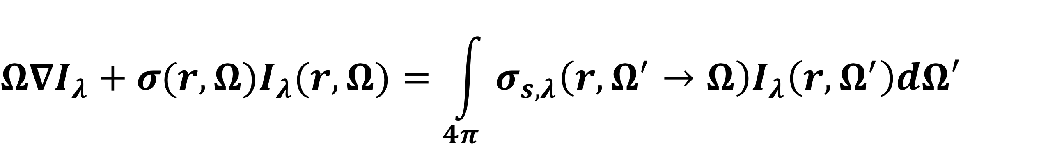
3D RADIATIVE TRANSFER IN VEGETATION CANOPY
  Ross’ team revolutionary results
  validity of RTE to describe photon-canopy interaction had been clearly demonstrated
  parameterization of its coefficients in terms of foliage area density, , leaf normal distribution function, , and leaf scattering phase function,
Forward Problem: given coefficients, find solution
Inverse Problem: given solution, find coefficients
Discuss methodologies and techniques developed in other scientific areas, motivated by other sciences and applications that can be applied in optical remote sensing of vegetation
Notes:
Area scattering phase function; leaf albedo = area scattering coefficient

Slide 3
3D RADIATIVE TRANSFER PROBLEM: BASIC
Classification of RTE (Germogenova, 1986)
  Standard problem: RT problem with nonreflecting boundary
  Boundary value problem for RTE
Boundary vale problem can be expressed via solutions of the standard RTE
  Relationships between forward and adjoint RTE
  Green’s function approach (George Green, 7/14/1793-5/31/1841)
Less important for the forward problem
Critical for the inverse problem
In developing inverse techniques, special emphasis should be given to the standard problem
Germogenova, T.A. (1986). Local properties of solutions to the transport equation. Moscow: Nauka (in Russian)
Notes:
Area scattering phase function; leaf albedo = area scattering coefficient

Slide 4
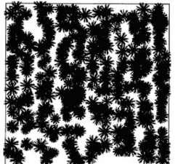
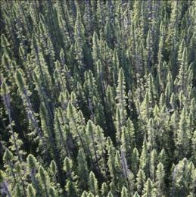
3D EFFECTS IN REMOTE SENSING DATA
Mean Intensity
mean intensity emanating from heterogeneous vegetation pixels
Can we derive equation for ?
Vainikko (1973): Mean intensity satisfies a simple system of equations
Titov (1990): Physical processes in clouds as stochastic process
Parameterization of 3D clumped canopy structure:
Conditional Pair Correlation Function
SRTE can reproduce all 3D effects reported in literature
Stochastic RTE
Vainikko, G.M. (1973). The equations of mean radiance in broken cloudiness. Trudy MGK SSSR. Meteorological Investigations, 21, 28-37.
Titov, G.A. (1990). Statistical Description of Radiation Transfer in Clouds. Journal of the Atmospheric Sciences, 47, 24-38.
Stoyan, D., Kendal, W.S., & Mecke, J. (1995). Stochastic geometry and its applications. New York: John Wiley & Sons.
Huang et al. (2008). Stochastic transport theory for investigating the three-dimensional canopy structure from space measurements. Remote Sens. Environ.2, 35-50.
Notes:
Area scattering phase function; leaf albedo = area scattering coefficient

Slide 5
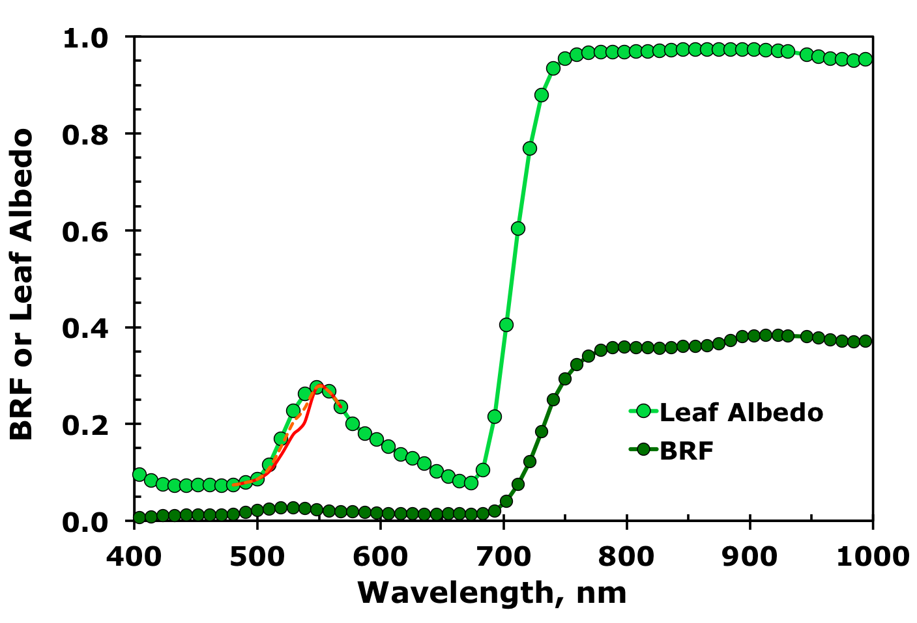

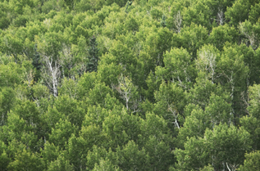
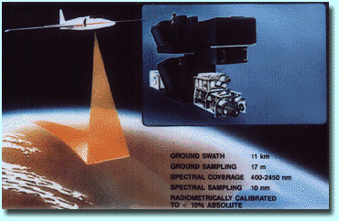
LEAF AND CANOPY SPECTRAL REFLECTANCE
leaf properties
canopy structure
aspen leaf
NASA
AVIRIS
aspen canopy
Leaf scattering and canopy reflectance are similar in shape, differ in magnitude

Slide 6
LEAF AND CANOPY SPECTRAL REFLECTANCE
leaf properties
canopy structure
aspen leaf
NASA
AVIRIS
aspen canopy
canopy structure

Slide 7
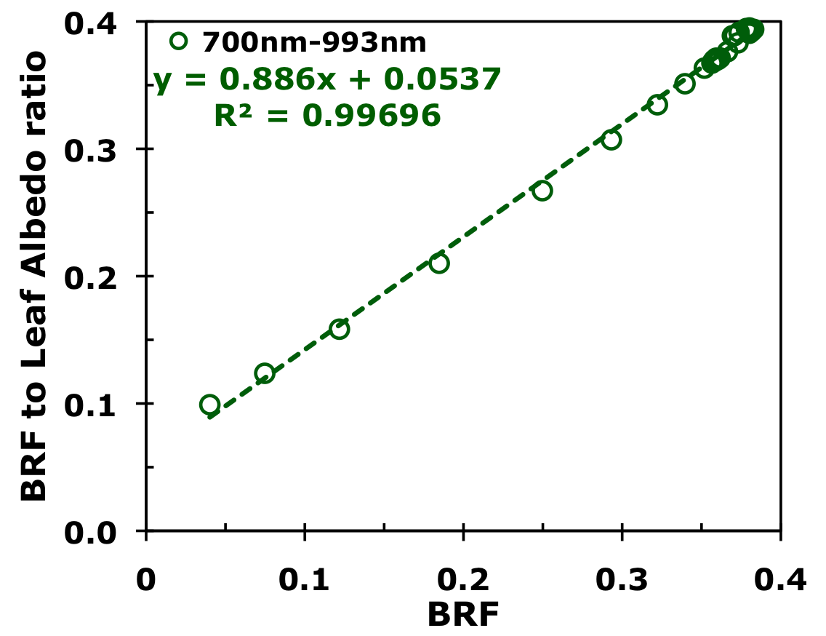
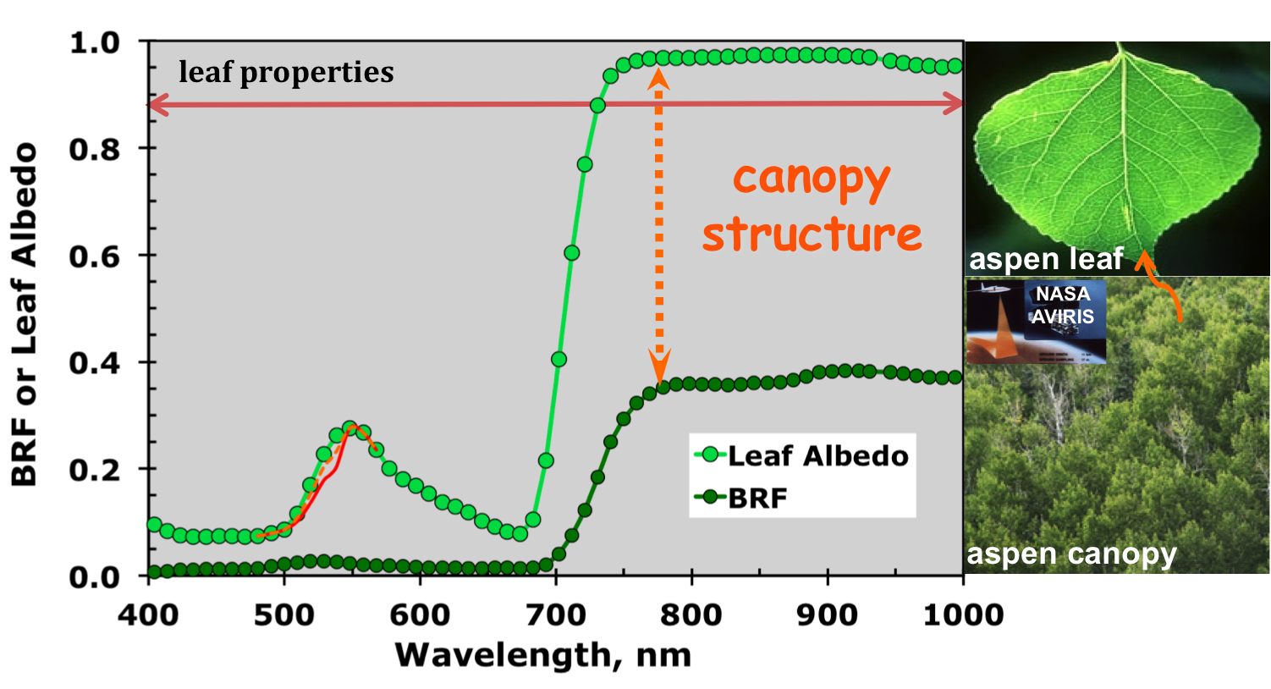
SPECTRAL INVARIANTS IN VEGETATION CANOPIES
Slope, p:
Intercept, R:
BRF to Leaf Albedo Ratio is linearly related to BRF
escape probability
resollision probability
Determined by distribution of photon free path

Slide 8
DECOMPOSITION OF THE STANDARD PROBLEM
Solution of the standard RTE
Directional Area Scattering Factor: canopy BRF if no absorption
Canopy scattering coefficient
DASF determines BRF angular shape while the scattering coefficient its magnitude
Solution of the standard RTE is expressed in terms measurable variables

Slide 9
TRUE AND EFFECTIVE LEAF AREA
true leaf area
effective leaf area
clumping: no
L_{eff}=L_{true}
p₀(L_{eff})
L_{eff}<L_{true} increase
DASF same
Rec prob increase
W_{λ} decrease

Slide 10
TRUE AND EFFECTIVE LEAF AREA
true leaf area
effective leaf area
clumping: no
L_{eff}=L_{true}
p_{c}(L_{eff})
p₀(L_{eff})
L_{eff}<L_{true} increase
DASF same
Rec prob increase
W_{λ} decrease
clumping: no
L_{eff}=L_{true}
W_{λ} same if p₀=p_{c}
L_{eff}
L_{true}
interpretation
p_{c}: Smolander&Stenberg, 2005
Smolander, S., & Stenberg, P. (2005). Simple parameterizations of the radiation budget of uniform broadleaved and coniferous canopies. RSE 94, 355-363.
Huang et al. (2007). Canopy spectral invariants for remote sensing and model applications. Remote Sens. Environ. 106, 106-122
Knyazikhin et al. (2011) Canopy spectral invariants. Part 1: A new concept in remote sensing of vegetation. J. Quant. Spectrosc. Radiat Transf. 112, 727-735

Slide 11
TRUE AND EFFECTIVE LEAF AREA
true leaf area
effective leaf area
clumping: no
L_{eff}=L_{true}
p_{c}(L_{eff})
p₀(L_{eff})
L_{eff}<L_{true} increase
DASF same
Rec prob increase
W_{λ} decrease
clumping: no
L_{eff}=L_{true}
W_{λ} same if p₀=p_{c}
L_{eff}
L_{true}
p_{c}: Smolander&Stenberg, 2005
Smolander, S., & Stenberg, P. (2005). Simple parameterizations of the radiation budget of uniform broadleaved and coniferous canopies. RSE 94, 355-363.
Lewis, P., & Disney, M. (2007). Spectral invariants and scattering across multiple scales from within-leaf to canopy. Remote Sens. Environ. 109, 196-206.

Slide 12
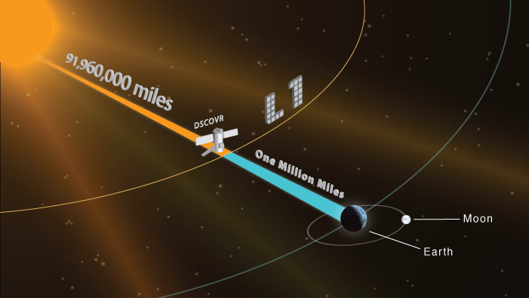
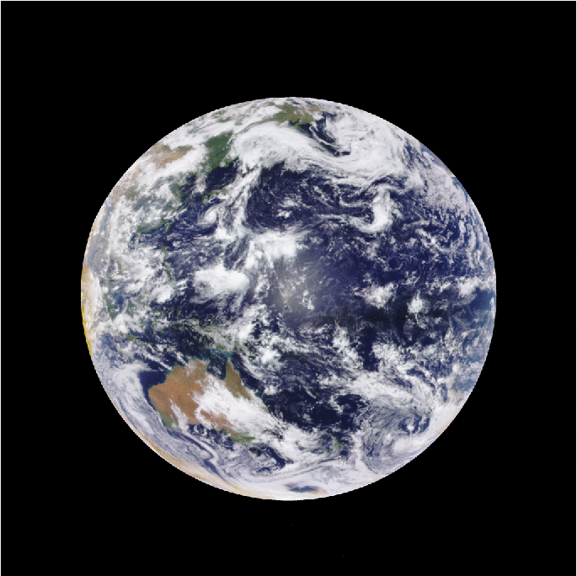
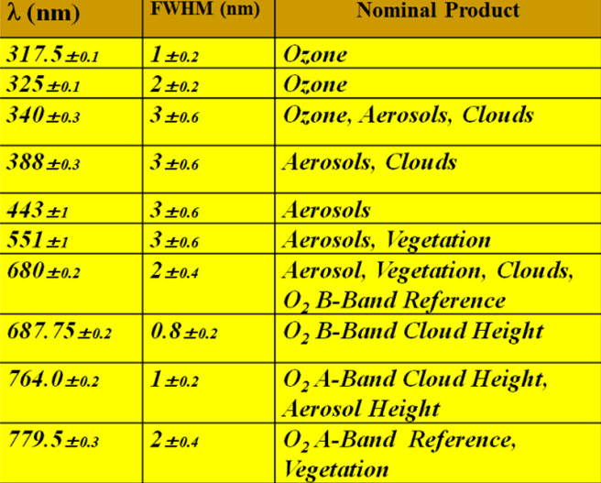
DEEP SPACE CLIMATE OBSERVATORY (DSCOVR)
DSCOVR mission was launched on February 11, 2015 to the Sun-Earth Lagrangian L1 point
  to monitor solar weather to provide early warning of solar storms affecting the Earth
  hosts NASA Earth-Observing Instrument: the Earth Polychromatic Imaging Camera (EPIC)
EPIC measures Earth’s reflected radiation at 10 UV to NIR spectral bands
Temporal resolution: 65 to 110 min
Pixel size near center: 10x10 km
L1B EPIC reflectance data (πI/F) are available from Langley ASDC
http://www.nesdis.noaa.gov/DSCOVR/mission.html
August-23-2016b
12
https://epic.gsfc.nasa.gov/epic

Slide 13
DEEP SPACE CLIMATE OBSERVATORY (DSCOVR)
DSCOVR mission was launched on February 11, 2015 to the Sun-Earth Lagrangian L1 point
  to monitor solar weather to provide early warning of solar storms affecting the Earth
  hosts NASA Earth-Observing Instrument: the Earth Polychromatic Imaging Camera (EPIC)
EPIC measures Earth’s reflected radiation at 10 UV to NIR spectral bands
Temporal resolution: 65 to 110 min
Pixel size near center: 10x10 km
L1B EPIC reflectance data (πI/F) are available from Langley ASDC
http://www.nesdis.noaa.gov/DSCOVR/mission.html
August-23-2016b
https://epic.gsfc.nasa.gov/epic
13

Slide 14
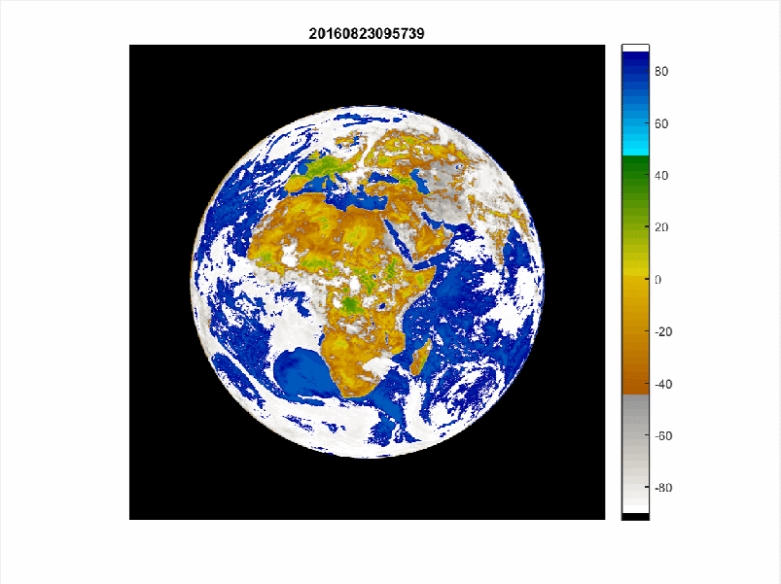
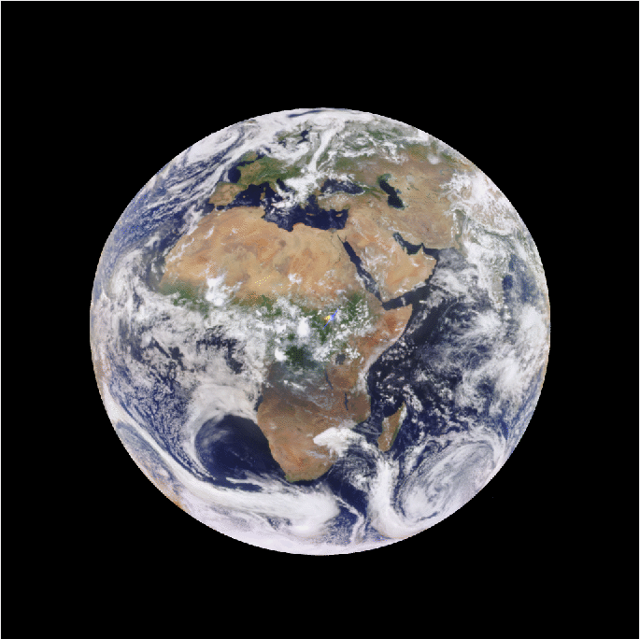
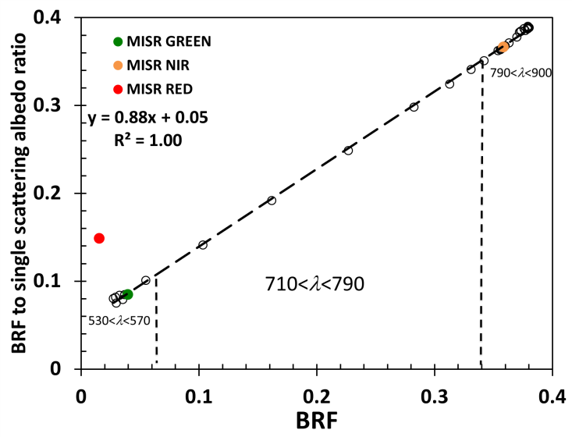
RECOLLISION PROBABILITY OF CLOUD AND VEGETATION
August-23-2016
ψ=atan p
R

Slide 15
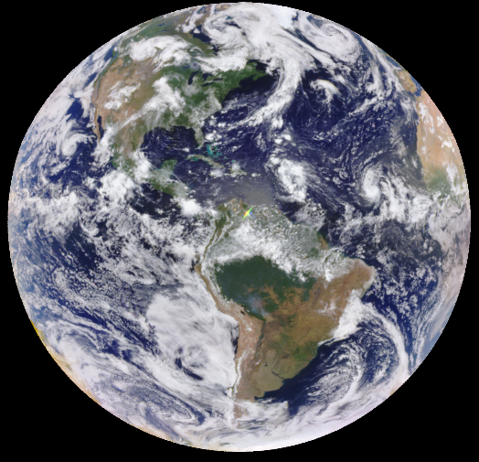
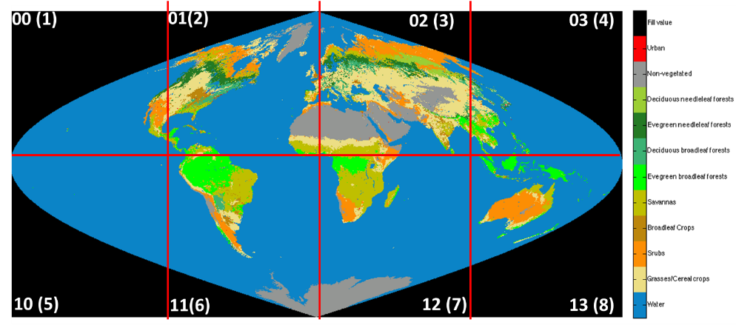
VEGETATION EARTH SYSTEM DATA RECORD (VESDR)
8/23/2017
16:30:25GMT
MAIAC (A.Lyapustin, NASA/GSFC )
10 km SIN grid
NIR BRF
+red
LAI
10 km LCM
VESDR
NDVI
FPAR
SLAI

Slide 16
VESDR ALGORITHM
  Uses decomposition of the boundary value problem for RTE
  Based on the stochastic RTE equation
    accounts for 3D effects in surface reflectance data
  Incorporates recent advances in the theory of canopy spectral invariants
    Special attention to the relationship between “true” and “effective” LAI
    Kuusk’s theory is incorporated into spectral invariants
    Energy conservation law is not violated
  Parametrized in terms of measurable parameters
  allows for direct validation of the algorithm, facilitates identification of its deficiencies and development of refinements
Yang et al. (2017). Estimation of leaf area index and its sunlit portion from DSCOVR EPIC data: Theoretical basis. Remote Sensing of Environment, 198, 69-84

Slide 17
SUMMARY
  Methodologies and techniques developed in other scientific areas, motivated by other sciences and applications:
  Decomposition of the boundary value problem for RTE
    Reactor physics, atmospheric physics, astrophysics
  Stochastic radiative transfer equation
    Cloud physics, mathematics
  Spectral invariants
    Reactor physics (criticality condition), mathematics
  Hot spot phenomenon
    Vegetation, amplified by reactor/cloud physics, mathematics
Notes:
From the physical stand point, the strong positive correlation …

Slide 18
http://www.mdpi.com/journal/remotesensing/special_issues/rt_rs
Deadline for manuscript submission:
15 May, 2018
Notes:
From the physical stand point, the strong positive correlation …

Slide 19
STOCHASTIC RTE AND STOCHASTIC BOUNDARY
  n=207
  Spherical leaf normals
  Area of 1 leaf:36
  Stationary Poisson Point Process of intensity d in volume V
  Canopy structure as stationary Poisson (germ-grain) process
  Stochastic reflecting boundary as points on leaf surfaces from which incident photons can enter the vegetation canopy
  Sunlit leaves form the boundary, depends on directions of solar beam
  Sunlit leaves can occur anywhere in the canopy, the boundary is subjected to both the direct and within canopy diffuse radiation
Notes:
Germ are points, discs are grain

Slide 20
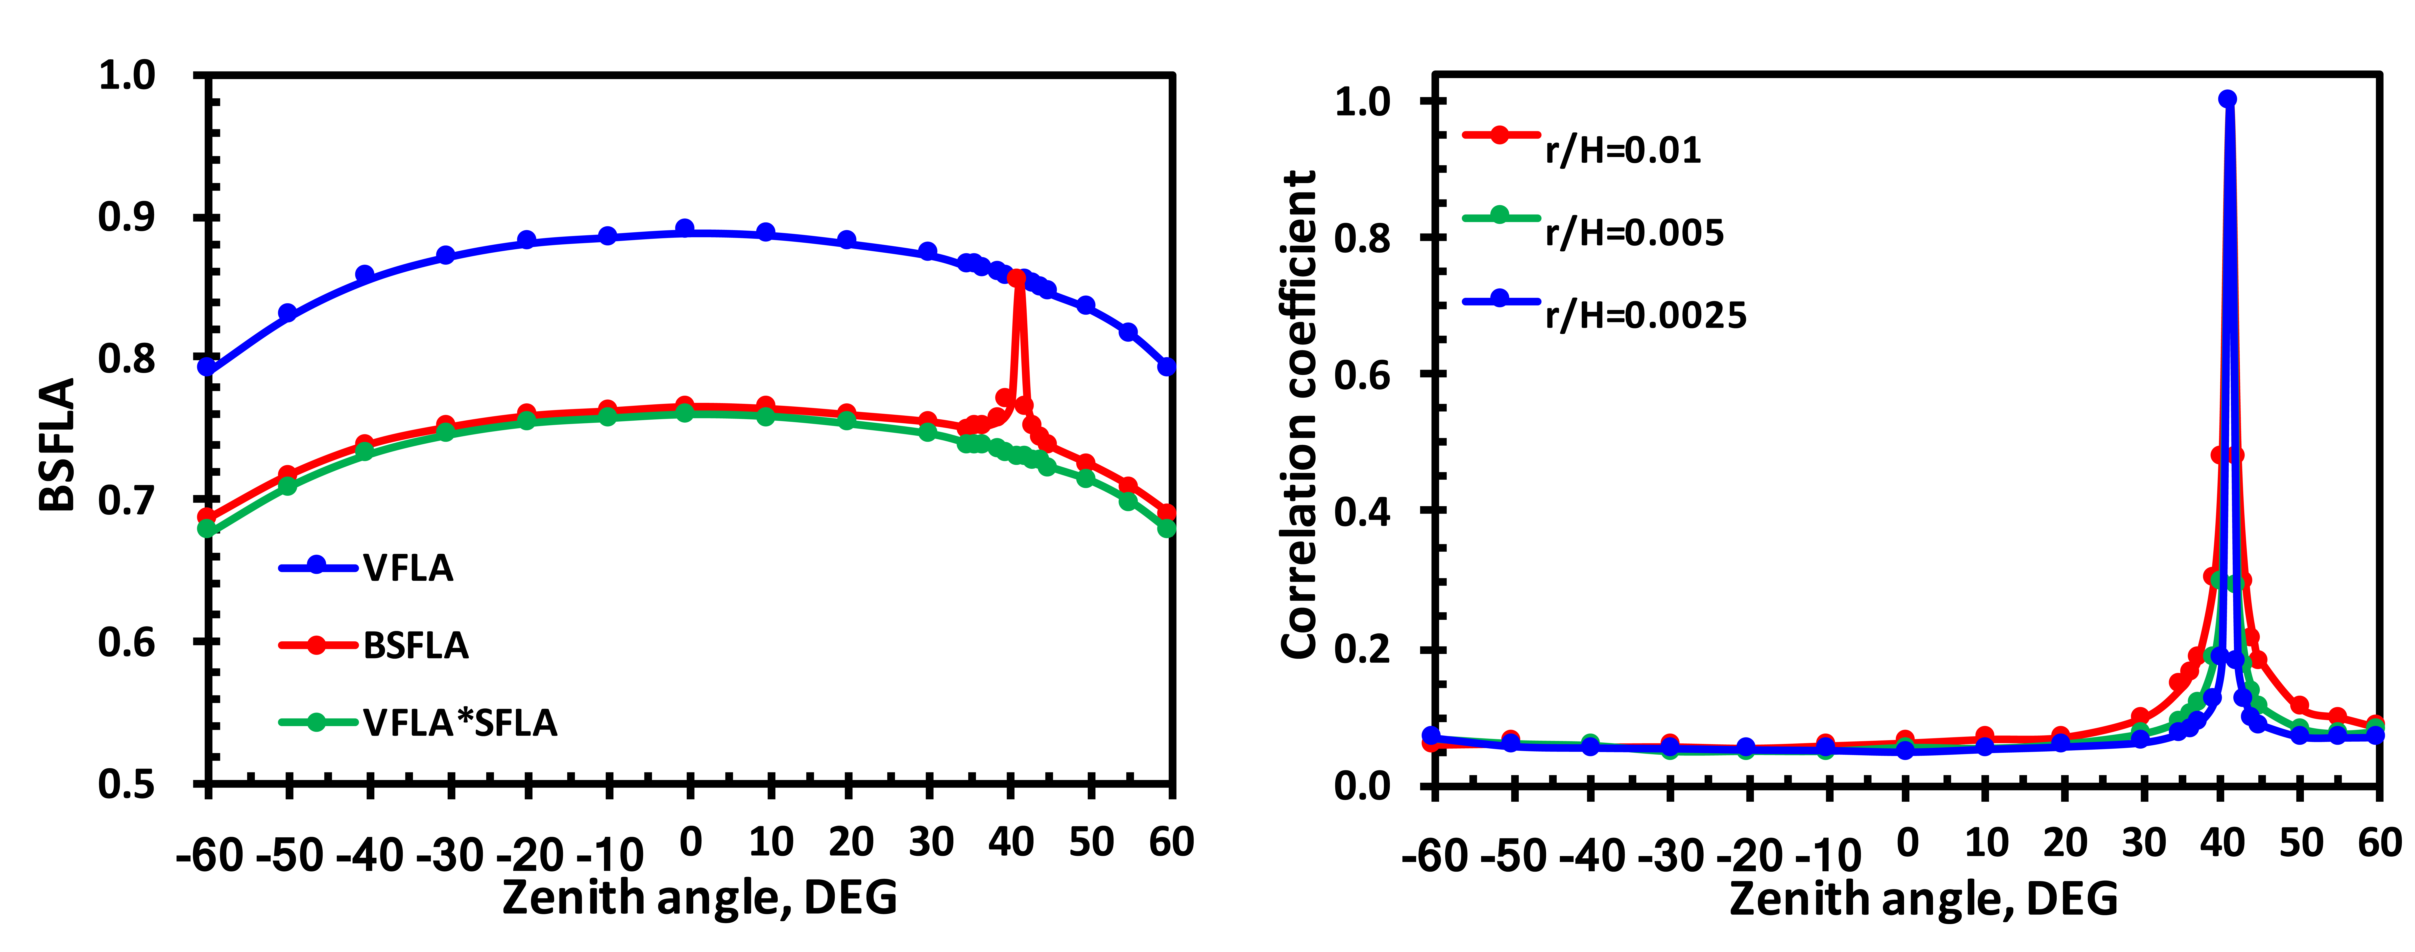
BI-DIRECTIONAL SUNLIT FRACTION OF LEAF AREA (BSFLA)
Events of seeing gaps from leaf surfaces in two directions are not independent
BSFLA(Ω;Ω₀): fraction of the total hemi-surface leaf area that is simultaneously visible from outside the canopy along two directions

Slide 21
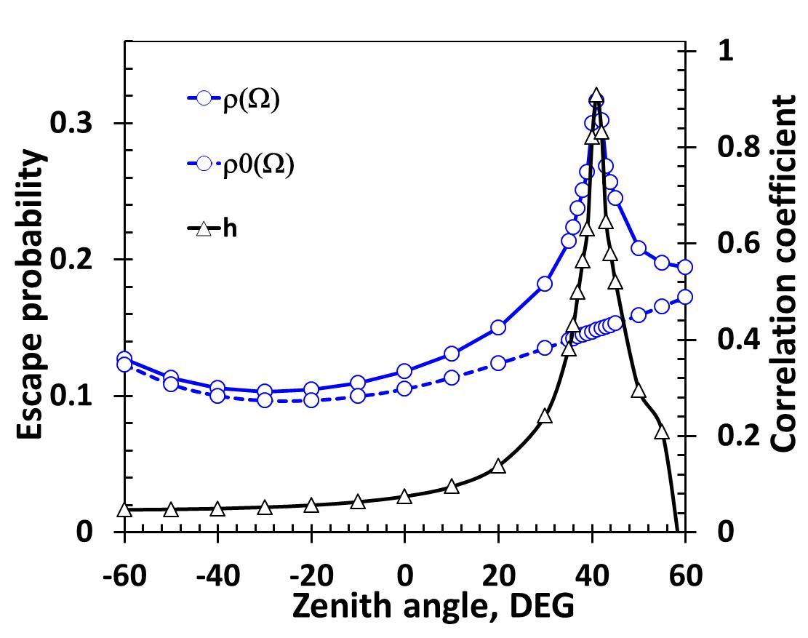
RESULTS
Solution of the standard RTE
Directional Area Scattering Factor: canopy BRF if no absorption
Canopy scattering coefficient
Correlation coefficient separates probabilities to escape from shaded and sunlit leaves
Solution of the standard problem holds all properties of its “classical” counterpart
Energy conservation law is not violated
Yang et al. (2017). Estimation of leaf area index and its sunlit portion from DSCOVR EPIC data: Theoretical basis Remote Sens. Environ. 198, 69-84

Slide 22
VESDR ALGORITHM
  Uses decomposition of the boundary value problem for RTE
  Based on the stochastic RTE equation
    accounts for 3D effects in surface reflectance data
  Incorporates recent advances in the theory of canopy spectral invariants
    Special attention to the relationship between “true” and “effective” LAI
    Kuusk’s theory is incorporated into spectral invariants
    Energy conservation law is not violated
  Parametrized in terms of measurable parameters
  allows for direct validation of the algorithm, facilitates identification of its deficiencies and development of refinements
Yang et al. (2017). Estimation of leaf area index and its sunlit portion from DSCOVR EPIC data: Theoretical basis. Remote Sensing of Environment, 198, 69-84

