Slide 1


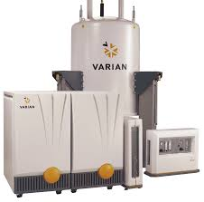
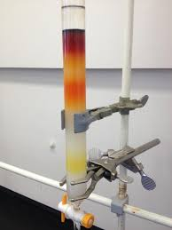
Synthesis of New Scaffolds via Bisalkyne Cyclizations Catalyzed by Triflic Acid
Jaime Alvarez Duque, Kyle Strom, John K. Snyder
Boston University, Department of Chemistry, Boston MA
INTRODUCTION
METHODS
Project dealt with synthesis of new molecular scaffolds via a novel acid-catalyzed cycloisomerization/Friedel-Crafts reaction.
The reaction provides an efficient way of creating tricyclic systems, termed Indenopyridenes.
The Idenopyridene scaffolds can be diversified both through the use of substituted bisalkyne precursors or by further reaction of the scaffold after its formation.
The effects of Tosyl and Nosyl protecting groups on the reaction viability was explored.
The effects of different substituents on the bisalkyne precursors was also studied.
Indenopyridene scaffold
1,6-Dyine substrates were all synthesized in the laboratory from commercially available precursors.
TfOH/TFA 20%mol solution used as reaction catalyst.
One-pot procedure
Reaction times ranging from 5 to 60 minutes.
Temperatures of 0° C or room temperature (~25°C)
Purification of desired product through flash column chromatography.
Characterization of products by Nuclear Magnetic Resonance (NMR) Spectroscopy.
SYNTHESIS OF BISALKYNES
Example of a common bisalkyne synthesis:
NMR Spectrometer
Column Chromatograpy
Bisalkyne substrate

Slide 2
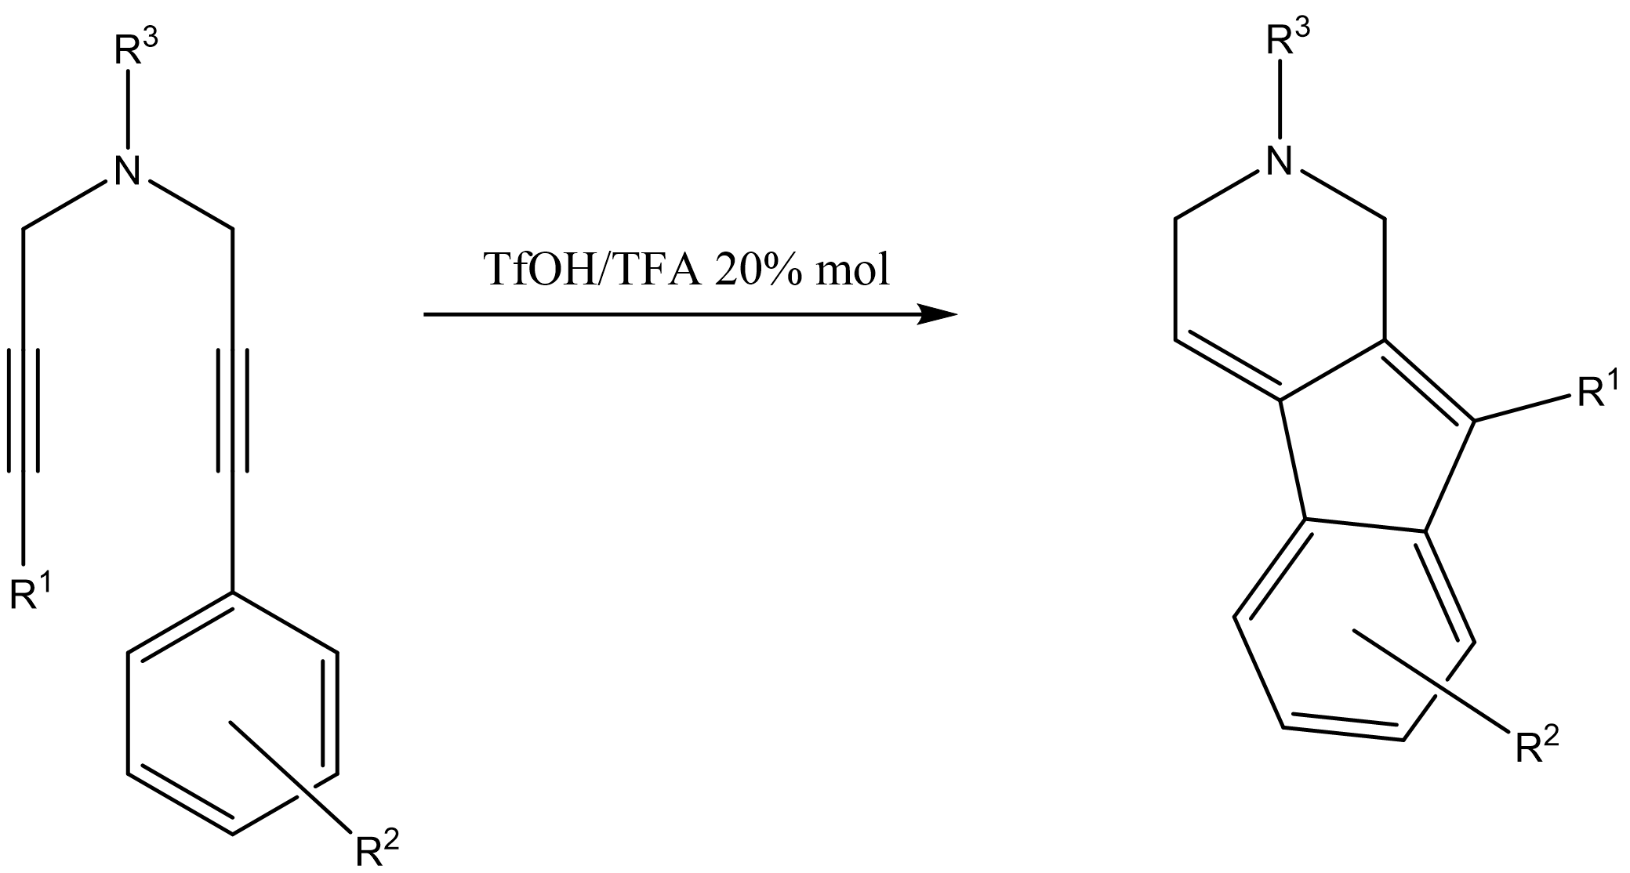
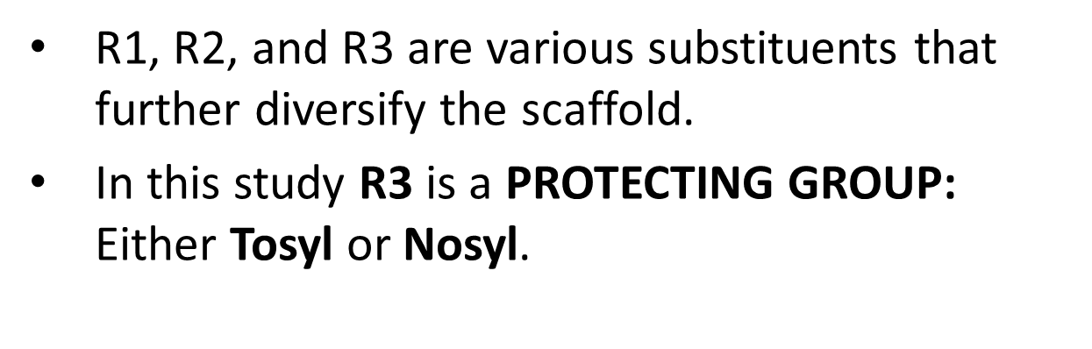
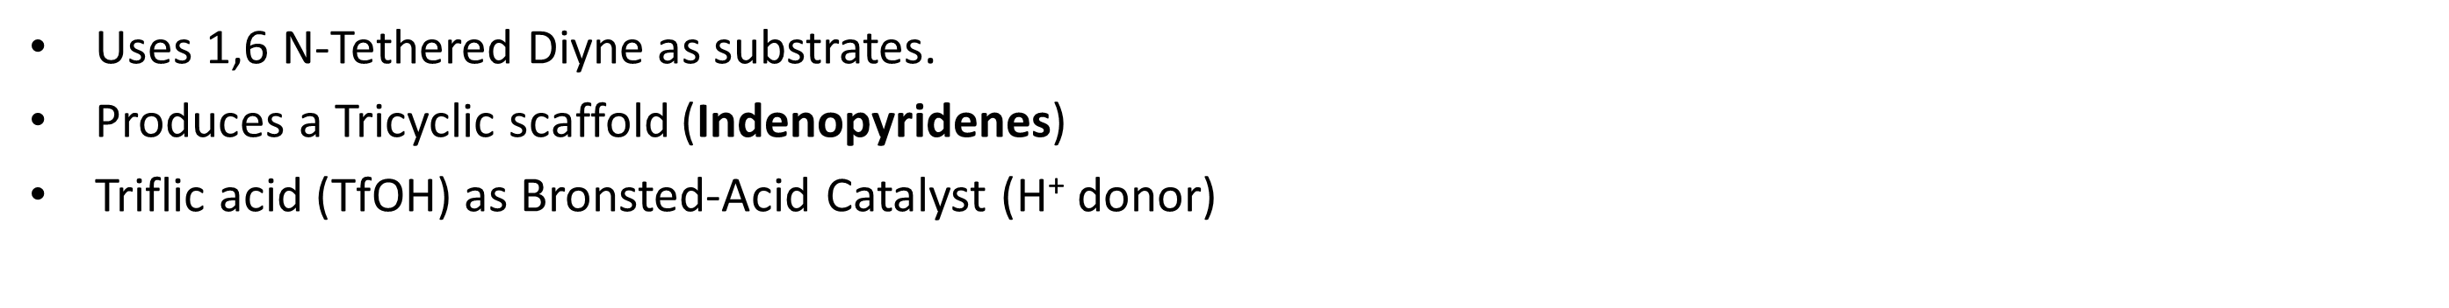
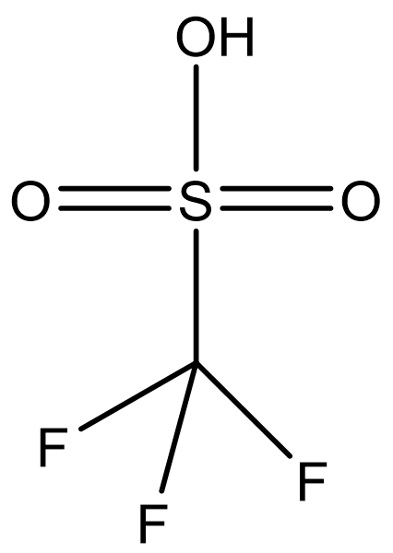
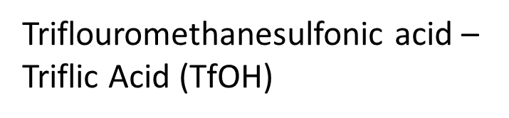
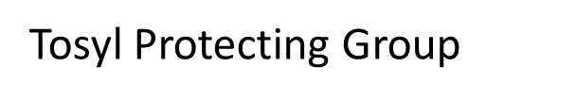

Synthesis of New Scaffolds via Bisalkyne Cyclizations Catalyzed by Triflic Acid
Jaime Alvarez Duque, Kyle Strom, John K. Snyder
Boston University, Department of Chemistry, Boston MA
REACTION
MECHANISM
MECHANISM
Acid-Catalyzed Cycloisomerization/Friedel-Crafts Reaction

Slide 3
Synthesis of New Scaffolds via Bisalkyne Cyclizations Catalyzed by Triflic Acid
Jaime Alvarez Duque, Kyle Strom, John K. Snyder
Boston University, Department of Chemistry, Boston MA
RESULTS
CONCLUSIONS
Reaction works with minimal substituents: Methyl as R1 and Phenyl with no substituents as R2.
Electron-withdrawing substituents on R2 seem to work well (i.e. p-Cl)
Very electron-donating substituents on R2 (i.e. m-OMe, p-OMe) don’t seem to work well at current conditions.
Equal R2 substituents at different positions have different effect on the reaction (i.e. p-OMe, m-OMe).
Slightly electron-donating substituents on R2 seem to work (i.e. 3,5-dimethyl).
Simple alkyl substituents at the carbon adjacent to the N do not favor the reaction.
The reaction yield seems to increase with decreasing reaction concentration.
Lower temperature seems to favor the formation of product when difficult (i.e. electron-withdrawing) substituents are present.
R1 | R2 | R3 | Concentration (M) | Yield (%)
Me | Ph | Ns | 0.2 | 33
Me | Ph | Ns | 0.02 | 67
Me | Ph* | Ns | 0.2 | 0
Ph | Ph* | Ns | 0.2 | 0
Me | p-OMe | Ts | 0.02 | 0
Me | m-OMe | Ts | 0.02 | 14ª
Me | p-Cl | Ts | 0.02 | 42
Me | 3,5-Dimethyl | Ts | 0.02 | 40ª
m-OMe
3,5-dimethyl
p-OMe
p-Cl
FUTURE WORK
Continue studying the effects of electron-donating and withdrawing groups.
Further study the role of temperature in reaction optimization.
React the Indenopyridene scaffold to assess its stability and viability.
Work with double-aryl bisalkynes in order to study the regioselectivity of the reaction.
Attempt the creation of stereogenic centers through the use of substituents at the C adjacent to N.
Diversify the scaffold to create a small library of analogues and screen them for potential biological activity.
* - Bisalkyne with two methyl substituents (gem-dimethyl) at the carbon next to the N on the side of the marked Ph.
a – Reaction carried at 0° C.

