Slide 1
Improving precaution adherence at BMC
Christopher Warsham MD,
Jacob Walker (MSMII, BUSM),
Uday Kumar Shanmugam MBBS, MPH
Under the Guidance of
Dr .Carol Sulis MD, Associate professor of Medicine (BUSM)

Slide 2
Introduction
MRSA, Clostridium Difficile are primary causes of health care associated infections at Boston Medical Center. They are also associated with higher mortality and morbidity rate. Health care associated infections are responsible for complication of estimated 1 in every 20 patients. We observed the protocols to be followed under different precautions such as Standard, Contact, Droplet, Contact plus (Clostridium Difficile infections) and Air borne infections at the Intensive care unit.

Slide 3
Guidelines
For standard precautions – Follow hand washing prior to entering the room and hand washing while exiting the room
For contact precautions one must wear the gown first and fasten it accordingly followed by wearing a mask ( if necessary) and don the gloves last
While exiting a room with contact precautions one must remove the gloves first followed by gown followed by mask
For a room with contact plus precautions one must follow the protocol for contact precautions but must wash their hands with soap and water instead of alcohol rub

Slide 4
Methods
Four blocks of three rooms were observed randomly
Every room was observed for a duration of 15 minutes regardless of the precaution
Entry and exit were viewed as two separate observations
We excluded EMT’s, correctional officers and visitors
We also excluded emergency situations and procedures
We also observed if any personal equipments were used and whether they were sanitized before exiting the room

Slide 5
Results
 | RN | MD | OVERALL
Entry hand washing | 60/134=(44.8%) | 14/55= (25.5%) | 87/219 =(39.7%)
Standard precaution | 42/90 (47.7%) | 11/28 (39.3%) | 59/132 (44.7%)
Contact precaution | 11/33 (33.3%) | 2/26 (7.7%) | 20/70 (28.6%)
Exit hand washing | 106/138 (76.8%) | 29/51 (56.9%) | 150/216 (69.4%)
Standard precaution | 73/92 (79.3%) | 14/26 (53.8%) | 95/134 (70.9%)
Contact precaution | 23/32 (67.6%) | 12/21 (57.1%) | 41/63 (65.1%)

Slide 6
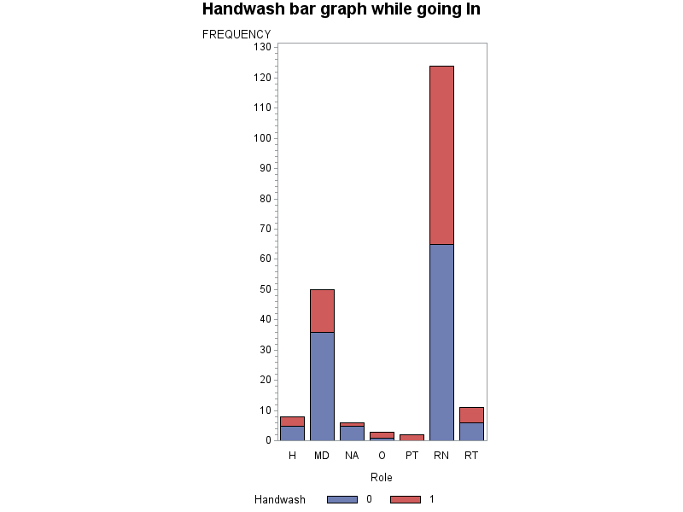
Hand washing before entering the room under any precaution

Slide 7
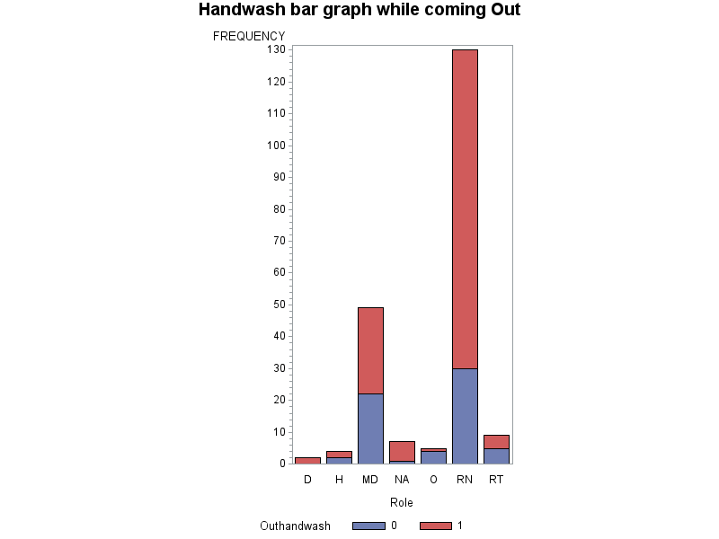
Hand washing while exiting room under any precautions

Slide 8
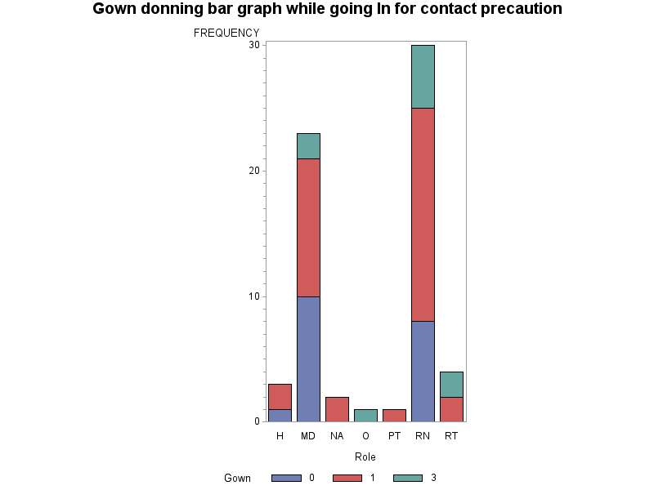
Gown donning while entering room under contact precautions

Slide 9
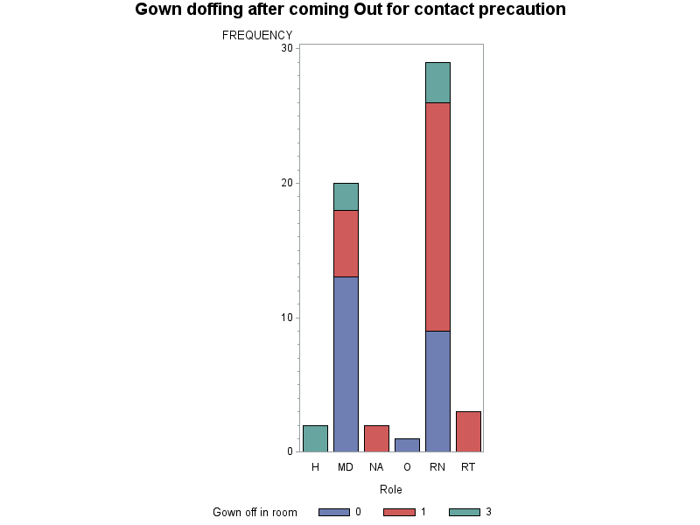
Gown doffing while coming out of room with contact precautions

Slide 10
Proposed Interventions
We must educate health care professionals to increase the hand hygiene practice and compliance
To ensure the availability of alcohol-based rub and gloves at the point of care
Health care professionals must be regularly monitored to ensure that hand hygiene is followed and intervention must be put in place if required

Slide 11
Proposed Interventions: “Safe Zone"
“Safe Zone” would be an area, approximately the first 3 feet of entering a room, marked on the floor
Pros
  Has been performed with some success at other institutions
  Allows HCW to “poke their head in” to check a monitor or briefly chat with patient
  Serves as a reminder not to touch patient or environment if precautions have not been taking
  Serves as a reminder to take the necessary precautions if passing beyond marked zone
Cons
  Requires alteration of floor
  Easily ignored

Slide 12
Proposed Interventions: Communication Campaign
WASH IN
Would involve signs and ideally an easy-to-remember catch phrase to associate with transmission-based precautions
  “Wash In, Wash Out” (or “Wash it In, Wash it Out”, “Gown In, Wash Out” et cetera) or some other phrase
Could add simple visual or color associations
Pros
  Simple
  Minimally invasive
  Relatively low cost
Cons
  Easily ignored or forgotten
  Would need buy in from HCW
WASH OUT
GOWN IN
MASK IN
WASH OUT
WASH OUT

