Slide 1

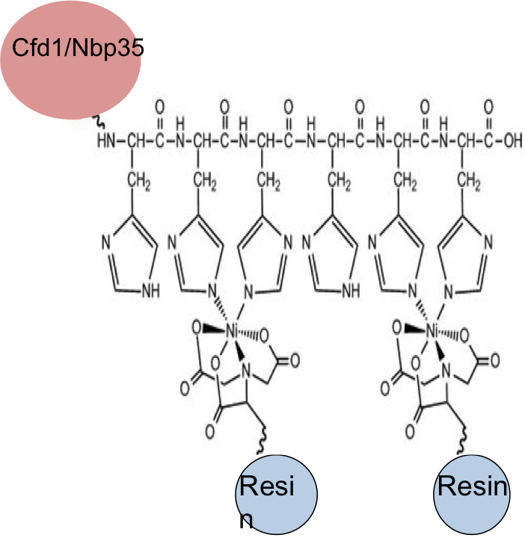
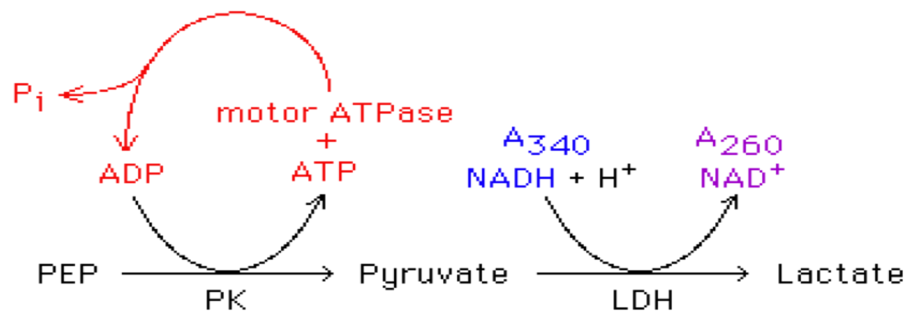

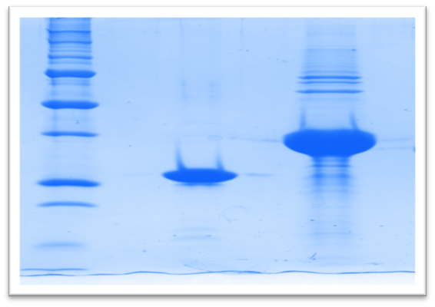
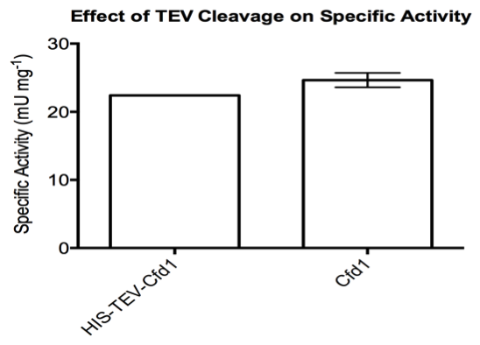
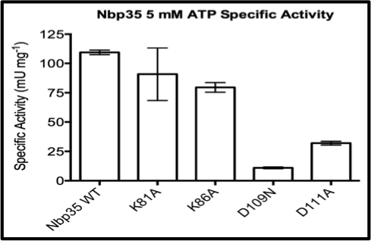
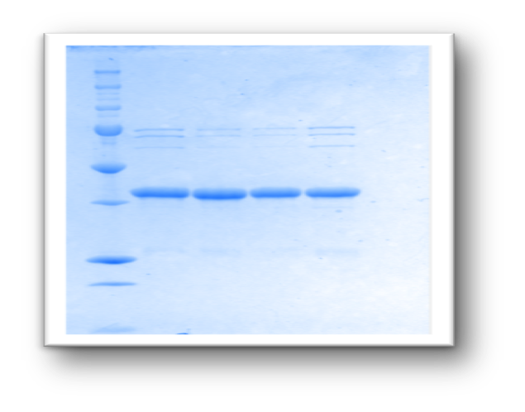
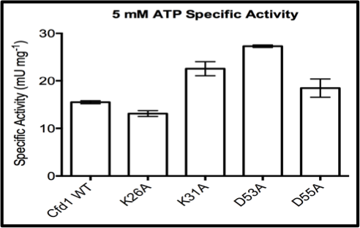
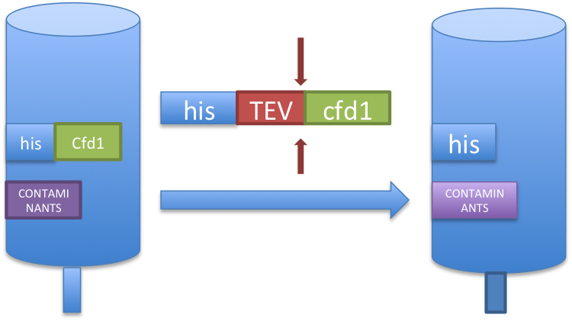
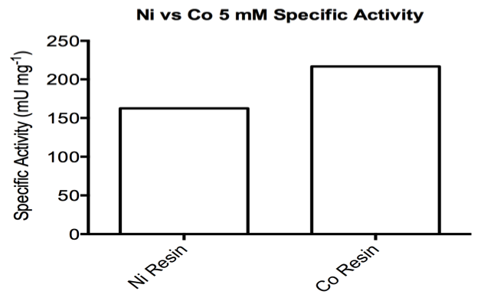
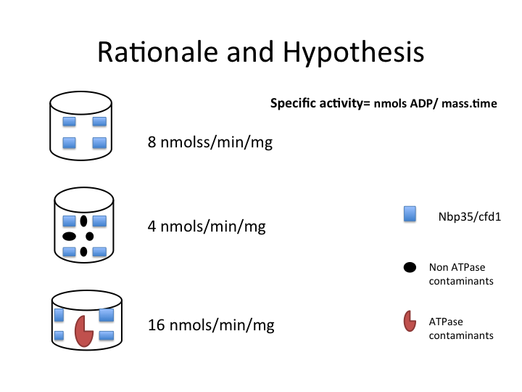
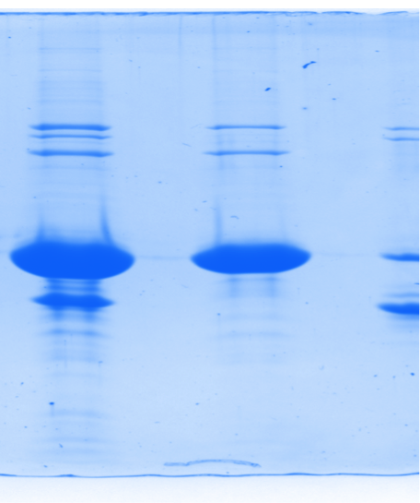
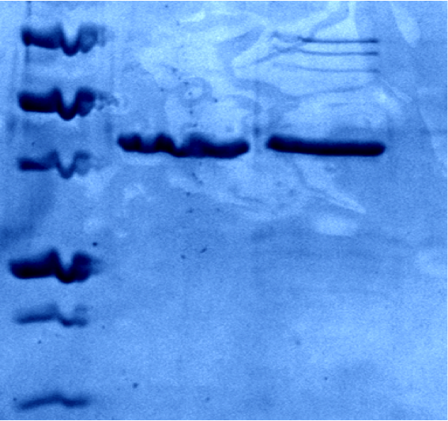

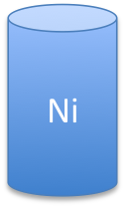




Purification and Enzymatic Activity of Cfd1 and Nbp35
Mierzhati Mushajiang, Eric Camire, and Deborah Perlstein
Department of Chemistry, Boston University, Boston MA 02215
ABSTRACT
Experiments
RESULTS
Affinity Chromatography and His Tags
5mM ATP Specific Activity
The Cytosolic Iron-Sulfur Cluster Assembly (CIA) pathway consists of eight proteins responsible for Iron-Sulfur cluster assembly and transfer to extramitochondrial apo-protein targets. Cfd1 and Nbp35 are two of these proteins that are responsible for assembling and transferring Iron-Sulfur clusters. Unlike other CIA proteins they also possess the ability to hydrolyze ATP. When both of them were purified in our lab, there are co-purified contaminants. It is unclear that if these co-purified contaminants contribute background activity to ATP hydrolysis. Therefore it has been my job to purify these proteins further and asses the affect of increased purity on ATPase activity by using an enzymatic readout of ATP hydrolysis. We found that most effective method for removing contaminants from Cfd1 and Nbp35 is using Co resin. Our results also suggest that co-purified contaminants are not ATPases.
His
Targeted protein
Ni
BACKGROUND
Since both Cfd1 and Nbp35 are ATPases, we can monitor the specific activity through an assay that couples ADP production to NADH oxidation that can be monitored at 340 nm using the UV-Vis.
His tags are genetically inserted to our targeted proteins and have binding affinity to nickel and cobalt resins. After washing multiple times to get rid of other proteins, we could elute our targeted protein with high concentration of imidazole.
Specific Activity of Cfd1 and Nbp35
TEV insertion and TEV protease
Nbp35 specific activity
Cfd1 specific activity
 | 5mM ATP Specific Activity
His-TEV-Cfd1 | 22.4nmol/min/mg
Cfd1 | 24.6nmol/min/mg
Nbp35
Cfd1
TEV
TEV Protease + time
When mutations were made to the active site of Nbp35, there was a significant decrease in the specific activity of the enzyme.
However, when mutations were made to active site of Cfd1 there was not that much of a difference between the WT enzyme and the mutants.
Both proteins had higher molecular weight contaminating bands when they were purified in gel.
cfd1
(flow thorough)
Nbp35 purified with | 5mM ATP Specific Activity
Ni resin | 163nmol/min/mg
Co Resin | 217nmol/min/mg
TEV protease recognition site was genetically inserted to our protein.
Affinity chromatography method was used to purify His-TEV-Cfd1.
To remove the His tag, purified Cfd1 was incubated with TEV protease over night.
Flow though was collected in next morning, and run it on the gel.
1
2
1 | 2
His-TEV-Cfd1 | Cfd1
TEV
cfd1
CONCLUSIONS
After cutting off the His tag from Cfd1 and purify it again, we were able to remove the middle contaminating band.
Cfd1 was successfully expressed and purified from E. coli after inserting TEV site and by cutting off the affinity tag, we were able to remove the middle contaminating band.
Using Cobalt resin has successfully removed all contaminants from Nbp35.
5mM ATP specific activity of Nbp35 has increased after purifying with cobalt resin, indicates that co-purified contaminants do not hydrolyze ATP.
Current work is focused on optimizing expression and purification using Co resin, and using Co resin to purify Cfd1.
If contaminants were non ATPases, increasing purity would increase the specific activity.
If contaminants were ATPases, increasing purity would decrease the specific activity.
Ni Resin vs. Co resin
Methods:
To test whether the contaminants are ATPase or not, we used two different methods for Cfd1 and Nbp35 respectively.
For Cfd1, we inserted a cleavable site into our protein, then cut off the affinity tag and purified it.
For Nbp35, we used two different resin, Ni VS Co, in purification.
Co
Ni
Acknowledgements:
* Perlstein group, Chemistry department,
For purifying Nbp35, we used both nickel and cobalt resin. By using cobalt resin, we were able to remove all of the contaminating bands from Nbp35.
Reference: photo adapted from KPL, Inc.

