Slide 1
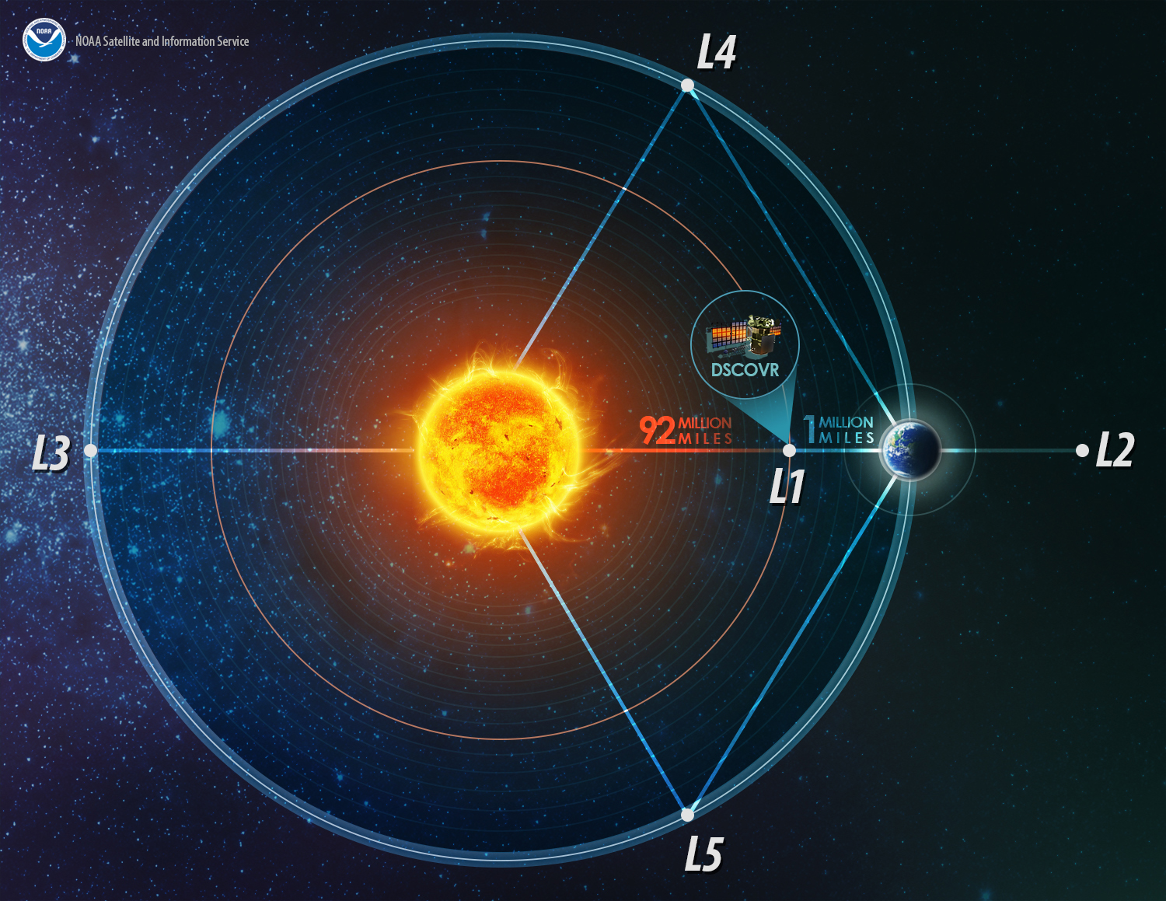
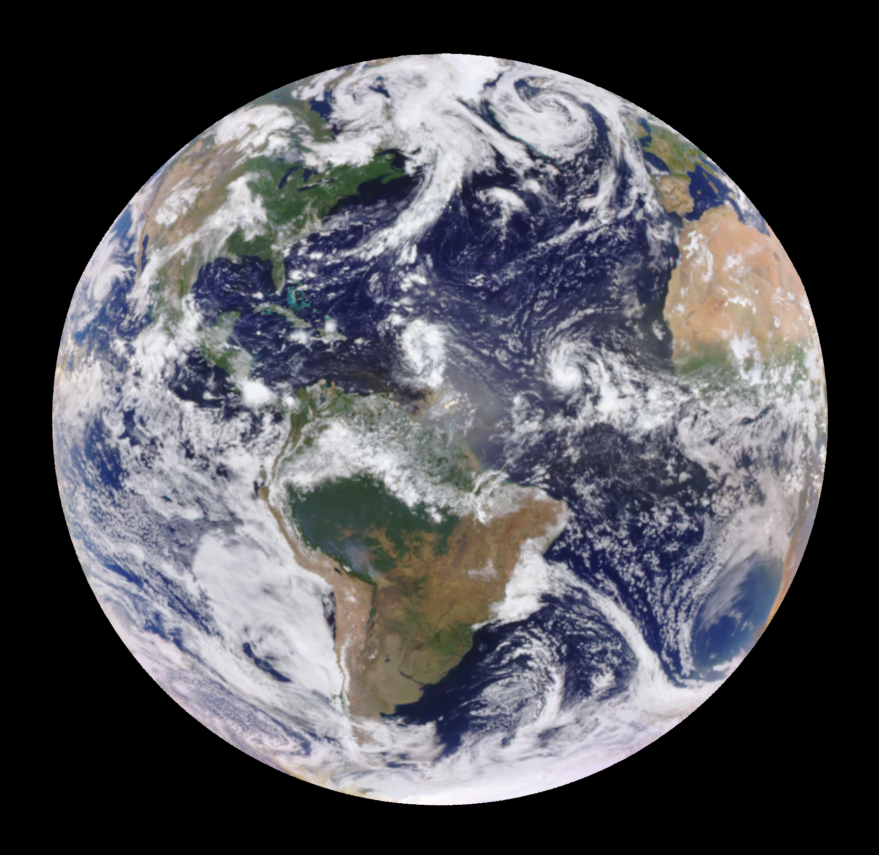
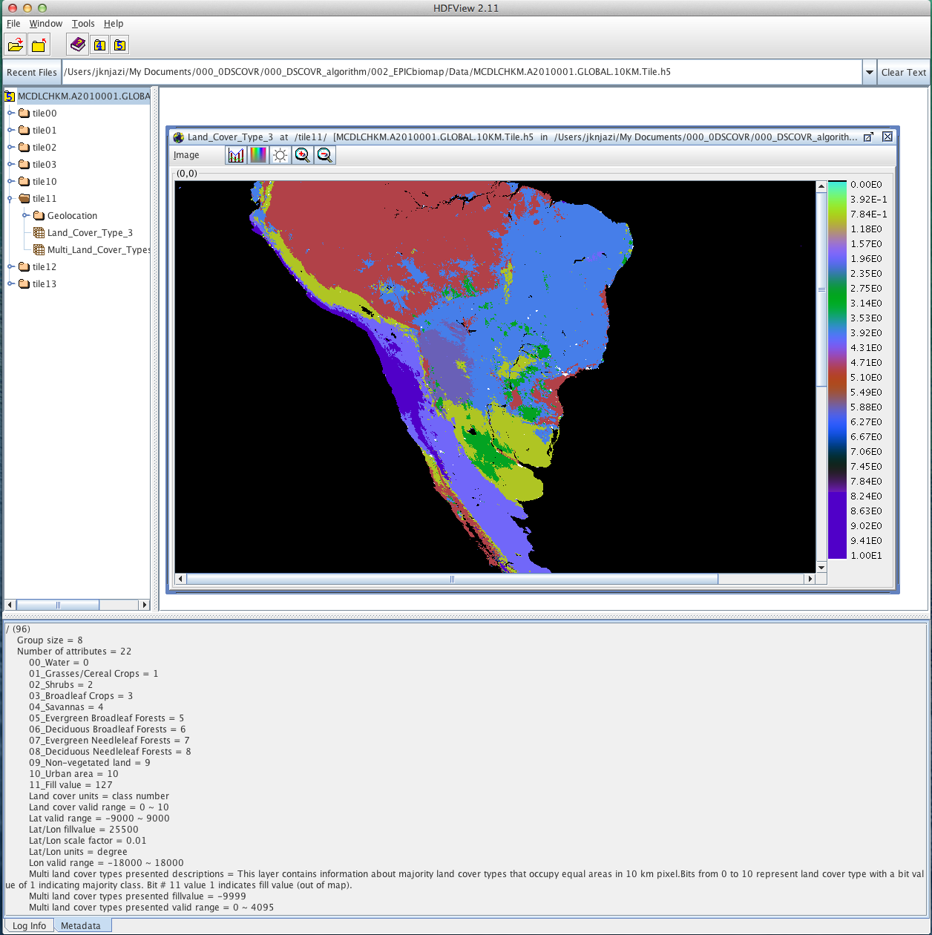
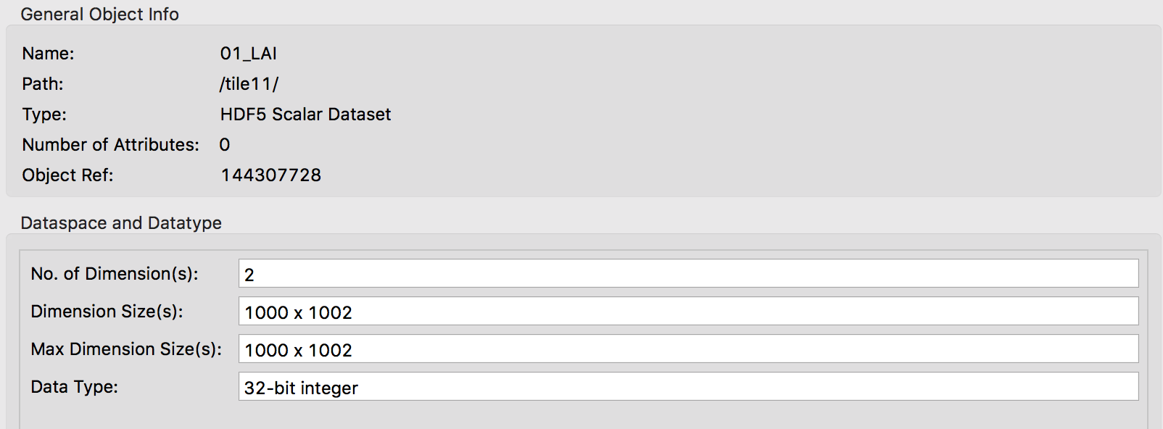
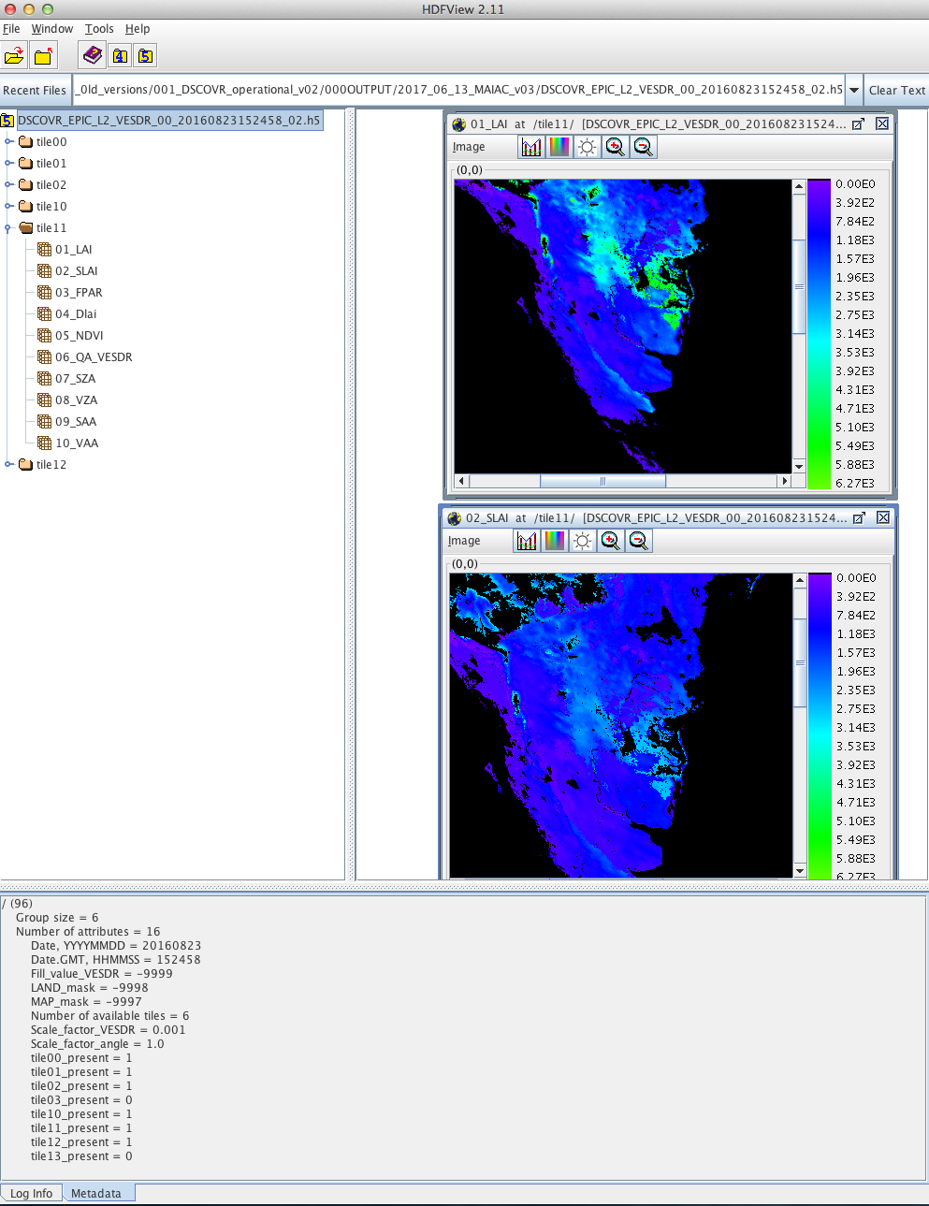
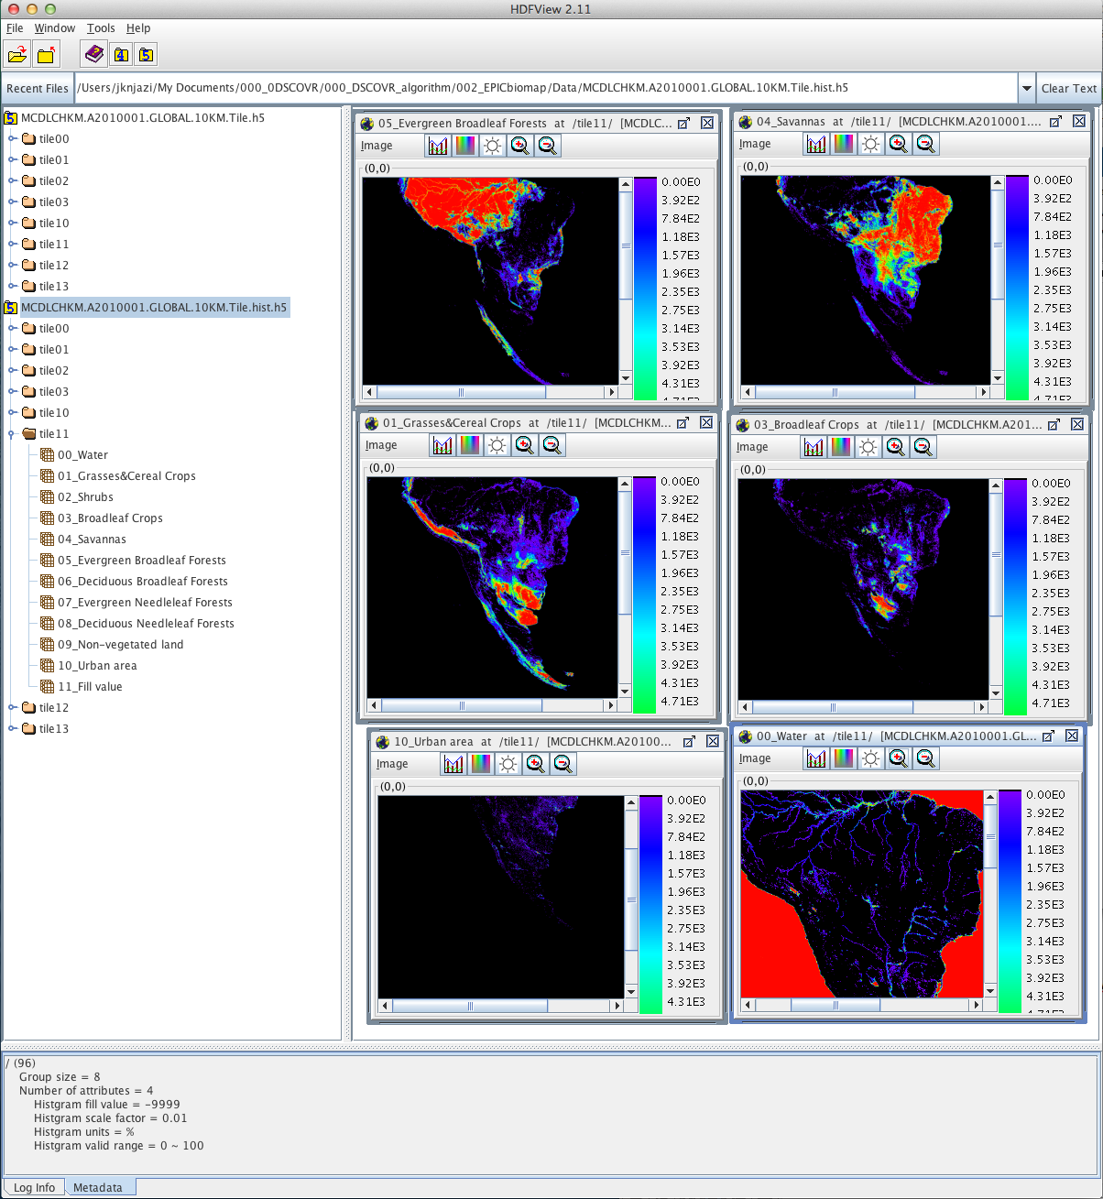
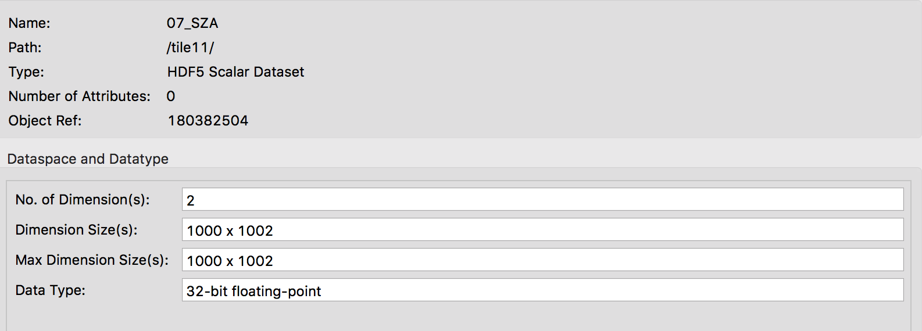
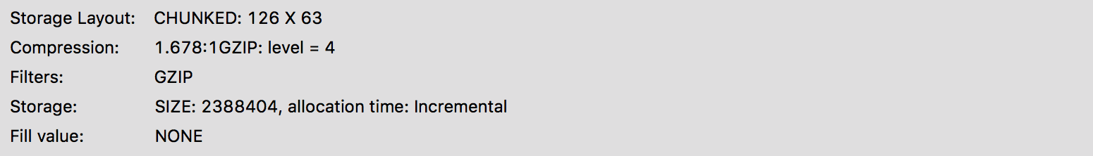
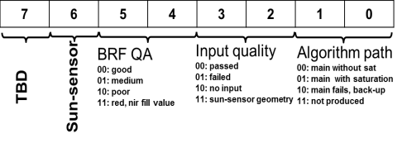
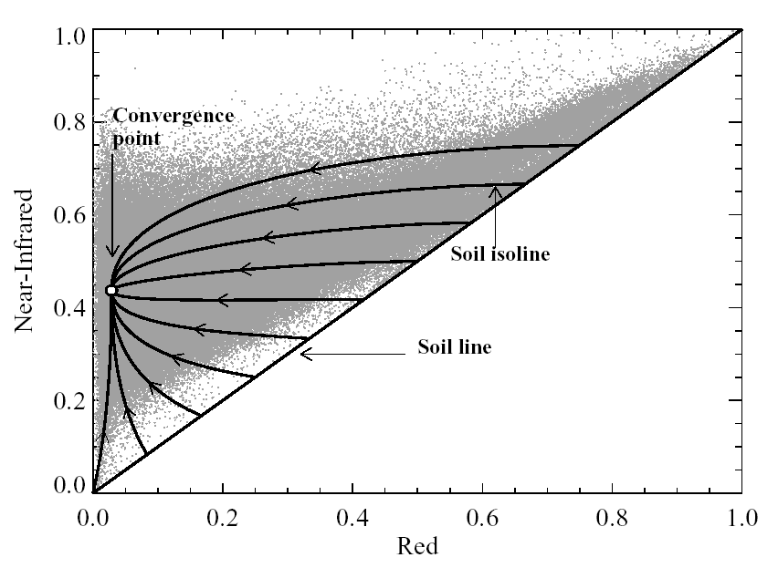
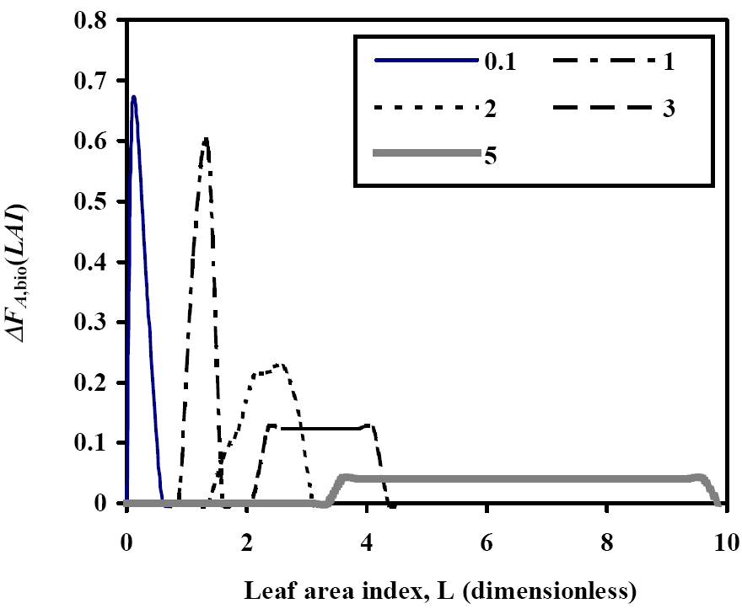


Vegetation Earth System Data Record from DSCOVR EPIC Observations
Yuri Knyazikhin¹, Wanjuan Song^{1,2}, Bin Yang^{1,3}, Matti Mõttus⁴, Miina Rautiainen⁵, Pauline Stenberg⁴, Taejin Park¹, Ranga Myneni¹
¹Boston University, MA; ² Beijing Normal University, China; ³ Hunan University, China; ⁴University of Helsinki, Finland; ⁵Aalto University, Finland
Abstract. The NASA's Earth Polychromatic Imaging Camera (EPIC) onboard NOAA's Deep Space Climate Observatory (DSCOVR) mission was launched on February 11, 2015 to the Sun-Earth Lagrangian L1 point where it began to collect radiance data of the entire sunlit Earth every 65 to 110 min in June 2015. It provides imageries in near backscattering directions with the scattering angle between 168° and 176° at ten ultraviolet to near infrared (NIR) narrow spectral bands centered at 317.5 (band width 1.0) nm, 325.0 (2.0) nm, 340.0 (3.0) nm, 388.0 (3.0) nm, 433.0 (3.0) nm, 551.0 (3.0) nm, 680.0 (3.0) nm, 687.8 (0.8) nm, 764.0 (1.0) nm and 779.5 (2.0) nm. This poster presents current status of the Vegetation Earth System Data Record of global Leaf Area Index (LAI), solar zenith angle dependent Sunlit Leaf Area Index (SLAI), Fraction vegetation absorbed Photosynthetically Active Radiation (FPAR) and Normalized Difference Vegetation Index (NDVI) derived from the DSCOVR EPIC observations. Whereas LAI is a standard product of many satellite missions, the SLAI is a new satellite-derived parameter. Sunlit and shaded leaves exhibit different radiative response to incident Photosynthetically Active Radiation (400–700 nm), which in turn triggers various physiological and physical processes required for the functioning of plants. FPAR, LAI and SLAI are key state parameters in most ecosystem productivity models and carbon/nitrogen cycle. The product at 10 km sinusoidal grid and 65 to 110 min temporal frequency as well as accompanying Quality Assessment (QA) variables will be publicly available from the NASA Langley Atmospheric Science Data Center. The Algorithm Theoretical Basis (ATBD) and product validation strategy are also discussed in this poster.
1. INTRODUCTION
2. PRODUCTION OF THE VESDR
3. VESDR DATA FORMAT
4. ANCILLARY DATA AVAILABLE TO USERS
Deep Space Climate Observatory
EPIC L1B image, Aug. 23 2016 15:24:58
8/23/2017
16:30:25GMT
MAIAC NIR BRF
File name: DSCOVR_EPIC_L2_VESDR_00_20160823152458_02.h5
MCDLCHKM.A2010001.GLOBAL.10KM.Tile.h5
YYYYMMDD
hhmm ss
(GMT)
The globe is divided into 4 horizontal tiles along the east-west, and 2 vertical tiles along the north-south axes. The tiles are identified by their horizontal and ver-tical coordinates: 00, 01, 02, 03, 10,11 and13.
LAI, August 2016
Biome classification map (Data set “Land_Cover_Type_3”). Vegetation is stratified into 8 canopy architectural types, or biomes. The biomes are grasses and cereal crops, shrubs, broadleaf crops, savannas, evergreen broadleaf forests, deciduous broadleaf forests, evergreen needle leaf forests and deciduous needle leaf forests. Data set “Multi_Land_Cover_Presented” contains information of most frequent land cover type within 10 km pixel. Group “Geolocation” contains lan/lot of each pixel. Derived from the MODIS 500m land cover type3 (MCDLCHKM) product [2]. File format: HDF5
https://www.nesdis.noaa.gov/content/dscovr-deep-space-climate-observatory
Structure of VESDR HDF5 files
NASA’s Earth Polychromatic Imaging Camera (EPIC) on board NOAA’s Deep Space Climate Observatory (DSCOVR) mission was launched on February 11, 2015 to the Sun-Earth L1 point where it began to collect Earth's images in near backscattering directions at 10 ultra-violet to near infrared spectral bands every 65 to 110 min in June 2015. EPIC L1B data are available from the NASA LARC [1].
SLAI
NDVI
FPAR
LAI, SLAI, FPAR, DLAI, NDVI, QA
MCDLCHKM.A2010001.GLOBAL.10KM.Tile.hist.h5
DSCOVR EPIC VESDR
(Vegetation Earth System Data Record)
Leaf Area Index (LAI)
Diurnal courses of
Sunlit Leaf Area Index
Fraction of PAR absorbed by vegetation (FPAR)
Normalized Difference Vegetation Index (NDVI)
Sun-Sensor geometry: SZA, VZA, SAA, VAA
LAI
EPIC L1B images are projected on the 10 km sinusoidal grid. The Multi-Angle Implementation of Atmospheric Correction (MAIAC) algorithm is used to generate surface Bidirectional Reflectance Factor (BRF) at 340nm, 388nm, 443nm, 551nm, 680nm and 780 nm (PI: A. Lyapustin, NASA Goddard). The VESDR operational algorithm in-puts BRF at green (551 nm), red (680 nm) and NIR (780 nm) spectral bands, sun-sensor geometry and biome classification map (Block 4) and retrieves LAI, SLAI, FPAR and NDVI. Uncertainties in LAI and Quality Assessment (QA) variables are also generated and archived.
All parameters
QA_VESDR
Reflectance of the vegetation reaches its maximum in the backscattering direction. This is known as the hot spot effect. The hot spot region represents the most information-rich directions in canopy reflected radiation. The uniqueness of the DSCOVR EPIC observing strategy is its ability to provide frequent observations of every region of the Earth in near hot spot directions that the existing Low-Earth-Orbiting and Geostationary satellites do not have.
Distribution of biome type within 10 km pixel. Derived from the MODIS 500m land cover type 3 (MCDLCHKM) product [2]. File format: HDF5
5. OPERATIONAL ALGORITHM
6. OBTAINING GROUND TRUTH SLAI DATA
8. STATUS
The Look-up-Table (LUT) approach implemented in the MODIS operational LAI/FPAR algorithm is adopted
effective Sunlit Fraction of Leaf Area (SFLA)
effective LAI
can be estimated from field measurements of canopy directional uncollided transmittance t(Ω) using LAI-2000PCA sensor [3]
Science tests of BRF and VESDR products are being finalized
analyses of spectral MAIAC BRF
understanding how uncertainties in input MAIAC BRF constrain retrievals
calibration of the VESDR operational algorithm for MAIAC surface reflectance data
analyses of the VESDR product
The DSCOVR EPIC VESDR product is expected to be released in February-2018
The LUT has been significantly modified [3]
its parameterization incorporates the canopy hot spot phenomenon and recent advances in the theory of canopy spectral invariants. Improves scaling properties of the LUT, simplifies adjustments of the algorithm for data spatial resolution and spectral band compositions;
the stochastic radiative transfer equations are used to generate the LUT for all biome types. The equations naturally account for radiative effects of the three-dimensional canopy structure on the BRF and allow for an accurate discrimination between sunlit and shaded leaf areas;
the LUT entries are measurable, i.e., they can be independently derived from both below canopy measurements of the transmitted and above canopy measurements of reflected radiation fields. This feature makes possible direct validation of the LUT, facilitates identification of its deficiencies and development of refinements.
Near-Infrared
Soil line (LAI=0)
Red
Solutions corresponding to various combinations of the coefficients in the RT equation are pre-calculated and stored in the Look-Up-Table
Input: Biome Classification Map (Block 4), Sun-Sensor Geometry, BRF at green*, red and NIR (Block 2) spectral bands and their uncertainties
Compares observed and simulated BRFs to select acceptable LAI values based on χ2 distribution
Mean LAI and its dispersion (DLAI), mean SLAI and FPAR are archived
*green spectral band is used to assess quality of input BRF
Table 1. Expected maturity status
Parameter | Maturity status
Epic Land Cover Type; Distribution of Biome Types within 10 km EPIC pixel | stage 2 validation status
LAI, NDVI | stage 1 validation status
FPAR | provisional validation status
SLAI | beta status
Angular profiles of SLAI (vertical axis on the left side) and effective LAI (vertical axis on the right side) for 18 sites in the Hyytiälä forest in southern boreal zone in Finland. Canopy directional uncollided transmittance t(Ω) derived from LAI-2000 Plant Canopy Analyzer (PCA) data are centered at five zenith angles: 7º, 23º, 38º, 53º and 68º. Effective LAIs were estimated using standard technique based on Miller equation [4].
POSTER ID: A33D-2386
2017 AGU Fall Meeting, New Orleans, Louisiana
$$REFERENCES$$
NASA Langley Atmospheric Science Data Center, https://eosweb.larc.nasa.gov/project/dscovr/dscovr_table.
Land Cover Type Yearly L3 Global 0.05Deg CMG. Land Process Distributed Active Adchive Center, https://lpdaac.usgs.gov/dataset_discovery/modis/modis_products_table.
$Yang, B., Knyazikhin, Y., Mõttus, M. et.al. “Estimation of leaf area index and its sunlit portion from DSCOVR EPIC data: Theoretical Basis,”Remote Sensing of Environment, vol. 198, pp. 69−84;$
Miller, J. (1967). A formula for average foliage density. Australian Journal of Botany, 15, 141-144$;$

