Slide 1


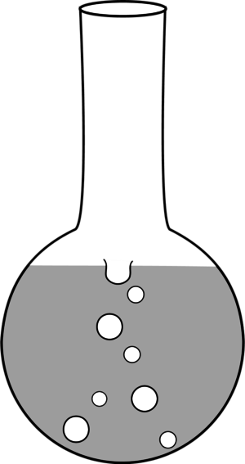
Cyathane Inspired Scaffold Synthesis in Flow
Ben Reinhardt¹, Alexis Courtney Young², Aaron B. Beeler²
¹St. John Fisher College ² Department of Chemistry Boston University
Abstract
Cyathane natural products were proven biologically relevant molecules as they stimulate the expression of NGF. As such some cyathanes are potential therapeutic agents for Alzheimer’s disease. A preliminary pharmacophore model was produced which consists of a simplified seven-six bicyclic molecular scaffold. A synthetic route could utilize the Buchner reaction, but until this time only unsubstituted, carbonyl stabilized diazo compounds have been used due to the explosive nature of other diazo species. Such a bicyclic compound would require further modification to remove the carbonyl functional group. Flow chemistry was utilized to overcome these restrictions with the Buchner Reaction. 1-(4-diazopentyl)-2-methoxybenzene was used as the model substrate, and numerous electronic and substitution analogs were synthesized to further expand the scope of the Buchner Reaction in flow. Optimizing the flow reaction to use unprotected hydrazine to form a free hydrazone intermediate in situ was also explored. The (5-(2-methoxyphenyl)pentan-2-yl) hydrazone was successfully formed, while further results are yet pending.
Explosive
Species explosive if handled in batch
Analog Synthetic Route
Electron-Donating Analogs
Table of Yields
R Group | Yield (%)
2,3-Ome | 88
2,4-OMe | 90
3,4-Dioxolane | 81
R Group | Yield (%)
2,3-Ome | 91
2,4-OMe | 97
3,4-Dioxolane | 90
R Group | Yield(%)
2,3-Ome | 74
2,4-Ome | 71
3,4-Dioxolane | 78
Para-OMe | 92
R Group | Yield (%)
2,3-Ome | 74
2,4-Ome | 20*
3,4-Dioxolane | 78
Para-OMe | 92

Slide 2
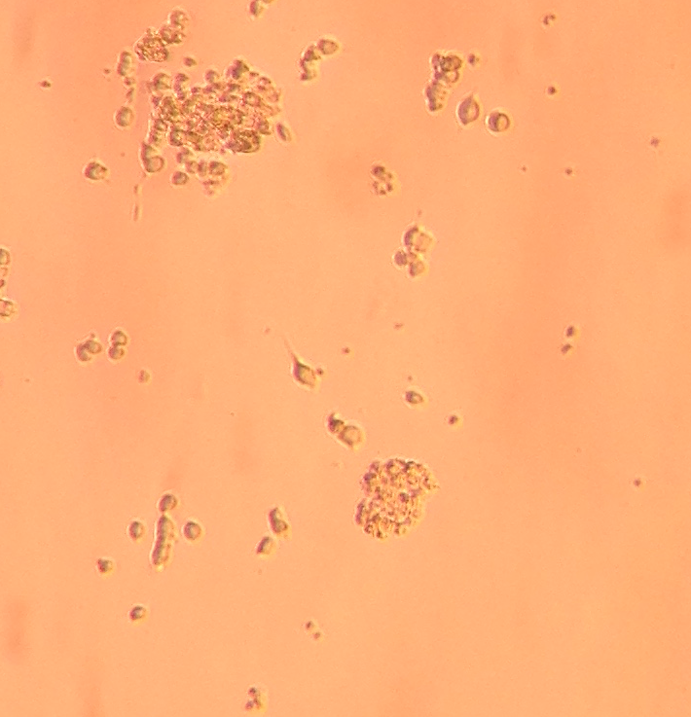

Cyathane Inspired Scaffold Synthesis in Flow
Ben Reinhardt¹, Alexis Courtney Young², Aaron B. Beeler²
¹St. John Fisher College ² Department of Chemistry Boston University
Buchner Reaction in Flow
Model Reaction in Flow
Ketone
Unprotected
Hydrazone
Reaction
Images
Conclusions
Future Work
4 of the analogs required hydrogenations, 3 of which required a Parr Shaker apparatus.
Only Preliminary results from Buchner reaction with Analogs, but the Para analog was most promising for Bicyclic formation
The unprotected hydrazone was formed in flow, but the complete Buchner reaction has yet to be completed without the use of a protecting group.
All analogs will undergo Buchner reaction, and effects of phenyl substitution on yields will be examined
In flow synthesis without the use of TBS protecting group will continue to be developed and tested for viability.
7,6 bicycle analogs will be tested on pheochromacytoma tissue (PC12) for NGF stimulation and subsequent neurite differentiation.
Neurite observed upon treatment with
7,6 bicycle. Biological Testing

Slide 3
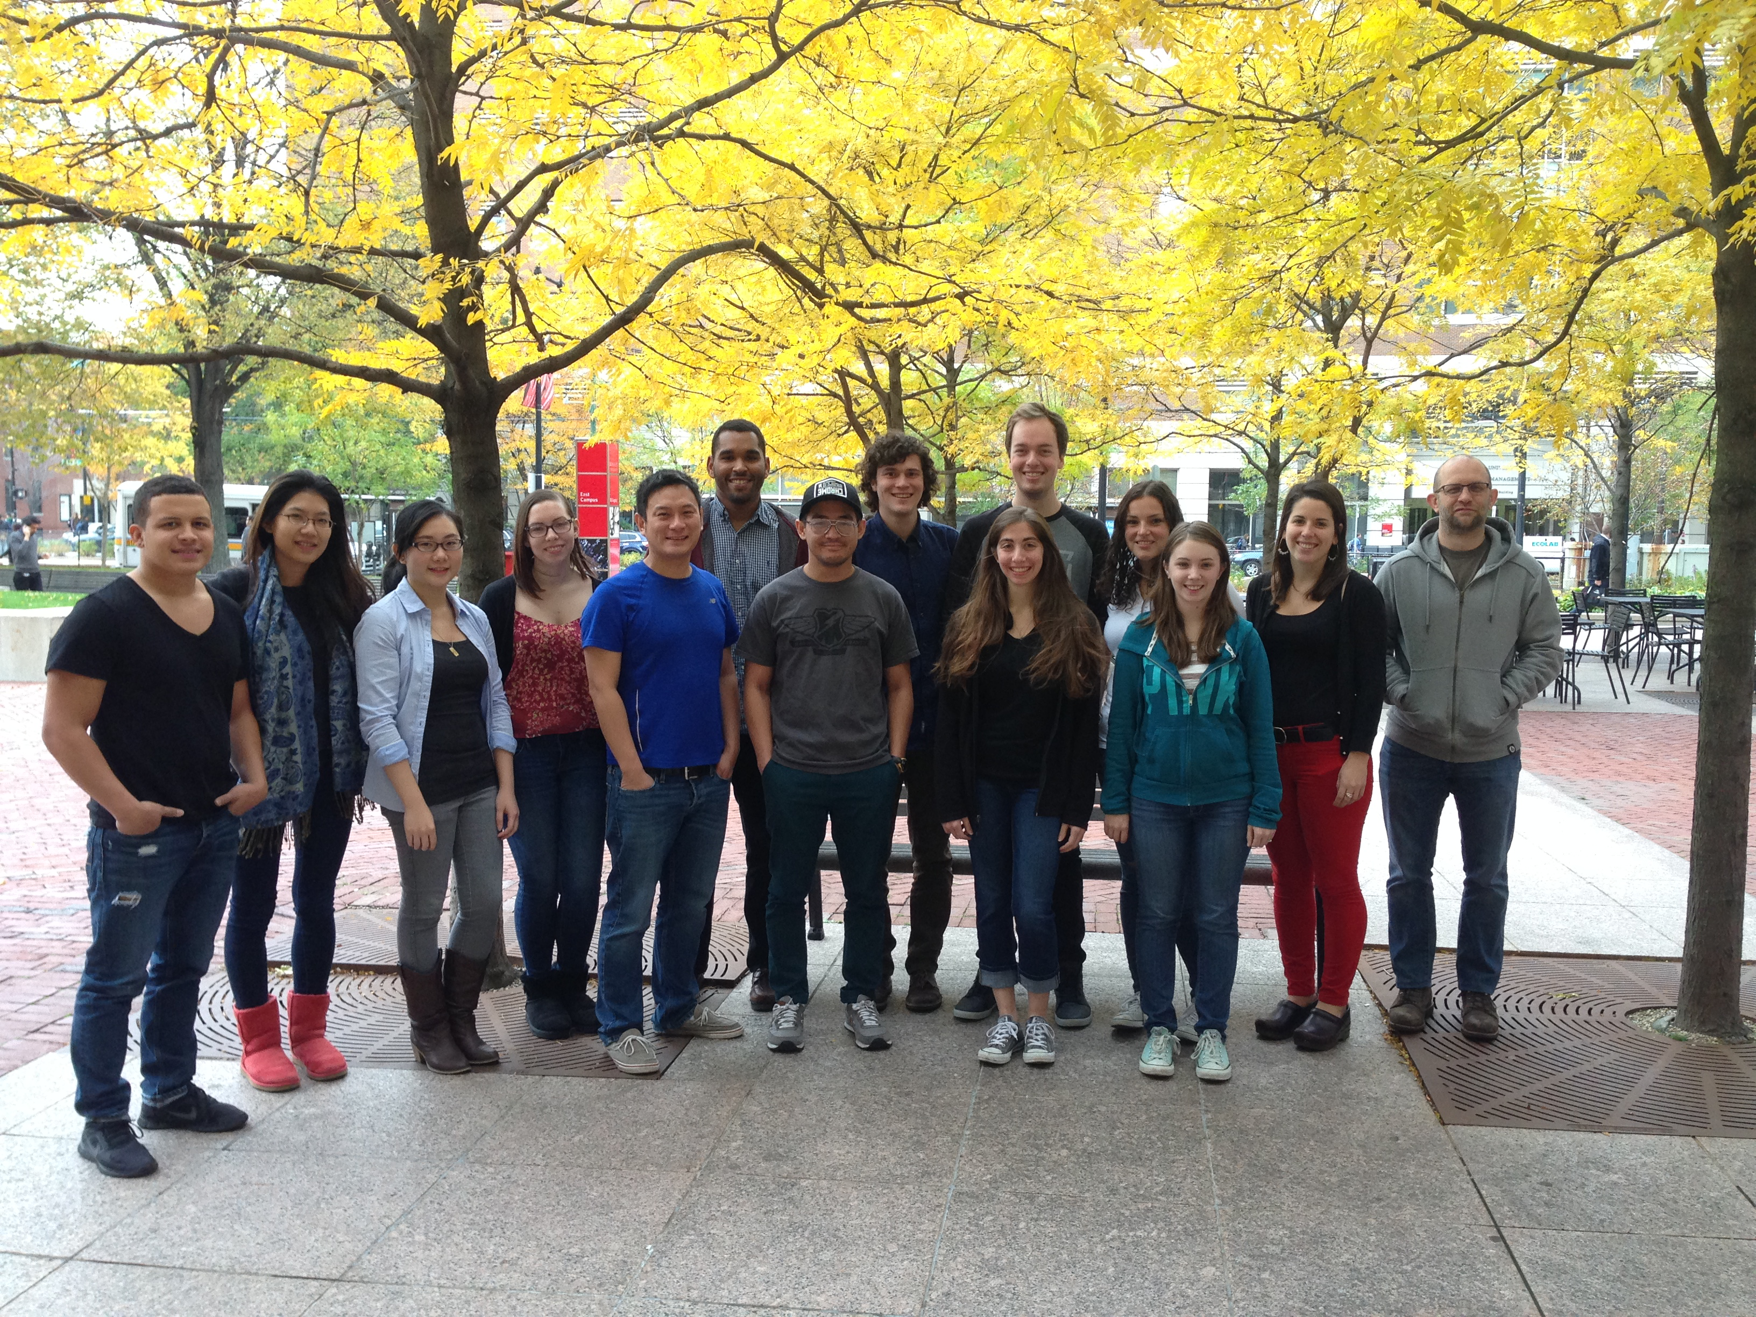
References
Life Sciences, 2007, 80, 1669-1677 Enguist, J. Stoltz, B. Nat. Prod. Rep., 2009, 26, 661-680; Aloe, L.; Rocco, M.; Biannchi, P.; Manni, L. J. Trans. Med., 2012, 10, 239;
Whitehead, C.; Wright, D. Org. Prep. Proced. Int., 2000, 32, 309-330; Weismann, C. Nature, 1999, 401, 184; Wender, P.; Verma, V.;
Paxton, T.; Pillow, T. Acc. Chem. Res., 2008, 41, 40-49; Burch, P.; Chicca, A.; Gertsch, J.;
Gademann, K. ACS Med. Chem. Lett., 2014, 5, 172-177; Kennedy, M. J. Chem. Soc., Perkin Trans. 1. 1990, 1047; Kennedy, M.;
McKervey, A. J. Chem. Soc. Perkin. Trans. 1, 1991, 2565; Cordi, A.; Lacoste, J.; Hennig, P. J. Chem. Soc., Perkin Trans. 1. 1993, 3.
Obara, Y.; Nakahata, N.; Kita, T.; Takaya, Y.; Ohizumi, Y. et al. Eur. J. Pharmacol., 1999, 370, 79-84; Obara, Y.

Slide 4
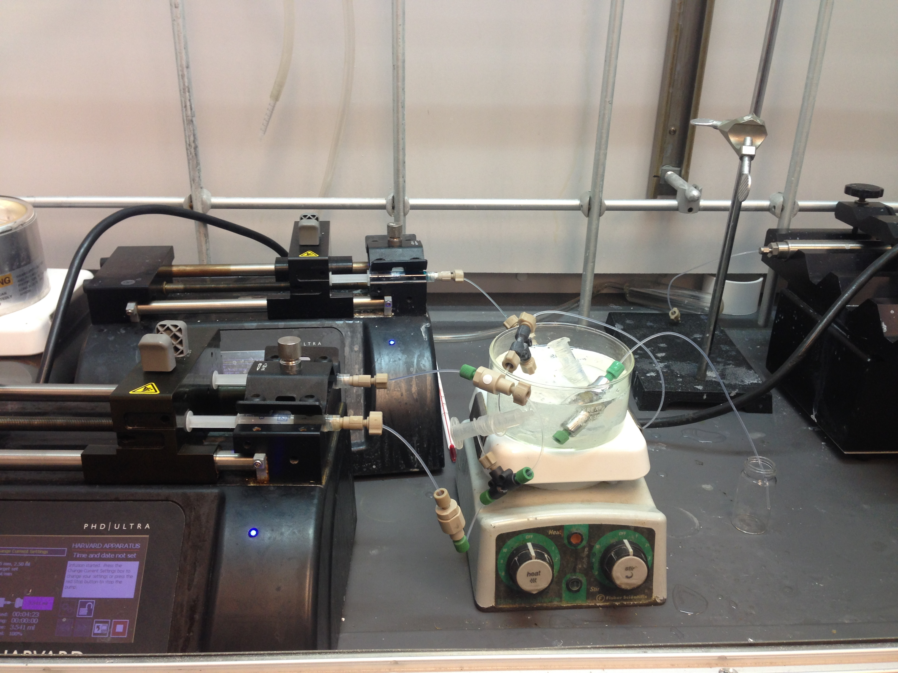
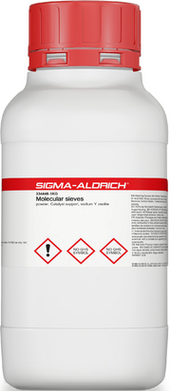
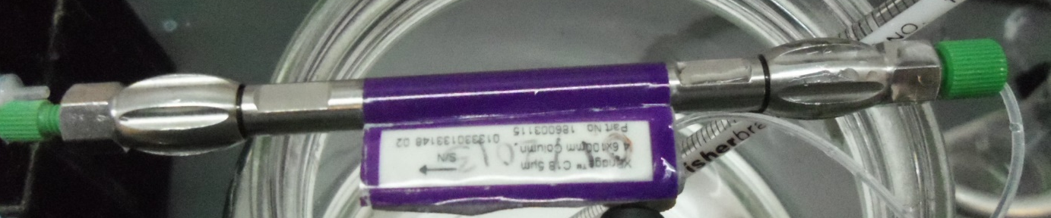
Return

Slide 5
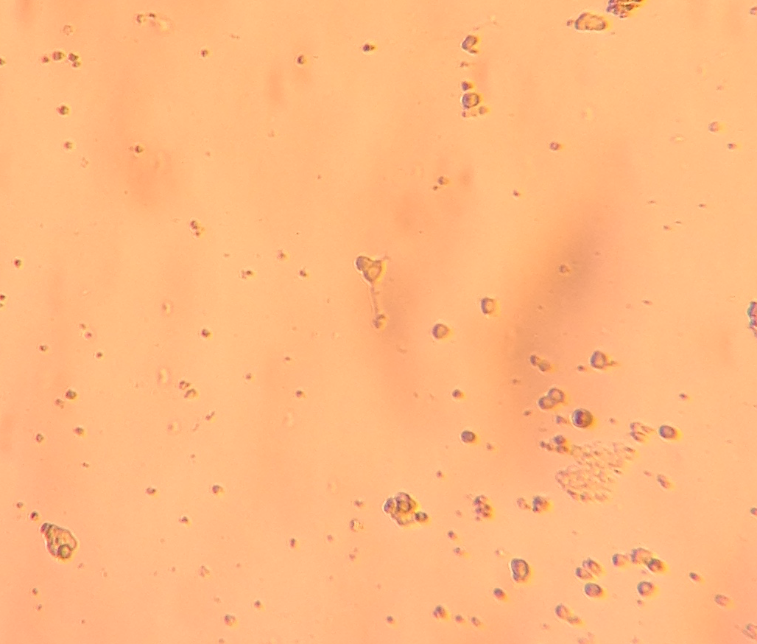
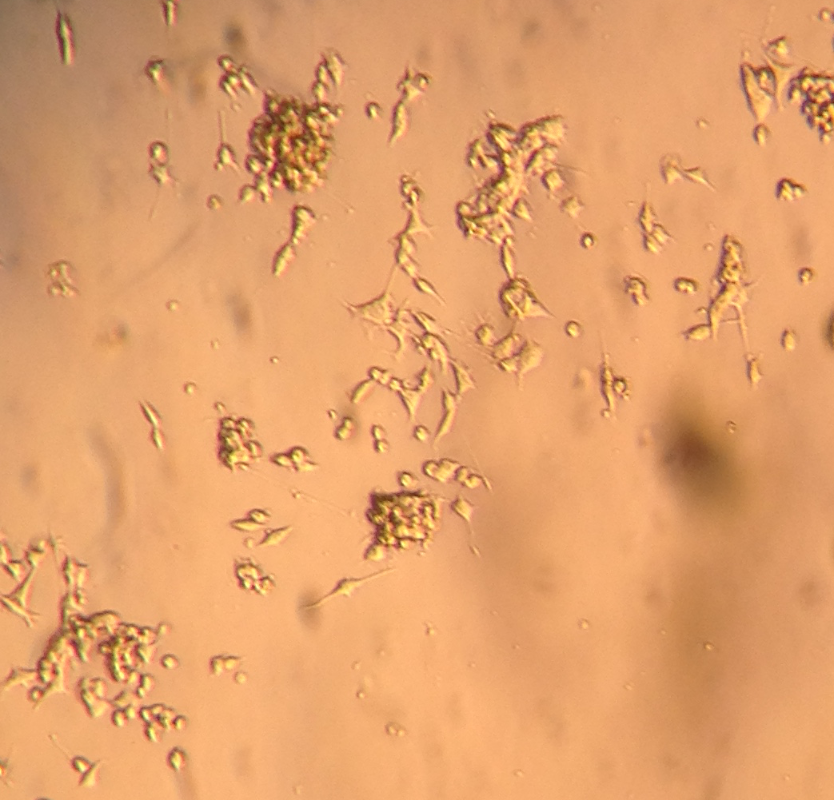
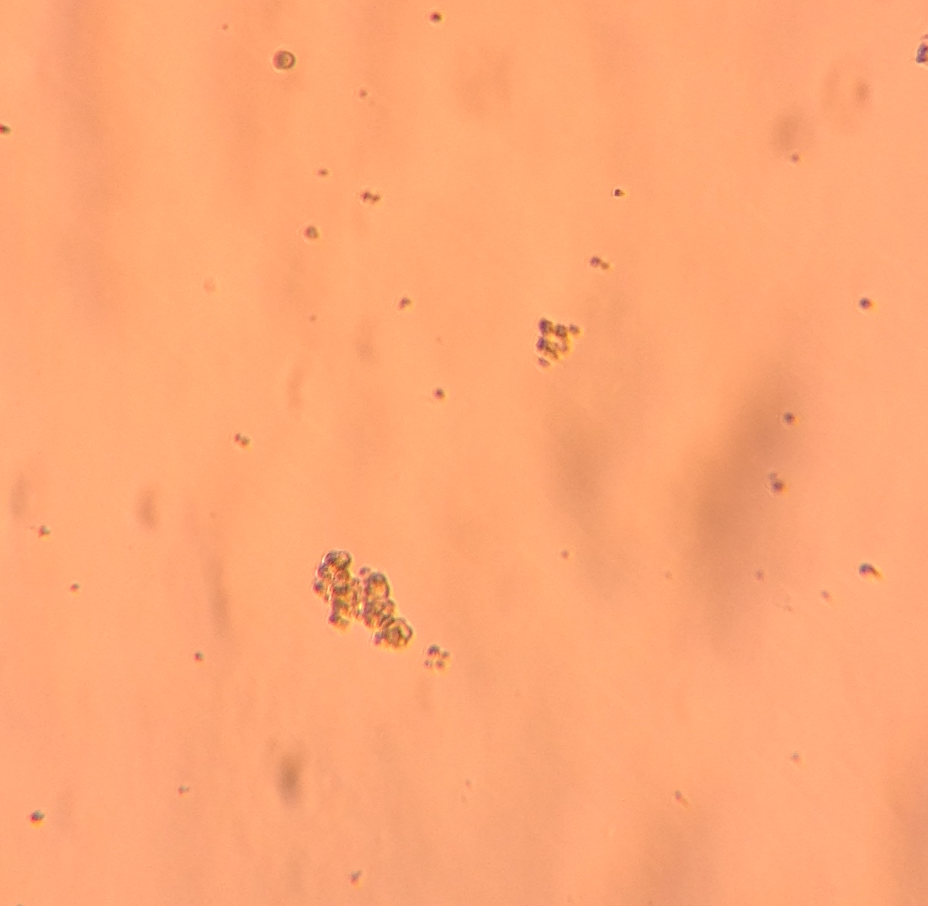
Future Biological Testing of Compound
Many synthetic chemistry labs outsource biological testing.
We test our own compounds using simple biological tests.
Rat pheochromocytoma (PC12) is used to test compounds
PC12 will be incubated with 7,6-bicycle and analogs
Efficacy of compounds evaluated by denrite differentiation and growth, NGF concentration, and RNA concentration
NGF concentration measured by commercially available Rat-NGF Elise kit
RNA will be converted to cDNA by Reverse Transcriptase, then amplified by PCR, and finally measured by gel-electrophoresis
NGF (+)
(-)
Return

Slide 6
Appendix I: Yields of Analog Synthesis in Tabular Format
Reagent | LAH Reduction | Yields (%) | TEMPO Oxidation | Yields (%) | Aldol | Yields (%) | Heck | Yields (%) | Wittig | Yields (%)
 | + | 88 | + | 91 | + | 74 |  | N/A |  | N/A
 | + | 90 | + | 97 | + | 71 |  | N/A |  | N/A
 | + | 81 | + | 90 | + | 78 |  | N/A |  | N/A
 |  | N/A |  | N/A |  | N/A | + | 81 | + | 90
 |  | N/A |  | N/A | + | 92 |  | N/A |  | N/A
Return

Slide 7
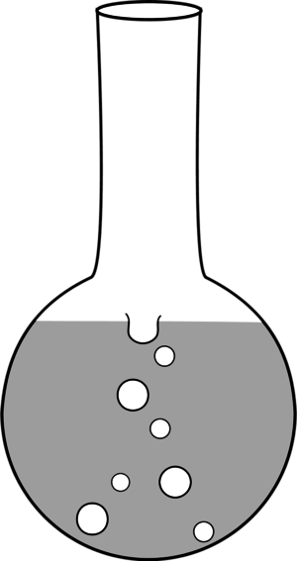
Cyathane Inspired Scaffold Synthesis in Flow
Ben Reinhardt¹, Alexis Courtney Young², Aaron B. Beeler²
¹St. John Fisher College ² Department of Chemistry Boston University
ABSTRACT
Cyathane natural products were proven biologically relevant molecules as they stimulate the expression of NGF. As such some cyathanes are potential therapeutic agents for Alzheimer’s disease. A preliminary pharmacophore model was produced which consists of a simplified seven-six bicyclic molecular scaffold. A synthetic route could utilize the Buchner reaction, but until this time only unsubstituted, carbonyl stabilized diazo compounds have been used due to the explosive nature of other diazo species. Such a bicyclic compound would require further modification to remove the carbonyl functional group. Flow chemistry was utilized to overcome these restrictions with the Buchner Reaction. 1-(4-diazopentyl)-2-methoxybenzene was used as the model substrate, and numerous electronic and substitution analogs were synthesized to further expand the scope of the Buchner Reaction in flow. Optimizing the flow reaction to use unprotected hydrazine to form a free hydrazone intermediate in situ was also explored. The (5-(2-methoxyphenyl)pentan-2-yl) hydrazone was successfully formed, while further results are yet pending.
Explosive
Species explosive if handled in batch
METHODS
Model Reaction in Flow
Unprotected Hydrazone Reaction
Images of Flow
TBS-Hydrazone
Ketone

Slide 8
RESULTS
Synthetic Route To Ketone Synthesis
Reagent | LAH Reduct. | Yields (%) | TEMPO Oxi. | Yields (%) | Aldol | Yields (%) | Heck | Yields (%) | Wittig | Yields (%)
 | + | 88 | + | 91 | + | 74 |  | N/A |  | N/A
 | + | 90 | + | 97 | + | 71 |  | N/A |  | N/A
 | + | 81 | + | 90 | + | 78 |  | N/A |  | N/A
 |  | N/A |  | N/A |  | N/A | + | 81 | + | 90
 |  | N/A |  | N/A | + | 92 |  | N/A |  | N/A
Results from Buchner Reactions
Appendix I: Yields in Schematic Format
Discussion
4 of the analogs required hydrogenations, 3 of which required a Parr Shaker apparatus.
Only Preliminary results from Buchner reaction with analogs, but para analog most promising for bicycle formation
The unprotected hydrazone was formed in flow, but the complete Buchner reaction has yet to be completed.
Future Work
All analogs will be reacted to form bicycle, and effects of phenyl substitution on yields will be examined
In flow synthesis without the use of TBS protecting group will continue to be developed and tested for viability.
7,6 bicycle analogs will be tested on pheochromacytoma tissue (PC12) for NGF stimulation and subsequent neurite differentiation.
REFERENCES
Enguist, J. Stoltz, B. Nat. Prod. Rep., 2009, 26, 661-680; Aloe, L.; Rocco, M.; Biannchi, P.; Manni, L. J. Trans. Med., 2012, 10, 239;
Whitehead, C.; Wright, D. Org. Prep. Proced. Int., 2000, 32, 309-330; Weismann, C. Nature, 1999, 401, 184; Wender, P.; Verma, V.;
Paxton, T.; Pillow, T. Acc. Chem. Res., 2008, 41, 40-49; Burch, P.; Chicca, A.; Gertsch, J.;
Gademann, K. ACS Med. Chem. Lett., 2014, 5, 172-177; Kennedy, M. J. Chem. Soc., Perkin Trans. 1. 1990, 1047; Kennedy, M.;
McKervey, A. J. Chem. Soc. Perkin. Trans. 1, 1991, 2565; Cordi, A.; Lacoste, J.; Hennig, P. J. Chem. Soc., Perkin Trans. 1. 1993, 3.
Obara, Y.; Nakahata, N.; Kita, T.; Takaya, Y.; Ohizumi, Y. et al. Eur. J. Pharmacol., 1999, 370, 79-84; Obara, Y. Life Sciences, 2007, 80, 1669-1677
Neurite differentiation observed upon treatment with
7,6 bicycle. Biological Testing

