Slide 1

INTERNATIONAL CUISINE BU LIBRARY RESOURCES

Slide 2
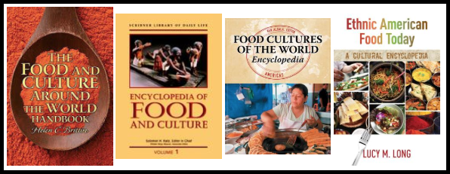
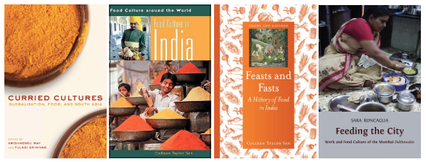
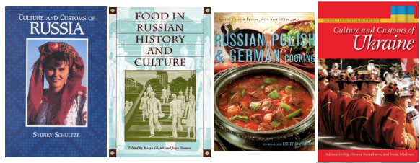
BOOKS

Slide 3
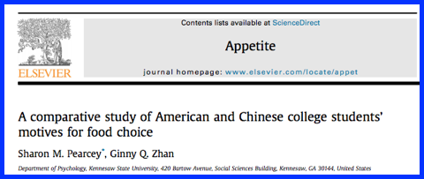

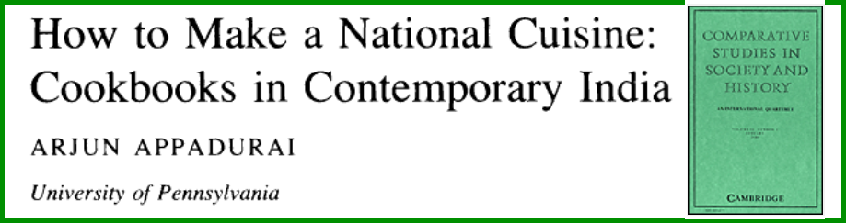
SCHOLARLY ARTICLES

Slide 4
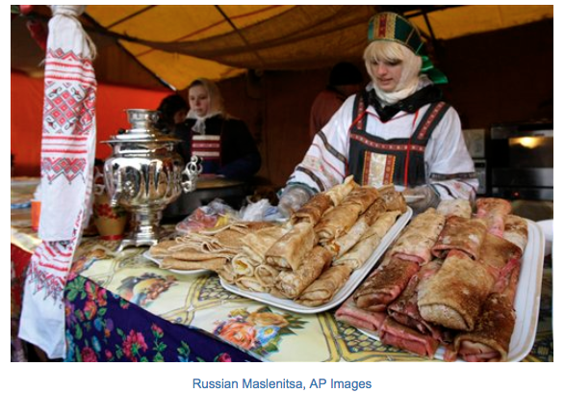
PHOTOS & VIDEOS

Slide 5

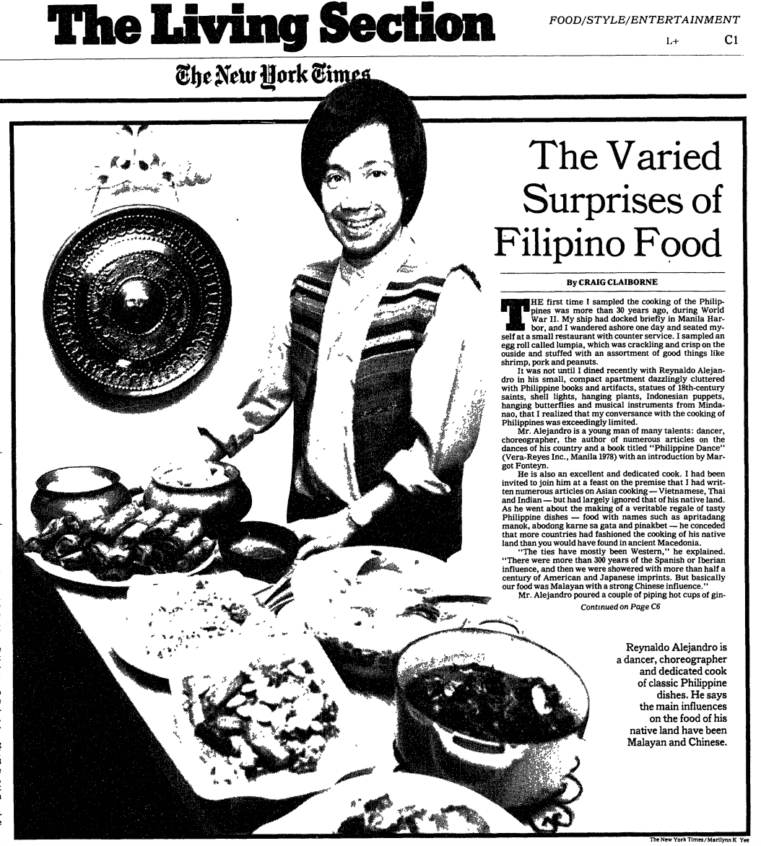
NEWSPAPERS &
MAGAZINES

Slide 6
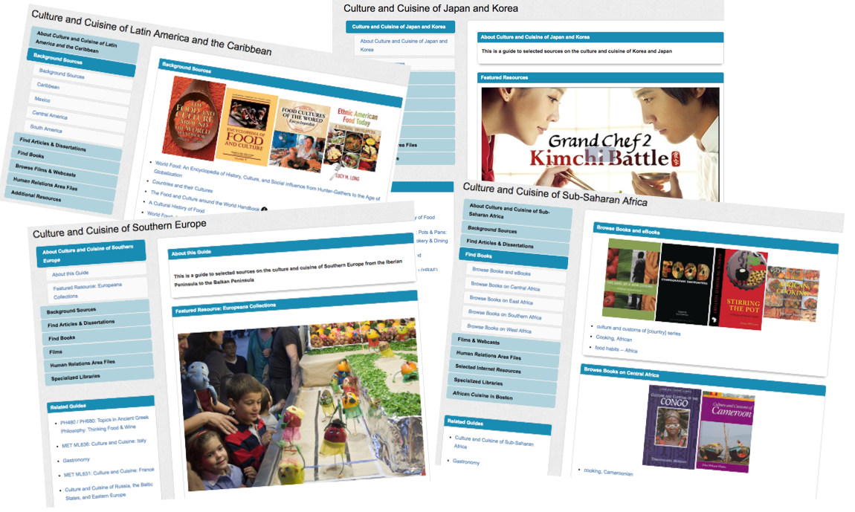
RESEARCH GUIDES

