Slide 1


CIDAR MoClo Labs
Synthetic Biology teaching labs
CIDAR Lab www.cidarlab.org

Slide 2
Background knowledge required
Basic understanding of DNA, proteins, expression, bacterial plasmids
LacZ blue/white selection method
Concept of restriction enzymes, ligase
Helpful but not required:
CIDAR MoClo: Improved MoClo Assembly Standard and New E. coli Part Library Enable Rapid Combinatorial Design for Synthetic and Traditional Biology – ACS Synthetic Biology (2015) http://pubs.acs.org/doi/abs/10.1021/acssynbio.5b00124
Various materials at www.cidarlab.org/moclo

Slide 3
Skills learned / used in this lab
Not taught directly in this module but needed for lab:
Pipetting
Measuring DNA concentration
Transformation and plating bacteria
Use of plate reader to measure concentrations
Taught in this lab
DNA engineering concept
Construction of plasmids using multipart DNA assembly standard
Building plasmid libraries
Analyze fluorescent data

Slide 4
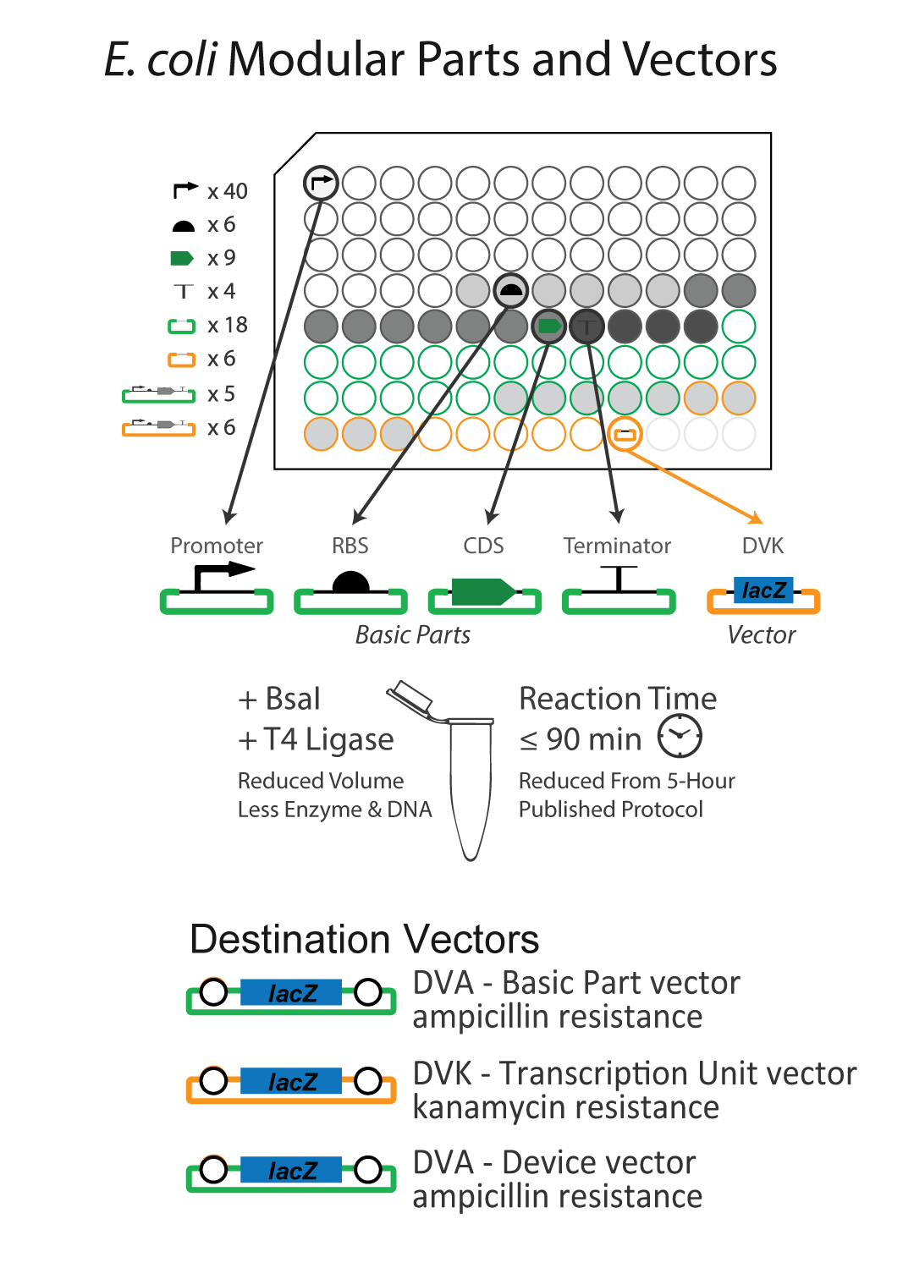
Plasmids needed - CIDAR MoClo Library (CML)
Plasmid Name (96-well Plate Location)
J23102_AB (CML-A5)
J23102_EB (CML-A6)
J23106_AB (CML-B1)
J23116_AB (CML-B9)
BCD2_BC (CML-D9)
E0040m_CD (CML-E5)
E1010m_CD (CML-E6)
eBFP2_CD (CML-E7)
B0015_DE (CML-E8)
B0015_DF (CML-E9)
DVA_AF (CML-F2)
DVK_AE (CML-H4)
DVK_EF (CML-H6)

Slide 5




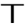
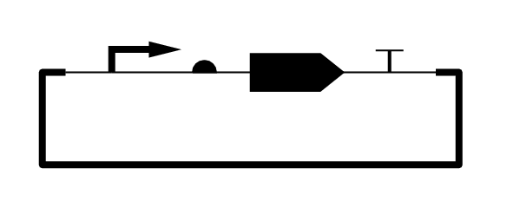
DNA as interchangeable parts
Promoter
Promoter
Coding sequence
Terminator
Ribosome binding site (RBS)
Ribosome binding site
Coding sequence (CDS)
Synthetic Biology Open Language
Terminator
Plasmid
Plasmid
http://sbolstandard.org/
Notes:
Show part types, symbols. Explain terminology.

Slide 6
CIDAR MoClo Assembly Standard
Traditional cloning methods take 6+ days to make a plasmid from 4 parts
MoClo can do this in a single reaction
MoClo is a Type IIS DNA assembly protocol
Type IIS restriction enzymes recognize non-palindromic sequences
Type IIS restriction enzymes cut outside their recognition sequence
The cut site can be any sequence, allowing for engineered ‘fusion sites’
MoClo uses defined fusion sites to assemble DNA in a modular fashion
Interchangeable parts
Assembly relies on fusion sites, 4 bps overhangs caused by Type IIS enzymes
Each part type is added in equimolar concentration
Each this makes parts interchangeable; any CDS can swapped for any other, for example
All promoters end in “B” site (‘ TACT’)
All RBS parts start with “B” and end with “C” (‘AATG’)
All CDS parts start with “C” and end with a “D” (‘AGGT’)
All terminator parts start with a “D” site (‘GCTT’)

Slide 7
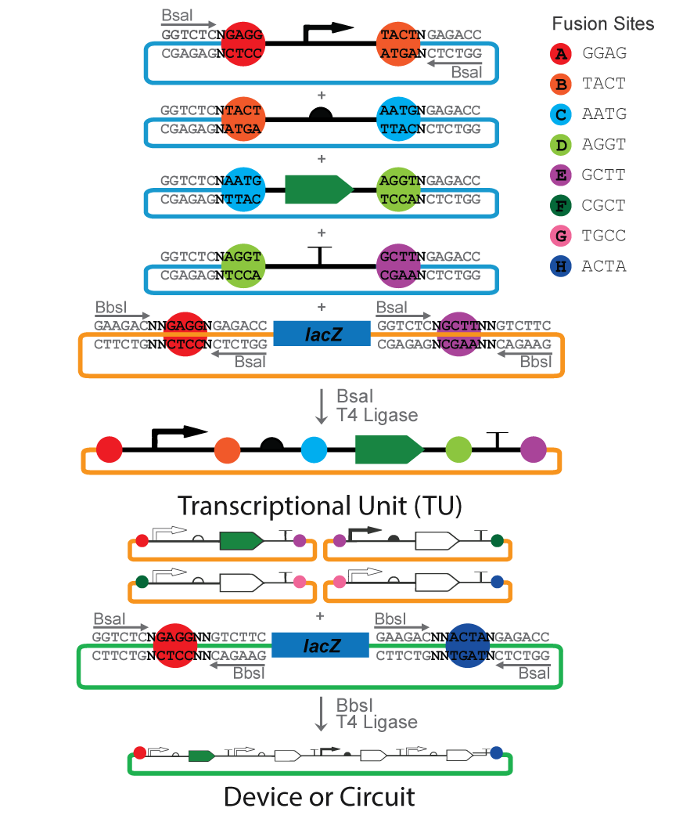
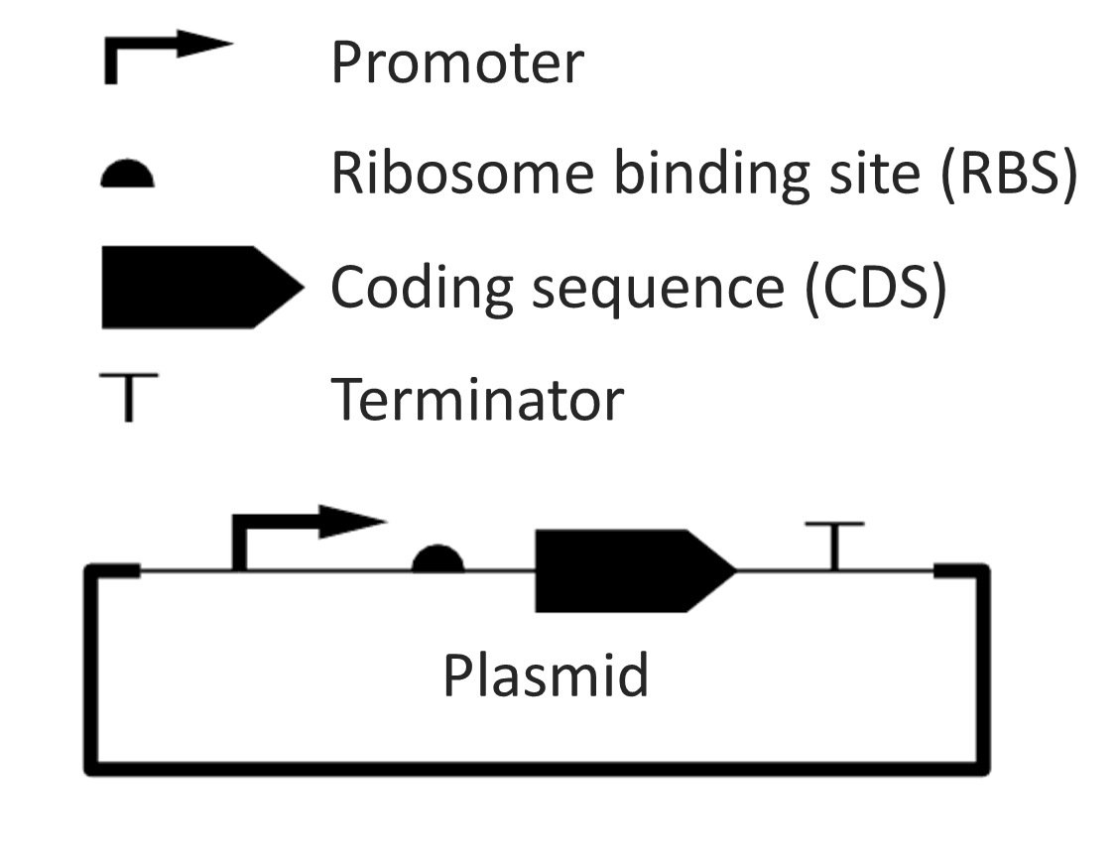
CIDAR MoClo Assembly Standard
/
Transcription Unit
“TU”
7
Notes:
Explain downfalls with 3Ab system (CAM and plasmid [], 3 Ab rotation unnecessary, more vectors required)

Slide 8
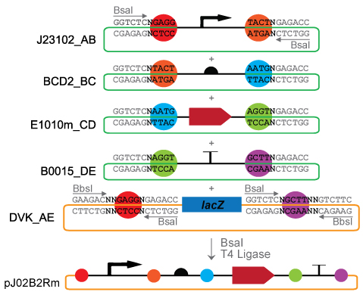
Lab 1 –Build a fluorescent reporter plasmid
Combine 4 MoClo parts in 1 destination vector (MC -1)
Promoter – J23102_AB
RBS – BCD_BC
CDS – E1010m_CD (Red Fluorescent Protein, RFP)
Terminator – B0015_DE
Vector – DVK_AE
Plate on LB + IPTG/X-gal, grow overnight
Count colonies, note colors
Calculate assembly efficiency
Notes:
Measure input plasmid concentrations
Use excel sheet to calculate volumes
Pipette carefully

Slide 9
Lab 1 – Calculation File
MC 1 - pJ02B2Rm_AE | FS | Sample | Location | Part Size | Vector Size | Conc (ng/ul) | Size (bp) | ng DNA (30 fmol) | uL to add
J23102_AB | AB | J23102 | CML-A5 | 35 | 2108 |  | 2143 | 42.43 | Input Conc
BCD2_BC | BC | BCD2 | CML-D9 | 88 | 2108 |  | 2196 | 43.48 | Input Conc
E1010m_CD | CD | E1010m | CML-E6 | 681 | 2108 |  | 2789 | 55.22 | Input Conc
B0015_DE | DE | B0015 | CML-E8 | 129 | 2108 |  | 2237 | 44.29 | Input Conc
DVK_AE | AE | DVK | CML-H4 | 496 | 2235 |  | 2731 | 54.07 | Input Conc
 |  |  |  |  |  | Other reagents | Stock Conc | Working Conc | uL to add
 |  |  |  |  |  | Ligase buffer | 10x | 1x | 2.00
 |  |  |  |  |  | T4 Ligase | 40 U/uL | 20 U/rxn | 0.50
 |  |  |  |  |  | BsaI | 5 U/uL | 10 U/rxn | 1.00
 |  |  |  |  |  | Water | -- | -- | 16.50
 |  |  |  |  |  |  |  | Total | 20.00
Note: “µL to add” will auto calculate in Excel when “Conc” is filled in.

Slide 10
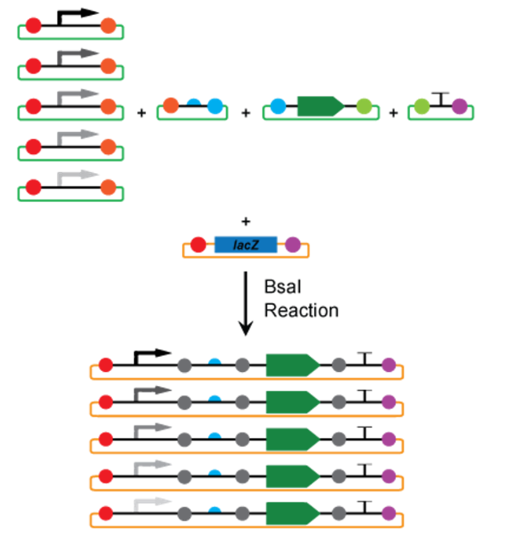
Lab 2 – Multiplex MoClo
MoClo parts are interchangeable
Multiple of the same part type can be added to a reaction to create multiple plasmids at once
Combine parts as described in the calculations sheet
MMC 1 – pJ02B2X_EF
MMC 2 – pJXB2Rm_AE
MMC 3 – pJXB2X_AE
“X” indicates a multiplexed part. Pay attention to the fusion sites.
Select colonies and measure fluorescence and OD using a plate reader
Analyze data, describe different populations, calculate efficiencies and assembly ratios.
Can you identify groups with similar amounts of fluorescence?
Notes:

Slide 11
Lab 2 – Calculation Files
MMC1 - pJ02B2X_EF | FS | Sample | Location | Part Size | Vector Size | Conc (ng/ul) | Size (bp) | ng DNA (30 fmol) | uL to add
J23102_EB | EB | 23102 | CML-A6 | 35 | 2108 |  | 2143 | 42.43 | Input Conc
BCD2_BC | BC | CD2 | CML-D9 | 88 | 2108 |  | 2196 | 43.48 | Input Conc
eBFP2_CD | CD | BFP2 | CML-E7 | 792 | 2108 |  | 2900 | 19.14 | Input Conc
E0040m_CD | CD | 0040m | CML-E5 | 720 | 2108 |  | 2828 | 18.66 | Input Conc
E1010m_CD | CD | E1010m | CML-E6 | 681 | 2108 |  | 2789 | 18.41 | Input Conc
B0015_DF | DF | B0015 | CML-E9 | 129 | 2108 |  | 2237 | 44.29 | Input Conc
DVK_EF | EF | DVK | CML-H6 | 496 | 2235 |  | 2731 | 54.07 | Input Conc
 |  |  |  |  |  | Other reagents | Stock Conc | Working Conc | uL to add
 |  |  |  |  |  | Ligase buffer | 10x | 1x | 2.00
 |  |  |  |  |  | T4 Ligase | 40 U/uL | 20 U/rxn | 0.50
 |  |  |  |  |  | BsaI | 5 U/uL | 10 U/rxn | 1.00
 |  |  |  |  |  | Water | -- | -- | 16.50
 |  |  |  |  |  |  |  | Total | 20.00
MMC2 - pJXB2Rm_AE | FS | Sample | Location | Part Size | Vector Size | Conc (ng/ul) | Size (bp) | ng DNA (30 fmol) | uL to add
J23102_AB | AB | J23102 | CML-A5 | 35 | 2108 |  | 2143 | 14.14 | Input Conc
J23106_AB | AB | J23106 | CML-B1 | 35 | 2108 |  | 2143 | 14.14 | Input Conc
J23116_AB | AB | J23116 | CML-B9 | 35 | 2108 |  | 2143 | 14.14 | Input Conc
BCD2_BC | BC | BCD2 | CML-D9 | 88 | 2108 |  | 2196 | 43.48 | Input Conc
E1010m_CD | CD | E1010m | CML-E6 | 681 | 2108 |  | 2789 | 55.22 | Input Conc
B0015_DE | DE | B0015 | CML-E8 | 129 | 2108 |  | 2237 | 44.29 | Input Conc
DVK_AE | AE | DVK | CML-H4 | 496 | 2235 |  | 2731 | 54.07 | Input Conc
 |  |  |  |  |  | Other reagents | Stock Conc | Working Conc | uL to add
 |  |  |  |  |  | Ligase buffer | 10x | 1x | 2.00
 |  |  |  |  |  | T4 Ligase | 40 U/uL | 20 U/rxn | 0.50
 |  |  |  |  |  | BsaI | 5 U/uL | 10 U/rxn | 1.00
 |  |  |  |  |  | Water | -- | -- | 16.50
 |  |  |  |  |  |  |  | Total | 20.00
Note: “µL to add” will auto calculate in Excel when “Conc” is filled in.

Slide 12
Lab 2 – Calculation Files
MMC3 - pJXB2X_AE | FS | Sample | Location | Part Size | Vector Size | Conc (ng/ul) | Size (bp) | ng DNA (30 fmol) | uL to add
J23102_AB | AB | J23102 | CML-A5 | 35 | 2108 |  | 2143 | 14.14 | Input Conc
J23106_AB | AB | J23106 | CML-B1 | 35 | 2108 |  | 2143 | 14.14 | Input Conc
J23116_AB | AB | J23116 | CML-B9 | 35 | 2108 |  | 2143 | 14.14 | Input Conc
BCD2_BC | BC | BCD2 | CML-D9 | 88 | 2108 |  | 2196 | 43.48 | Input Conc
eBFP2_CD | CD | eBFP2 | CML-E7 | 792 | 2108 |  | 2900 | 19.14 | Input Conc
E0040m_CD | CD | E0040m | CML-E5 | 720 | 2108 |  | 2828 | 18.66 | Input Conc
E1010m_CD | CD | E1010m | CML-E6 | 681 | 2108 |  | 2789 | 18.41 | Input Conc
B0015_DE | DE | B0015 | CML-E8 | 129 | 2108 |  | 2237 | 44.29 | Input Conc
DVK_AE | AE | DVK | CML-H4 | 496 | 2235 |  | 2731 | 54.07 | Input Conc
 |  |  |  |  |  | Other reagents | Stock Conc | Working Conc | uL to add
 |  |  |  |  |  | Ligase buffer | 10x | 1x | 2.00
 |  |  |  |  |  | T4 Ligase | 40 U/uL | 20 U/rxn | 0.50
 |  |  |  |  |  | BsaI | 5 U/uL | 10 U/rxn | 1.00
 |  |  |  |  |  | Water | -- | -- | 16.50
 |  |  |  |  |  |  |  | Total | 20.00
Note: “µL to add” will auto calculate in Excel when “Conc” is filled in.

Slide 13
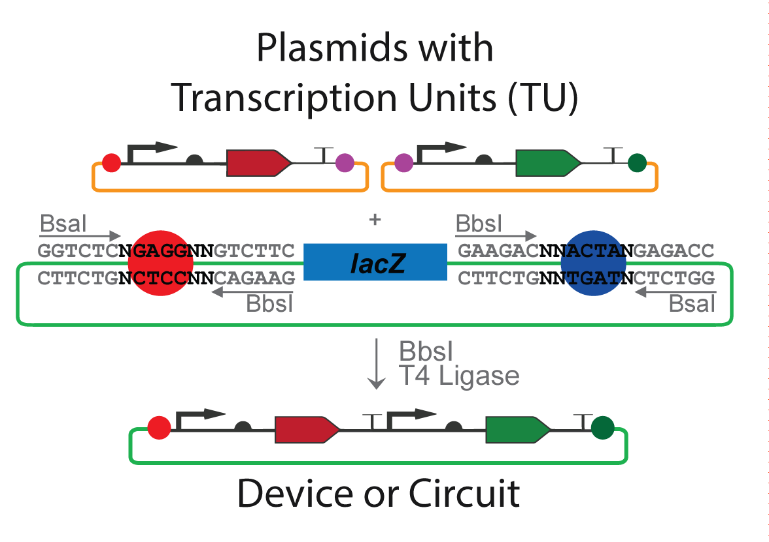
Lab 3 – Create a multipart device
Combine 2 ‘Transcription Units’
A strongly red pJXB2Rm_AE from MMC 2
A strongly green pJXB2X_EF from MMC 1
Vector – DVA_AF
Notes:
Measure concentrations
Use excel sheet to calculate volumes
Pipette carefully
Measure expression on a plate reader. Compare to the expression of each individual transcription unit from Lab 2.
Alternately, make multiple ‘Devices’ using different plasmids from the MMC reactions to visualize the various expression combinations possible.

Slide 14
Lab 3 – Calculation File
MC 2 - pJ02B2Rm:J02B2Gm_AF | FS | Sample | Location | Part Size | Vector Size | Conc (ng/ul) | Size (bp) | ng DNA (30 fmol) | uL to add
pJ02B2Rm_AE | AE | pJ02B2Rm | CML-H2 | 941 | 2235 |  | 3176 | 62.88 | Input Conc
pJ02B2Gm_EF | EF | pJ02B2Gm | CML-H1 | 984 | 2235 |  | 3219 | 63.74 | Input Conc
DVA_AF | AF | DVA | CML-F2 | 498 | 2108 |  | 2606 | 51.60 | Input Conc
 |  |  |  |  |  | Other reagents | Stock Conc | Working Conc | uL to add
 |  |  |  |  |  | Ligase buffer | 10x | 1x | 2.00
 |  |  |  |  |  | T4 Ligase | 40 U/uL | 20 U/rxn | 0.50
 |  |  |  |  |  | BbsI | 5 U/uL | 10 U/rxn | 1.00
 |  |  |  |  |  | Water | -- | -- | 16.50
 |  |  |  |  |  |  |  | Total | 20.00
Note: “µL to add” will auto calculate in Excel when “Conc” is filled in.

Slide 15
Additional information
The following slides contain pictures and information which may be useful.

Slide 16
Known troubleshooting
Minipreps must be high quality (clean prep, correct plasmid)
Inaccurate measuring/pipetting results in low efficiency cloning
If few colonies arise, white colonies are likely artifacts (incorrect clones)
With poor quality reactions (bad preps, wrong preps, part missing from reaction) partially assembled plasmids result in which the LacZ has been removed but none or only some of the parts have been inserted.
Plates with mostly or all blue colonies indicate a failed reaction.
Restriction enzyme may have been incorrect or forgotten.
Too much ligase may inhibit rearrangement of parts
Lots of white and blue: Too much Destination Vector added to reaction.
NOTE: Always plate controls to aid in troubleshooting
Plate excess competent cells on antibiotic media as negative control

Slide 17
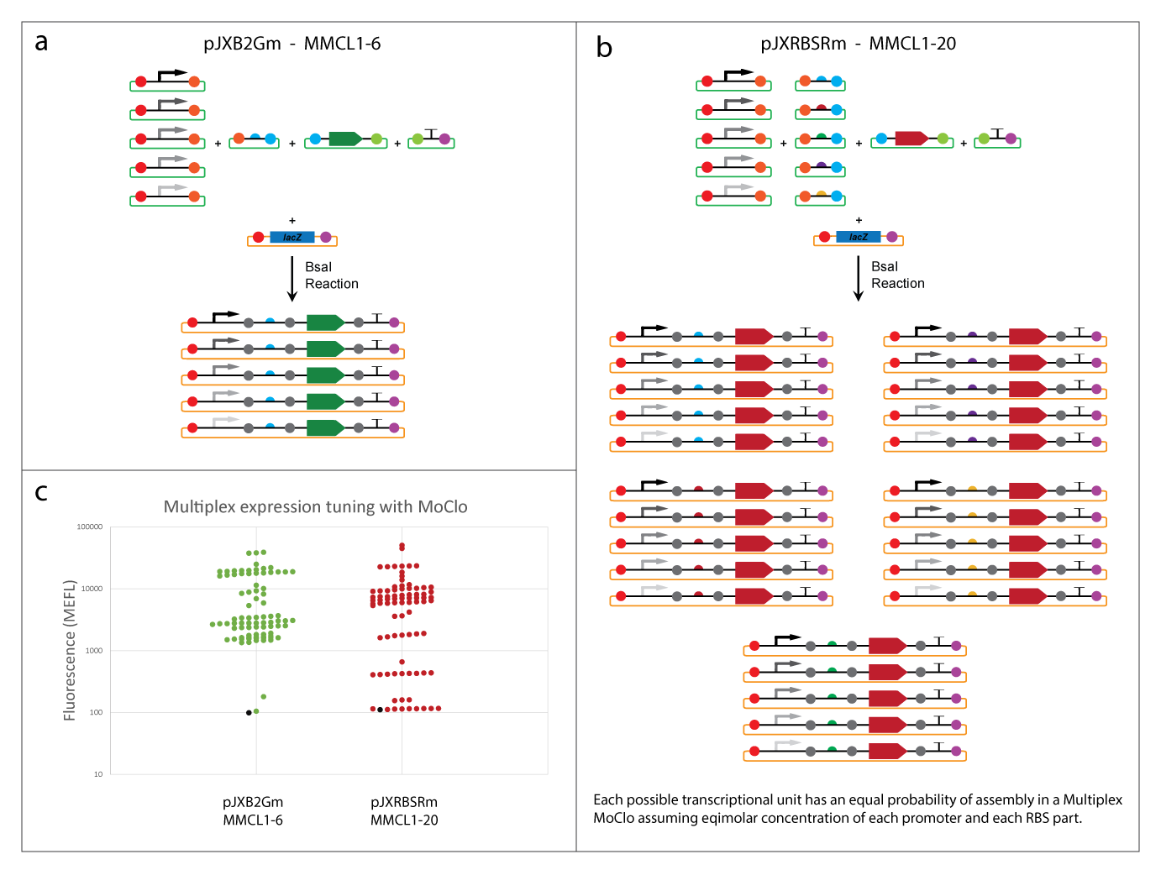
Combinatorial assembly with multiplex MoClo
Create a library in a single tube
Transcription factor / binding site characterization
Mutant library screening
Expression tuning of genetic devices
Multiplex basic parts = TU library
Multiplex TUs = Device library
Notes:
Concept. Use animations. Explain benefits in building libraries, etc. Animate that? Show data from MMC figure?

Slide 18
Promoters & RBS parts in CIDAR MoClo Library

Slide 19
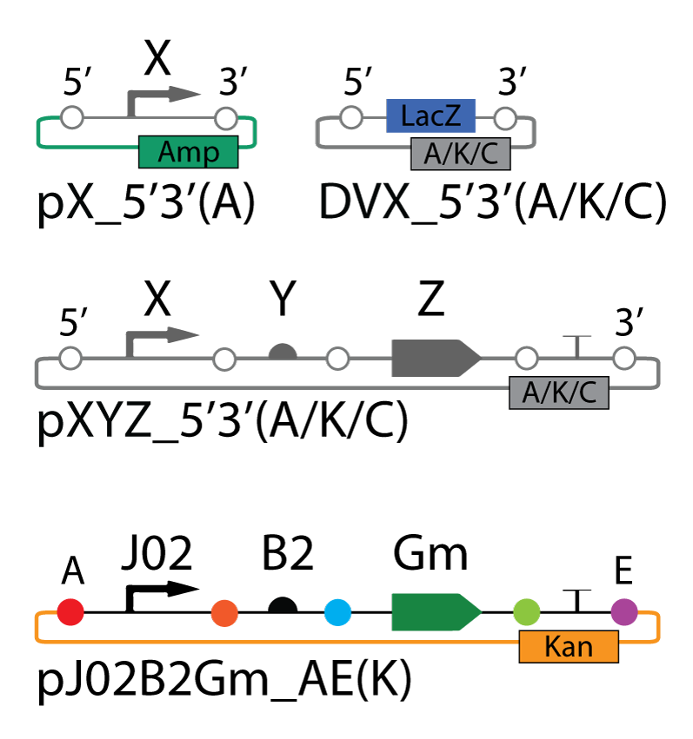
Plasmid nomenclature
Naming convention for all CIDAR MoClo plasmids
Unique ID
Descriptive

