Slide 1


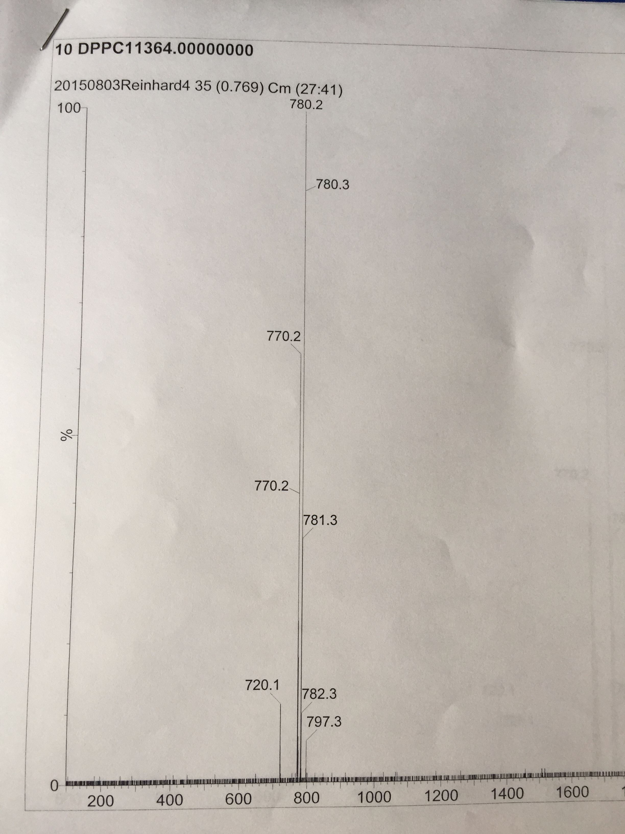

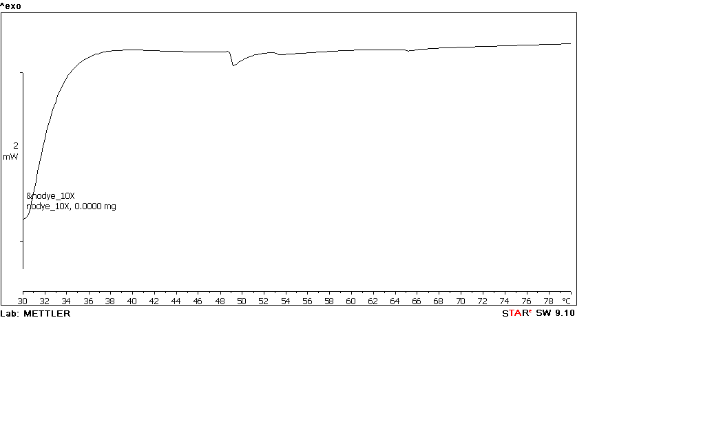
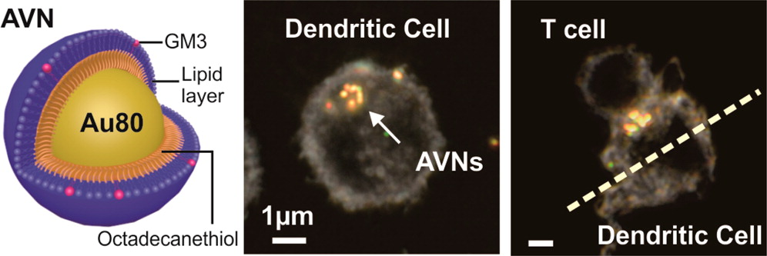
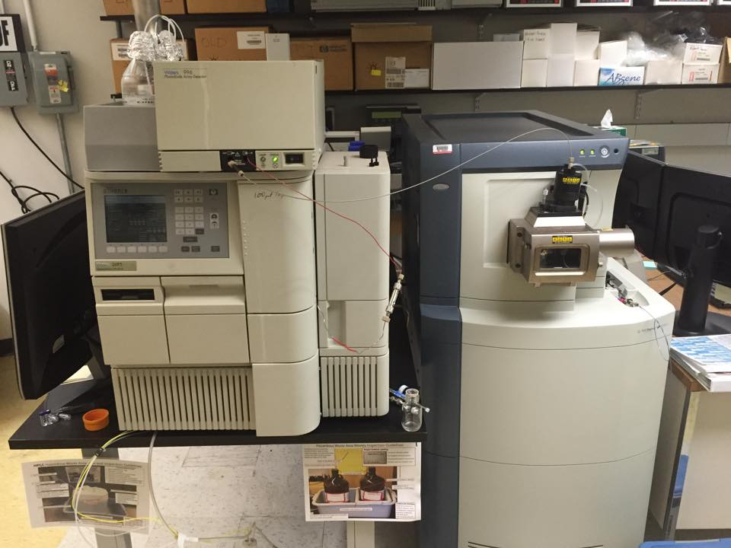


Quantifying extracted lipid membrane composition of Gold Nanoparticles
Julie Phanord¹, Fangda Xu², Bjoern REINHARD²
Chemistry Department, Boston University², Boston MA
ABSTRACT
RESULTS
Gold Nanoparticles(Au NPs) have been the object of profound studies regarding their distinctive physical and biological properties, as well as their promising applications as drug carriers in the field of bio-medical engineering. Lipid wrapped Au NPs are emerging up as a novel bio-medical tool in the field of bio-imaging and target-delivery due to their enhanced bio-compatibility and extended lipid based bio-functions. Interestingly, the lipid membrane behavior supported by the surface of Au NPs could substantially differ from its precursor, liposomes, in which lipid membrane can flow in a relatively free fashion . This research aims to characterize and validate such difference and explore the intrinsic reasons behind such difference, such as lipids content variation before and after wrapping. In this research, lipid membrane behavior was mostly focused on the phase transition of lipid membrane. Differential Scanning Calorimetry (DSC) strategy was taken to quantify such potential phase transition of lipid membrane in the free liposomes and on the surface of Au NPs. In addition to the DSC method, a High Performance Liquid Chromatography Mass-spec method was developed as well to quantify the potential lipids content variation before and after lipid membrane wrapping.
MASS- SPEC
DSC
GOLD NANOPARTICLES AND MEMBRANE COMPOSITION
5 mM DOPS ------ 1%
1,2-dioleoyl-sn-glycero-3-phospho-L-serine (sodium salt)
10 mM DPPC ------- 51%
1,2-dipalmitoyl-sn-glycero-3-phosphocholine
10 mM Cholesterol – 40 %
PC Dye---- 8%
Fig1. Sample of 10mM DPPC; peaks of different molecular weight were detected
Fig2. Sample of liposomes showing a transition at 49°C, close to that of DPPC 41°C, the primary constituent of the lipid membrane.
METHODS: HPLC-MS
CONCLUSION
AKNOWLEDGEMENTS
Samples are forced by a solvent (mobile phase) through a column containing a stationary phase in which molecules are fragmented and brought to the mass detector, leading to the removal of the solvent followed by the ionization of the fragments. The ions are carried through a vacuum and scanned by mass by a detector, recording a spectrum on a monitor for each sample.
Fig1.
-Molecular weight detected is greater than expected: 780 > 733 (DPPC MW)
-Possible presence of other compounds in samples which might be the peaks we are seeing in the chromatogram.
Fig2.
-If a phase transition happens at 49°C, then human body temperature 37°C may not be a potential cause of variations of lipid content in the AuNPs membrane.
National Science Foundation and BU Photonics Center

Slide 2

EPOSTERBOARDS TEMPLATE
LC-MS METHOD
CONCLUSIONS
REFERENCES

