Slide 1
Dimensions & Pivot
Finding Collaborators, Identifying Funding
Ellen Phillips
Open Access Specialist
Boston University Libraries
ephillip@bu.edu
October 25, 2018
https://goo.gl/guLvA6
Notes:
This presentation is about the two databases Dimensions and Pivot. Dimensions has a lot of published content, in addition to articles, monographs and book chapters, there are also policy papers and patent publications. Pivot is a rich source of grant data and can give detailed profiles for research organizations and for funders. It also has lists of invited papers. Both of them are excellent resources for you to use to find collaborators, sources of funding, and can help you find places to publish your work.
First we’re going to talk a little bit about them, then we will compare and contrast the different features of each.
After we run through an overview, we’re going to do some hands-on activities in Dimensions.

Slide 2


Dimensions Relies on Machine Learning
“[Dimensions] combines advanced concept extraction, natural language processing, categorization and complex machine learning....”
Notes:
How does Dimensions work?
Uses existing classification systems, openly available content, and an AI/machine learning based approach.
This is used to automatically assign a consistent set of categories to all documents - regardless of the source.
Then, using a reverse-engineering technique, based on machine learning, a corpus of manually-coded content are examined and the manually-applied codes are reproduced by the algorithm. This is then checked against actual codes, and the algorithm is iterated.
Source: Dimensions (2018): A Guide to the Dimensions Data Approach. figshare. Paper.
https://doi.org/10.6084/m9.figshare.5783094.v5

Slide 3

A Curated Approach
“Pivot’s expert editors continuously update an authoritative list of keywords that are carefully matched to each Pivot funding opportunity.”
Notes:
How does Pivot work?
The resources in Pivot are selected by an editorial staff.

Slide 4

Publications (Dimensions)
84+ million articles & books indexed
View abstracts
Find @BU (full text via the Library)
Journal Lists
Utilizes Multiple Classification Schemes
Notes:
In the next few slides, we will go over the respective features of each database.
Dimensions has a lot of publication data from many sources, including openly-available databases together with those with permissive content licenses, such as PubMed, PubMed Central,ArXiv and CrossRef. Majority of records are from CrossRef.
There are four classification schemes used in Dimensions:
ANZSRC and FOR (Fields of Research) (Australia/New Zealand)
RCDC (The Research, Condition, and Disease Categorization) used by NIH to report to congress.
HRCS (The Health Research Classification System) UK-based system. There are two strands to HRCS – Research Activity Codes (RAC) and Health Categories (HC).
Other schema can be implemented, most likely as a customization.
Development partners that are helping to create one unified proprietary classification scheme.

Slide 5
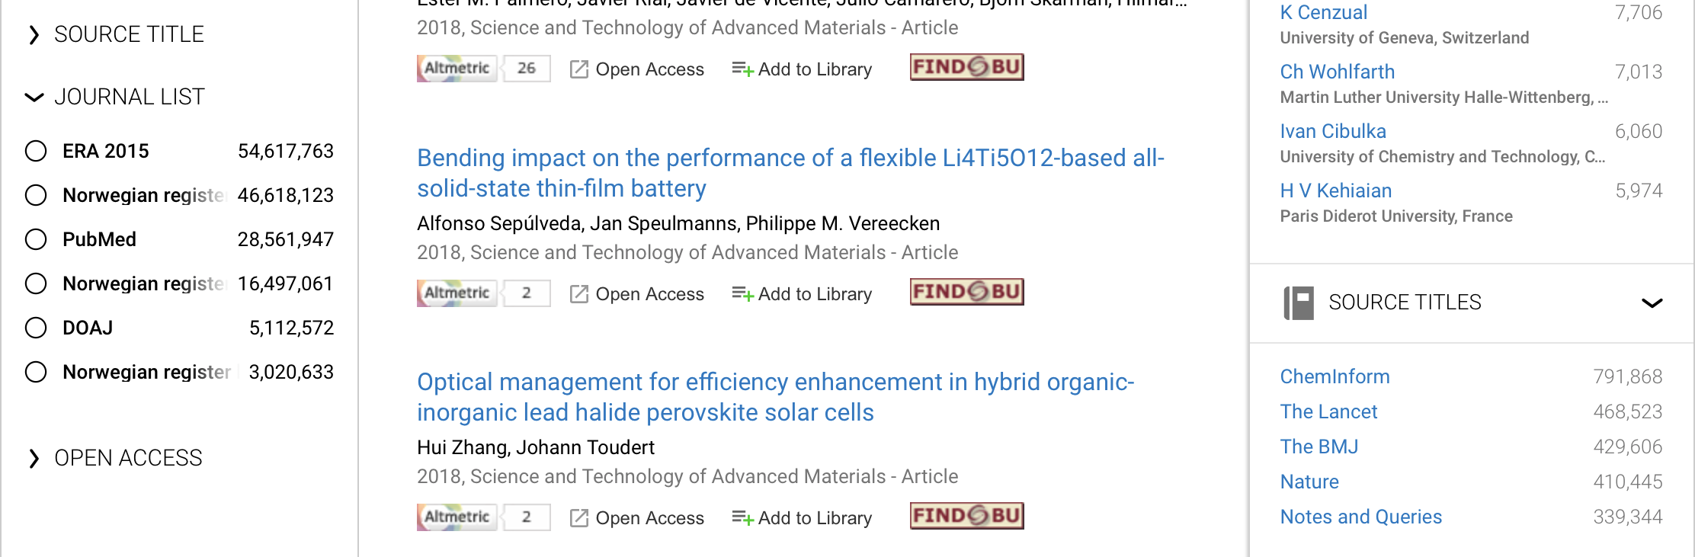
Use Dimensions to Find a Journal to Publish in
Select a journal from the list.
Click on individual titles, then Analytic View to see statistics about a publication.
Notes:
Journal lists
ERA (Excellence in Research for Australia) list:The ERA 2015 journal list was designed by the Australian Research Council (ARC).
All included journals had to meet the criteria of being academic/scholarly and publish publish original peer reviewed research. The ERA 2015 journal list includes over 16k journal titles.
Norwegian register, officially the ‘Norwegian Register for Scientific Journals, Series and Publishers’ is operated jointly by the Norwegian Centre for Research Data (NSD) and the National Board of Scholarly Publishing (NPU)
Norwegian register divides journals and series considered to meet scientific quality criteria into Level 1 and Level 2, where Level 2 is superior than Level 1. These scientific quality criteria include a valid ISSN, a scientific editorial board, and a peer-review process. Source titles which do not meet these criteria are identified as Level 0.
PubMed. These mainly come from MEDLINE
The PubMed filter in Dimensions filters to only publications which have a PubMed identifier (PMID), as used in PubMed.
DOAJ (Directory of Open Access Journals).
Community-curated online directory that indexes high quality, open access, peer-reviewed journals. The DOAJ journal list includes over 10k journal titles covering all areas of science, technology, medicine, social science and humanities.

Slide 6
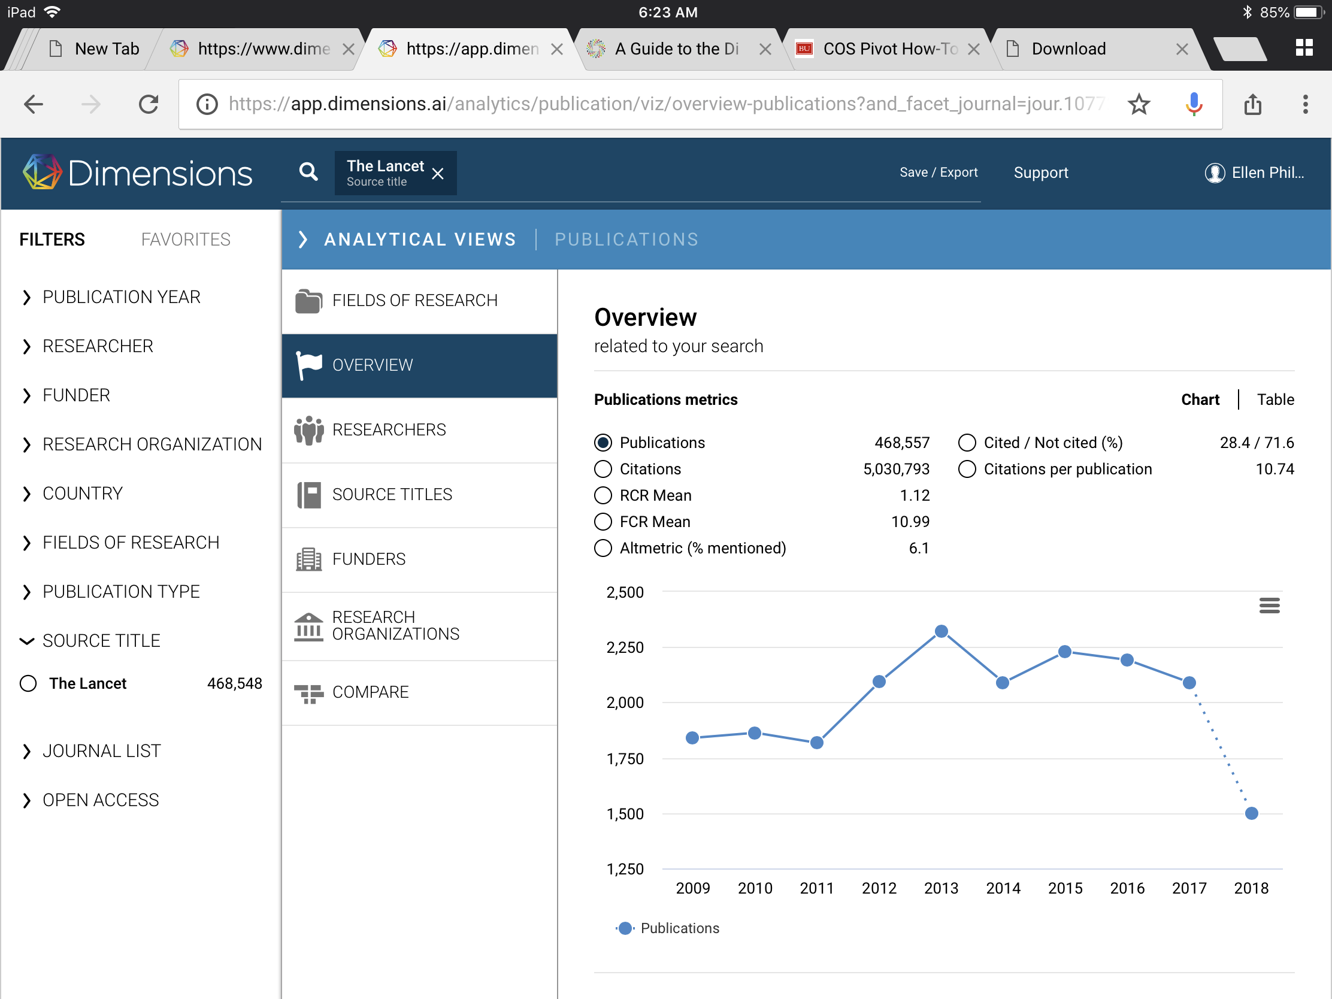
Use Dimensions to Find a Journal to Publish in
Notes:
This is the Analytic View for “The Lancet.” On the Overview tab you can see a lot of different statistics about the journal, including the number of citations, the average number of citations per article, the Altmetric score which measures Internet and social media mentions. It also includes the FCR and the RCR, these are additional ways to measure impact.
FCR. The Field Citation Ratio (FCR) is a citation-based measure of scientific influence of one or more articles. It is calculated by dividing the number of citations a paper has received by the average number received by documents published in the same year and in the same Fields of Research (FoR) category.
RCR The Relative Citation Ratio (RCR) is a citation-based measure of scientific influence of a publication. It is calculated as the citations of a paper, normalized to the citations received by NIH-funded publications in the same area of research and year.
The other tabs contain additional ways to learn about a journal including
Researchers which will show you who is publishing in this journal, Funders will show you a ranked list of funders who have funded studies that were later published in the lancet.

Slide 7
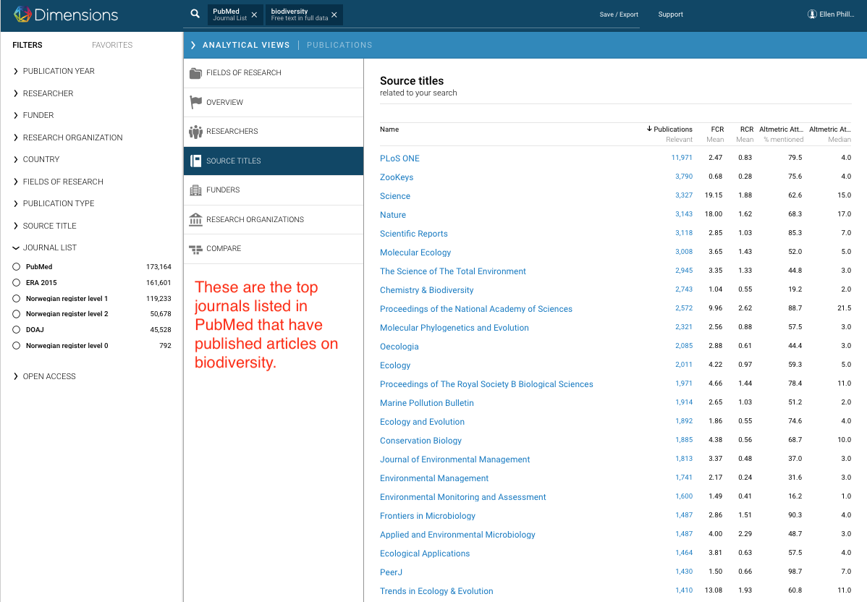
Use Dimensions to Find a Journal to Publish in
Notes:
This is another way to find a journal to publish in.
These are the top journal results for a keyword search on the term Biodiversity. You might also try the official subject headings for topics particularly when researching a journal. Keywords are applied algorithmically using machine learning techniques. Subject headings are usually part of the metadata record for an item.

Slide 8
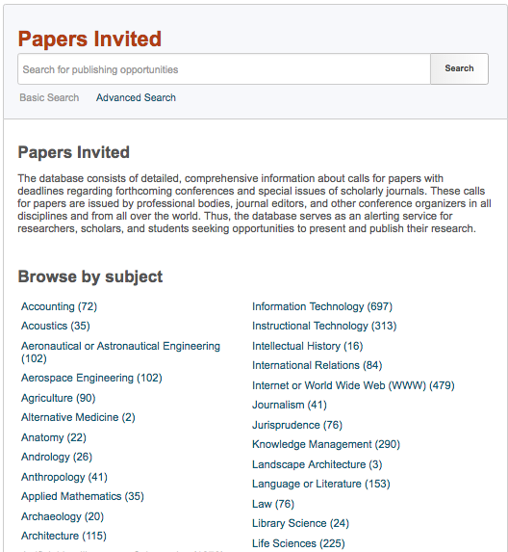
Use Pivot to Find a Journal to Publish in:
Papers Invited
Notes:
Pivot has a curated list of publishing opportunities.

Slide 9
Grants (Dimensions)
No standardized metadata schema.
Grants from 174 countries.
Compare funders and research organizations.
Visualization tools to help you track specific research areas over time.
Notes:
Grants are a difficult content source for several reasons:
Do not have a common metadata schema in the way that publications do,
Lack a persistent identifier such as the DOI
They are highly dependent on individual national frameworks of research funding.
Geographic differences are not trivial. In some countries, the majority of the research funding is given out in competitive project grants, while in other countries there is a skew toward block funding, which will never show up in a funded grants database. Of course, there are a lot of countries that fall between the ends of this spectrum with a mix of block funding and project-based funding. For that reason, the grant data should not be taken as a complete view of all research related fundi

Slide 10
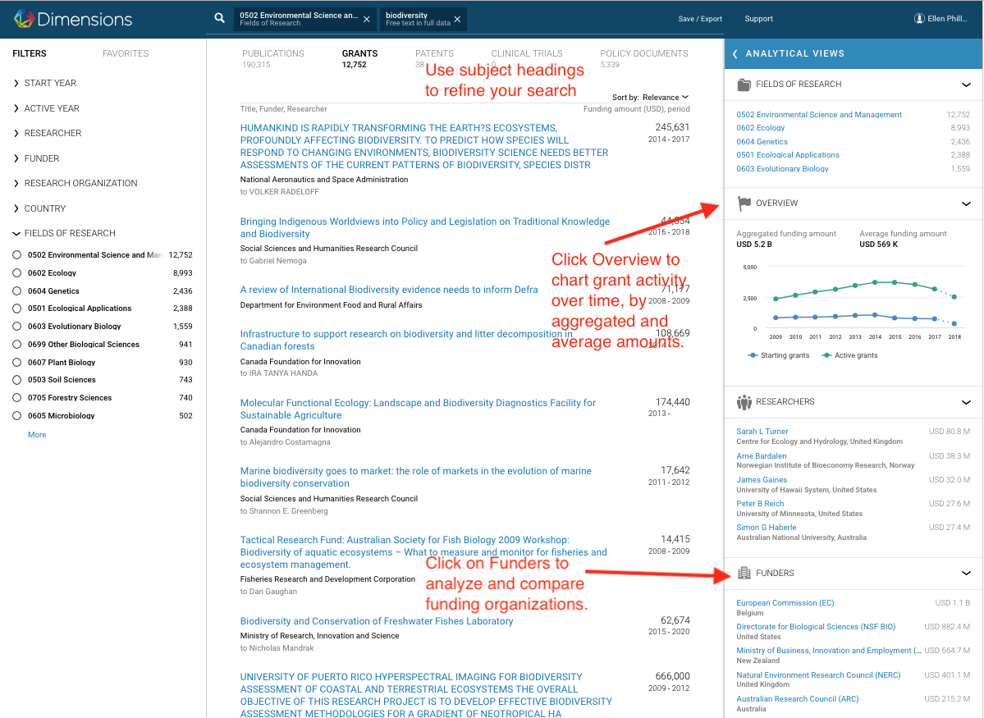
Use Dimensions to Find Funding for your Research Project
Notes:
Click on Grants at the top of the screen. Enter some keywords. Refine your keyword search by clicking on “Fields of Research” (icon with folders) on the right top side. There’s a lot you can do from this screen. You can use the Overview feature to see grant activity, you can also click on Funders to analyze and compare.

Slide 11
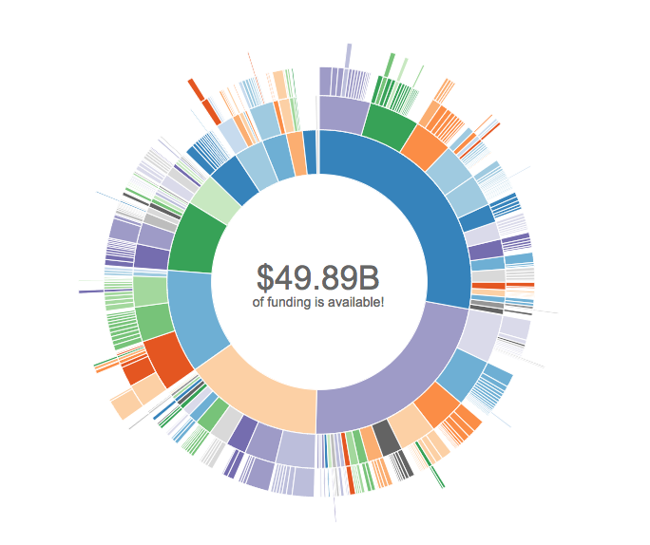
Use Pivot to Find Funding for your Research Project
You can search using the interactive wheel, keywords, or advanced searching.

Slide 12
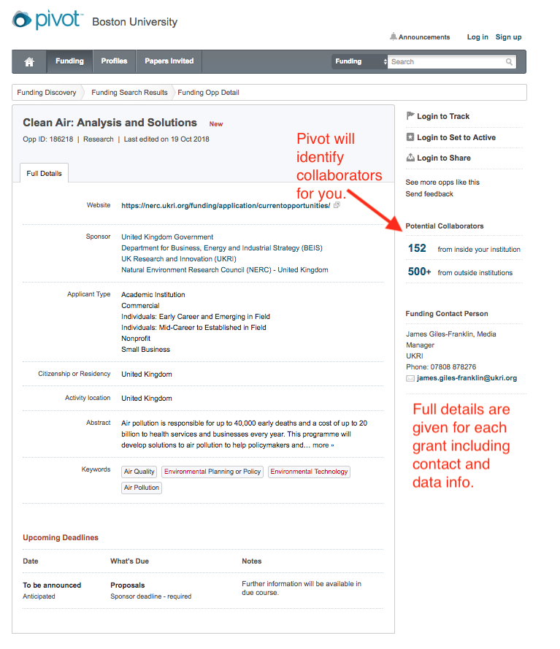
Use Pivot to Find Funding for your Research Project
Notes:
Pivot can help you find collaborators to work with and will give you a list on the right hand side of the screen.
You can also find contact info regarding the grant.

Slide 13
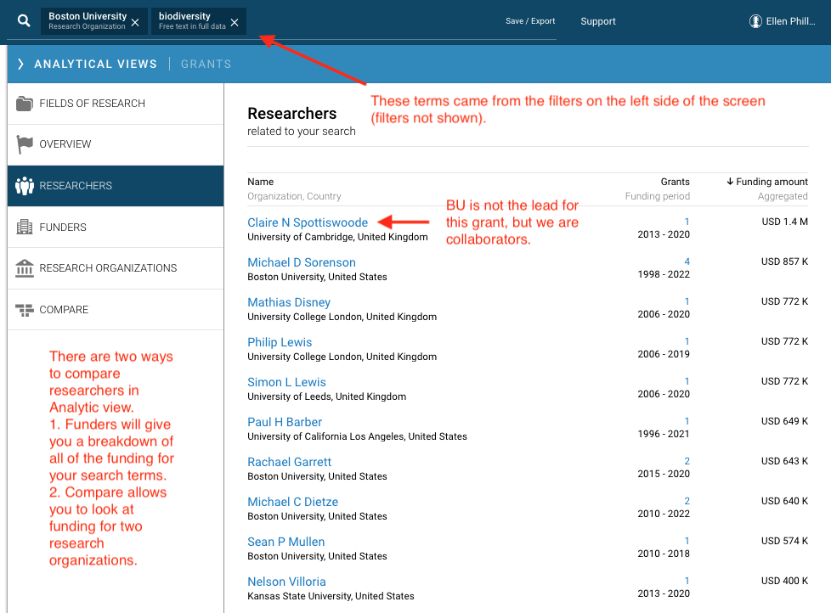
Use Dimensions to Find a Collaborator
Notes:
Switching back to Dimensions, you can use it to find a collaborator. This screen shows a keyword search on the term biodiversity that is then filtered by Boston University. This will give us results for research where a BU faculty member was the lead investigator and also results where BU was a collaborator on another team.

Slide 14
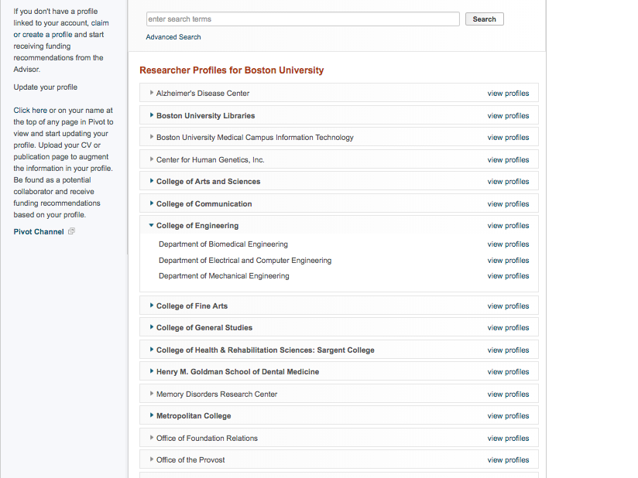
Use Pivot to Find a Collaborator:
Researcher Profiles
Notes:
If you click on the individual profiles you will see the names of researchers working in these areas.

Slide 15
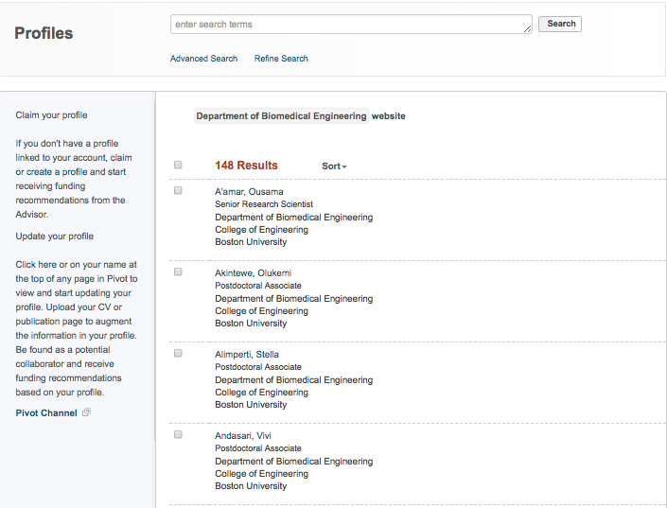
Use Pivot to Find a Collaborator:
Researcher Profiles.

Slide 16

Patent Coverage
(Dimensions)
USPTO
EPO (EU)
WIPO
DPMA (Germany)
CIPO (Canada)
IPI (India)
IPO (UK)
INPI (France)
IPD (Hong Kong)
Notes:
Currently over 11.3 M links based on PubMed publications only.

Slide 17
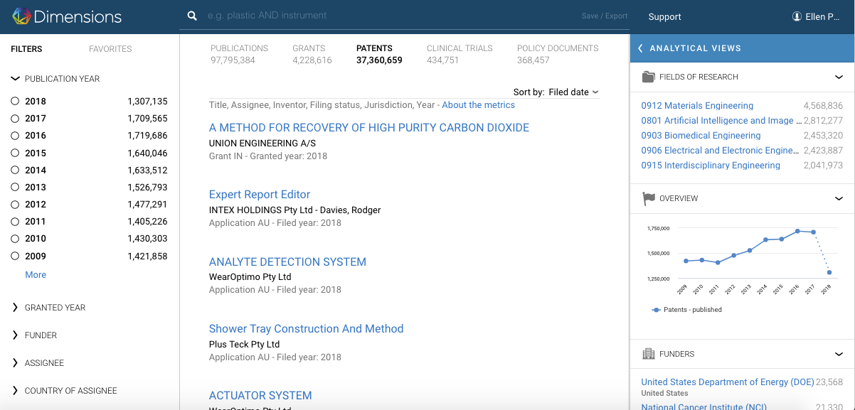
Patents (Dimensions)
Notes:
The filters work the same for patents that they do for the other main categories (publications, patents, clinical trials, and policy papers).

Slide 18
Clinical Trials
Eight registries
ClinicalTrials.gov (US)
EU-CTR (EU)
UMIN-CTR (Japan)
ISRCTN (Int’l.)
ANZCTR (Australia/New Zeland)
CHICTR (China)
NTR (Netherlands)
GTRS (Germany)

Slide 19
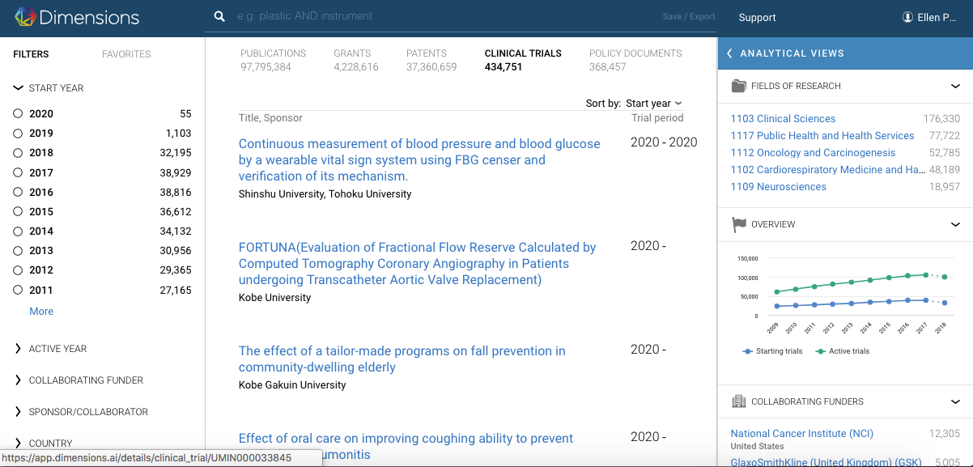
Clinical Trials (Dimensions)

Slide 20
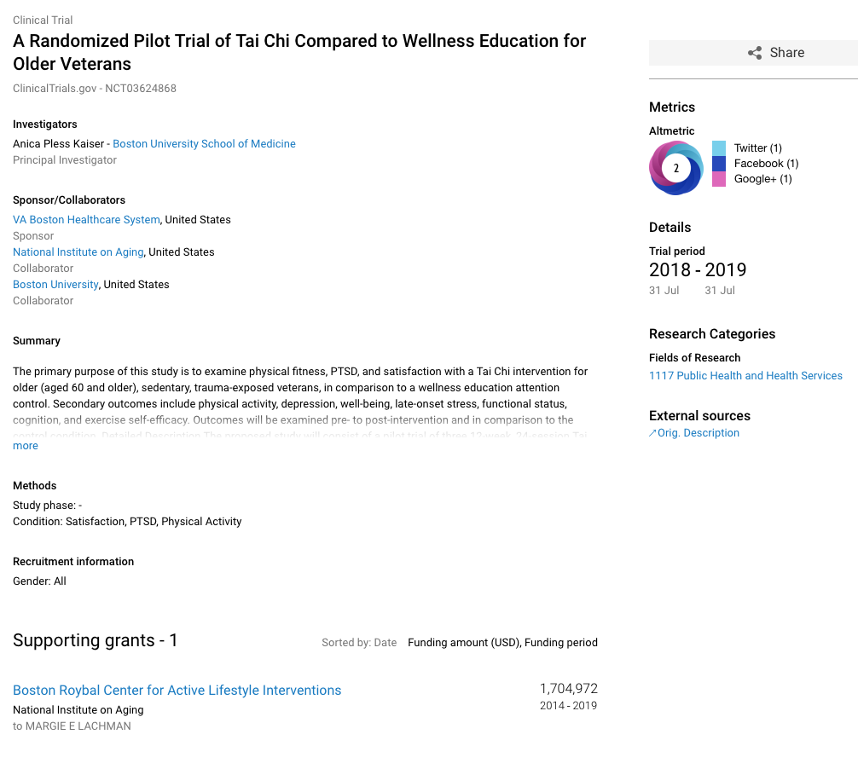
Detailed view of a Clinical Trial Record in Dimensions
Notes:
You can view Altmetrics for clinical trials. This measures attention that the study is garnering on the world wide web as opposed to being formally cited. You can also see that there are links to the other collaborators, the supporting grant, as well as an external link to more information.

Slide 21
Policy Documents
360,000+ documents.
50+ global policy sources.
Analyze the societal influence of published research.
Track policy activity and trends worldwide.
Notes:
Available since August 2018.
Policy sources that are part of the initial integration include:
Government of the United Kingdom
World Health Organization
World Bank
Centers for Disease Control and Prevention
Australian Policy Online
And over 45 others

Slide 22
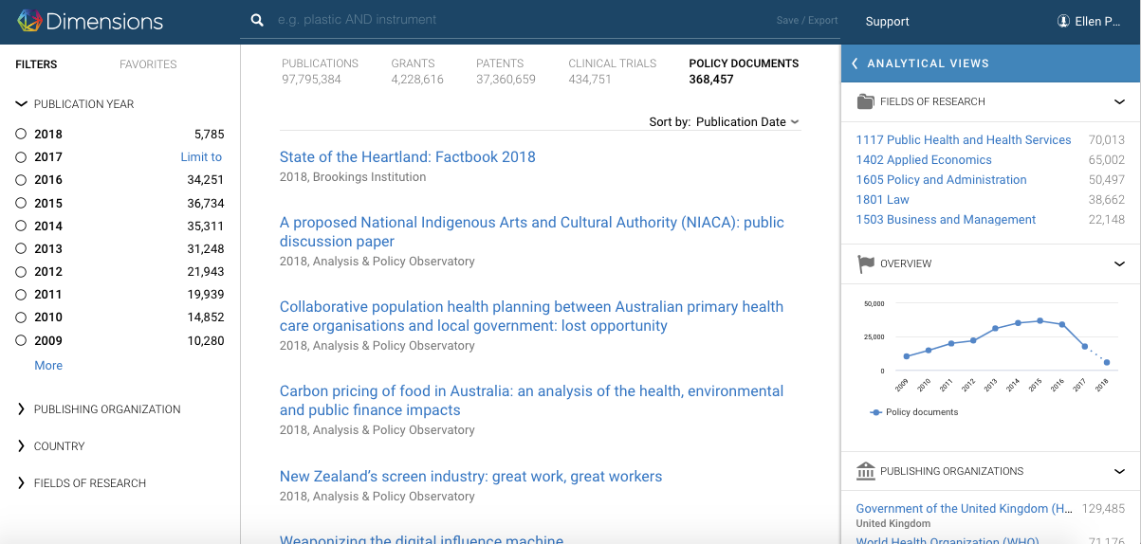
Policy Documents

Slide 23
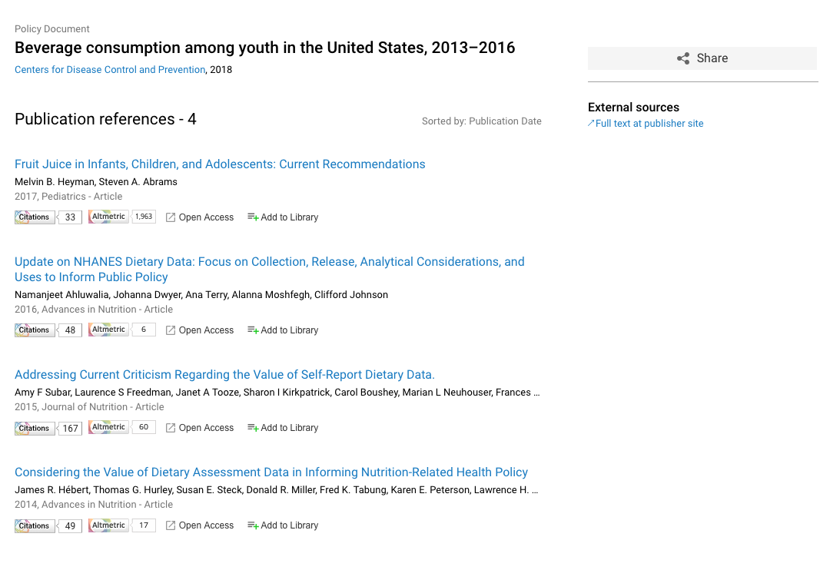
Detailed view of a Policy Document record.
Notes:
Links to the full document at the CDC site, and a list of publications that were cited.

Slide 24
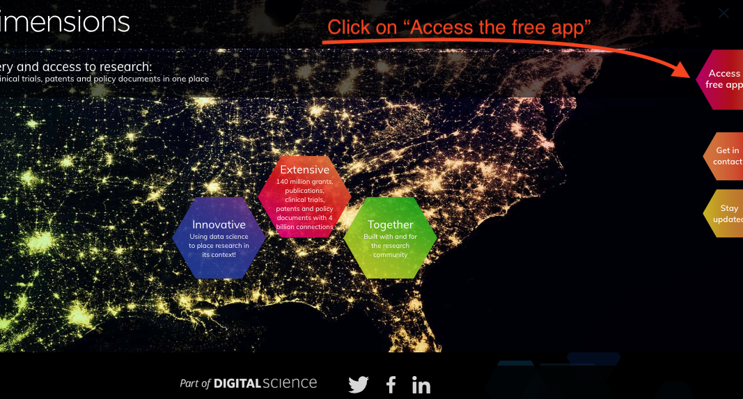
How to login to Dimensions...
Go to: https://www.dimensions.ai/
Notes:
Go to: https://www.dimensions.ai/
1.login
Welcome screen, screen you see when you first log in. There is a free version as well. The free version has only publications. The subscription version that we have for faculty, staff, and students has more features.
Click on “Access the free app”

Slide 25
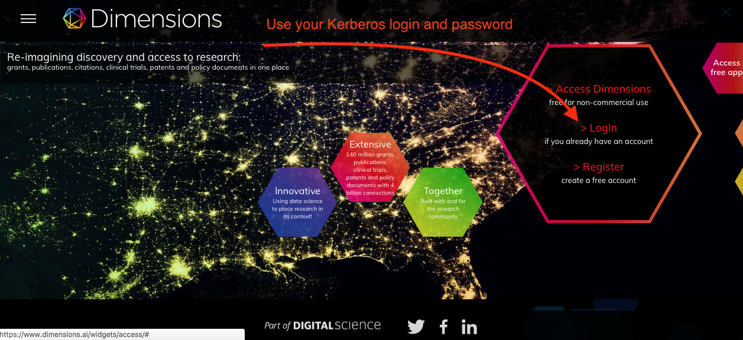
Step two of three
Notes:
1a.login
You will need your Kerberos signin in a few screens.

Slide 26
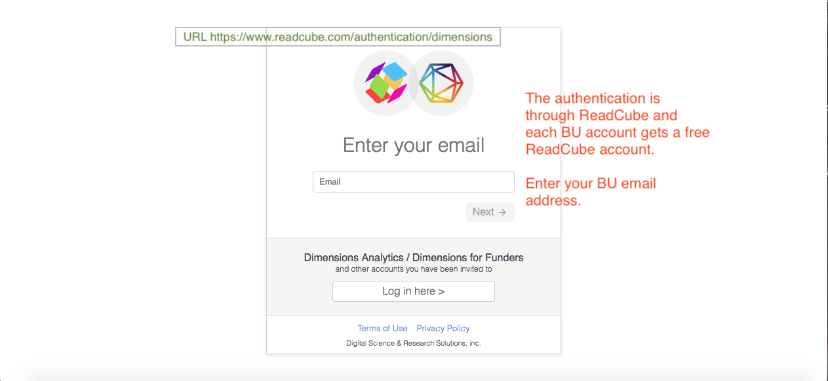
Step three
Notes:
1b.login
The login is through ReadCube, the URL is at the top of the screen. Each institutional account comes with a free readcube account. Readcube is a citation management platform.
Enter your email and click next, go through the kerberos sign in screen.

Slide 27
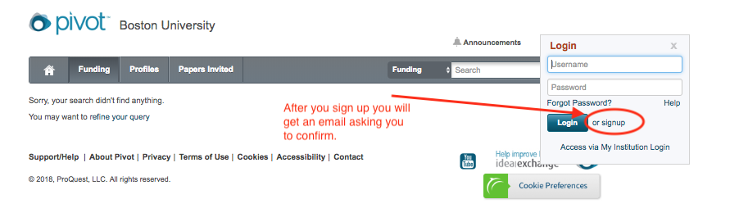
How to Access Pivot
Go to: https://pivot.cos.com/

Slide 28

Before you go….
The library hosts interesting events on open access. Join us next month for a screening of the new movie Paywall.
Notes:
The BU Libraries would like to thank the BU Office of Research for sponsoring this event!

Slide 29
Thank You
Please feel free to contact me with any questions:
Ellen Phillips
Open Access Specialist
Boston University Libraries
ephillip@bu.edu
disc@bu.edu
https://goo.gl/guLvA6 (This presentation)

