Slide 1
H-30
H-28
H-28
H-19
H-3

Slide 4
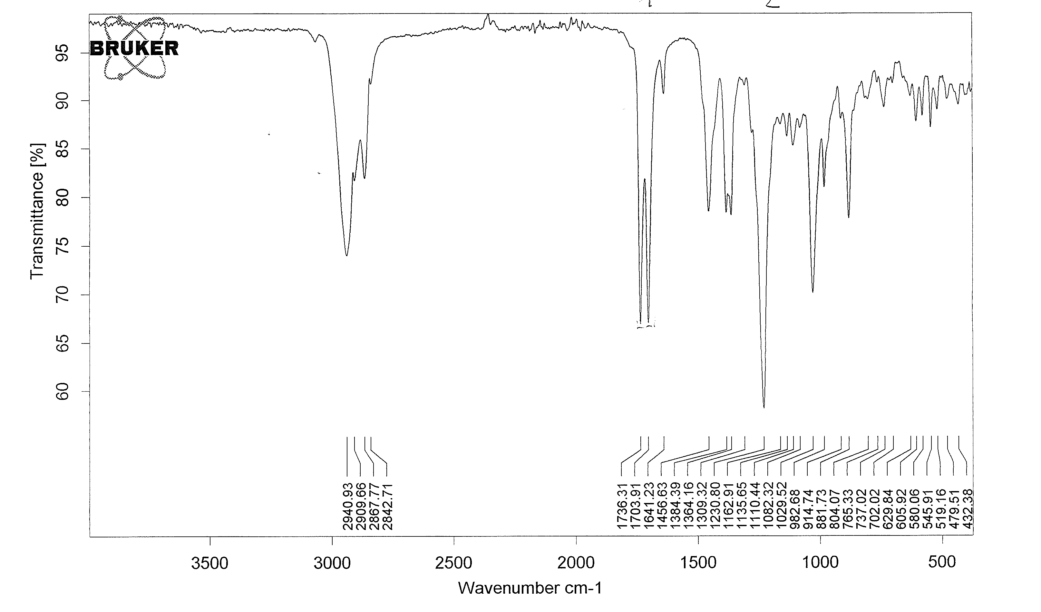
Betulone Acetate IR
ν_{C-H}
ν_{C=O}
ν_{C-O}

Slide 6
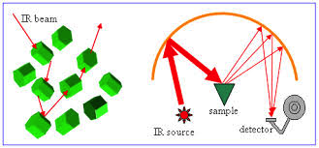
DRIFTS – Diffuse Reflectance Infrared Fourier Transform Spectroscopy
%T = 100 x 10^{(-A)}

