Slide 1




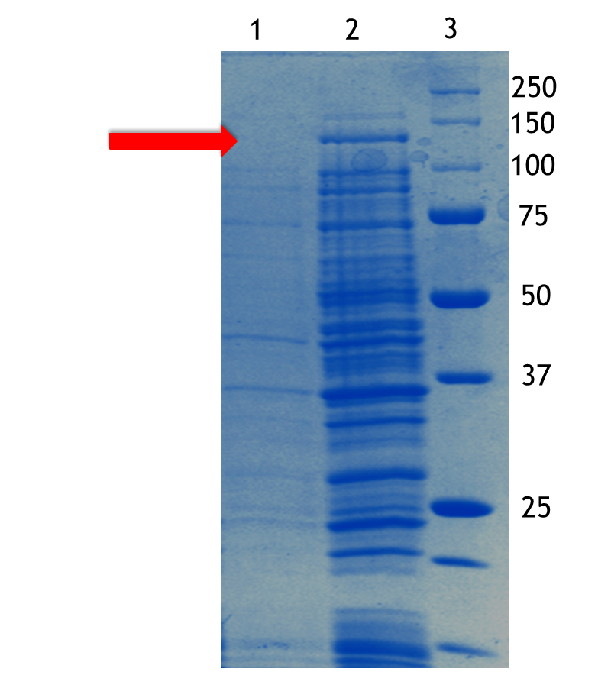
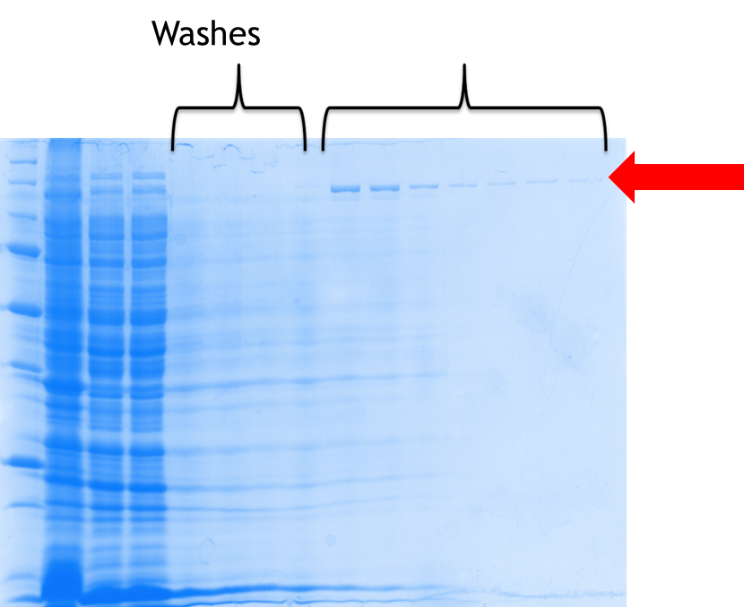
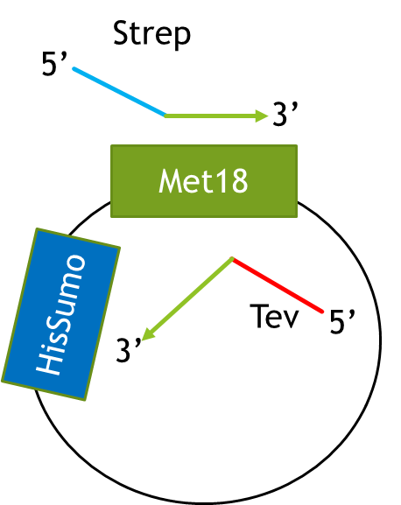
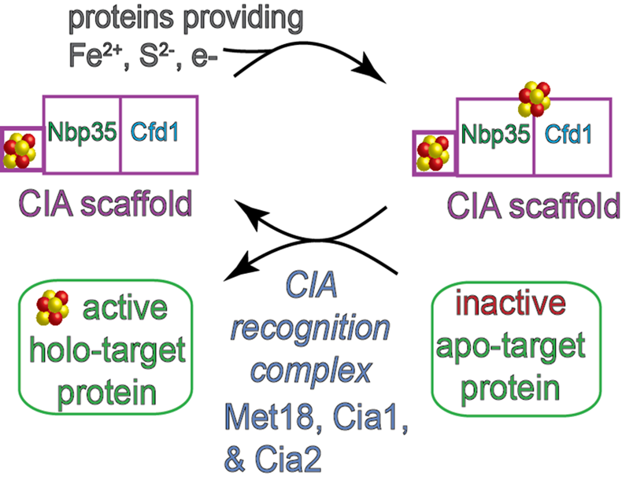
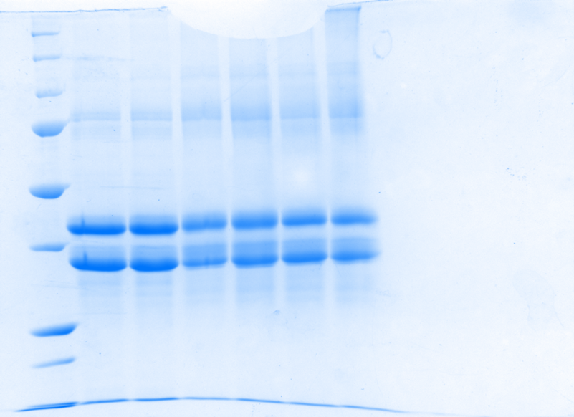
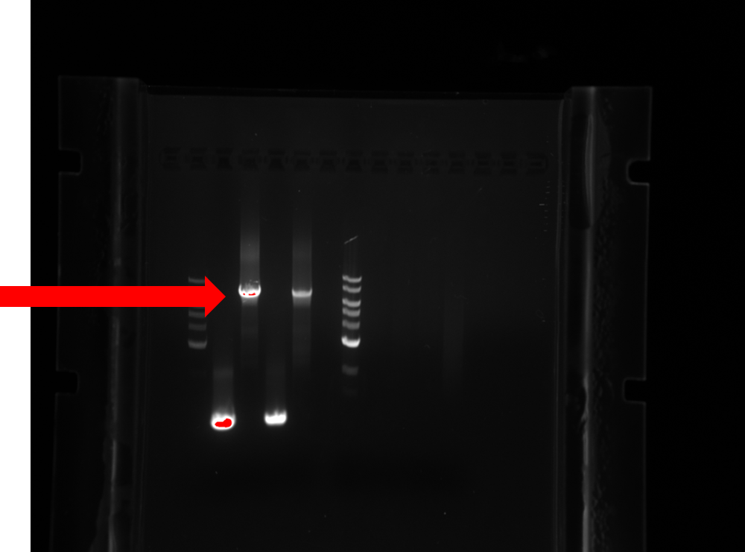
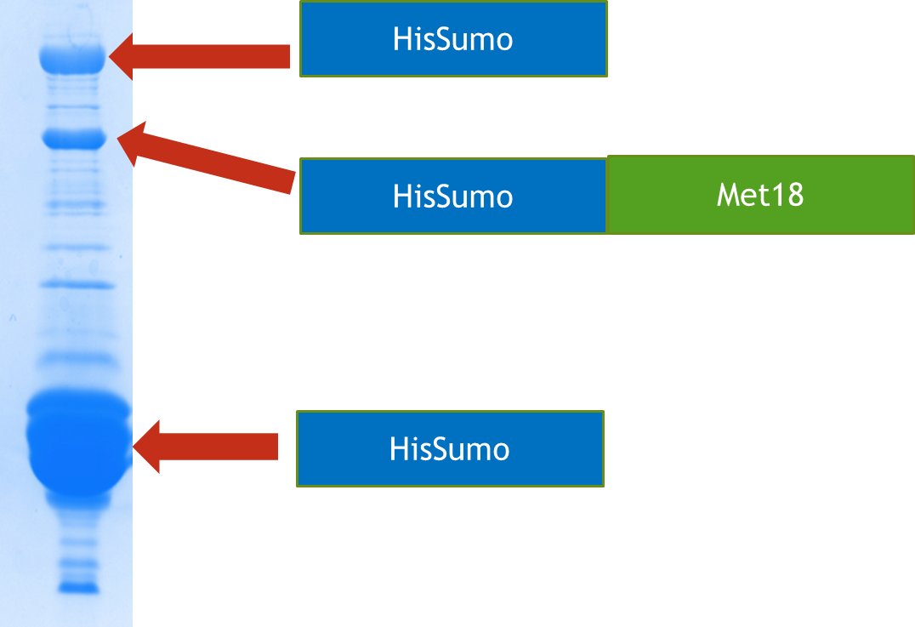
Cloning, Expression and Purification of HisSumoMet18TevStrep, and Chemical Crosslinking of Proteins in the targeting Complex of Cytosolic Iron Sulfur Cluster Pathway Zanub Hassan, Amanda Vo, and Deborah Perlstein Department of Chemistry, Boston University, Boston MA 02215
ABSTRACT
Construct
Expression and Purification
120kDa
Elutions
120kDa
Our StrepMet18 protein expressed at 120kDa and we purified it using a strep affinity column.
BACKGROUND
The top construct is what we have, and the one below is what we want.by primers we designed
DSS Crosslinking
Cloning by Q5 method
The incubation of Cia 1 and Cia 2 formed a crosslinked product.
CONCLUSIONS
. With all the components of the targeting complex at our disposal, interaction testing within complex, and with apo-proteins can be done
. The DSS crosslinker can be used to stabilize dynamic interactions that exists within the complex, to enable us do a biochemical characterization of the complex.
REFERENCES
By optimizing annealing temperature, and concentration, HiSumoMet18TevStrep amplified at a length of 7kbp.
Amanda Vo
Deborah Perlstein

